Slide 1
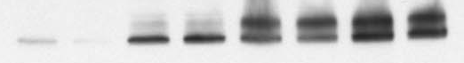
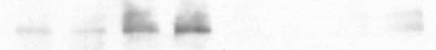
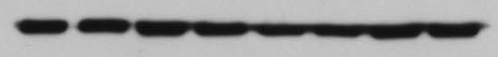
Supplemental Figure
Normoxic
Hypoxic
Vector
Myc
Vector
Myc
NAC, 10mM: - + - + - + - +
HIF1α
Hydroxy-P564
HIF1α
GAPDH

