Slide 1
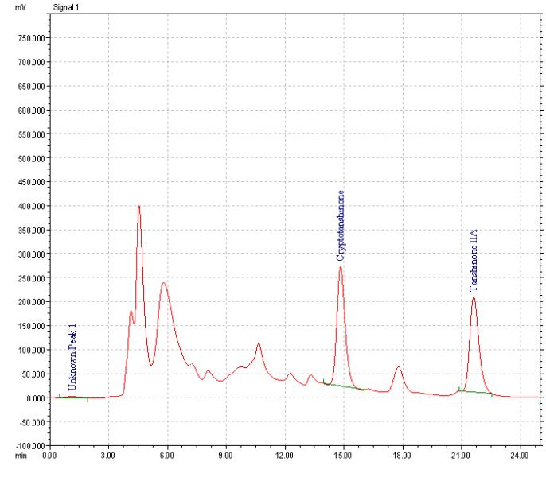
Additional file 1
Absorbance (254 nm)
0.00 3.00 6.00 9.00 12.00 15.00 18.00 21.00 24.00
Time (min)
Additional file 1 Chromatogram of constituents from SM extracts by HPLC analysis. Peaks: Tanshinone IIA and cryptotanshinone. Conditions: column (Grom Sil 120 ODS-5 ST column, 250 X 4 mm I.D., 5 µm particle size) in gradient mode; mobile phase: composed of methanol/water (80:20 v/v) containing 0.5 % acetic acid; flow-rate: 0.5 mL/min; detection at 254 nm. The retention time for Cryptotanshinone and Tanshinone IIA was 14.8 and 21.6 min. The content of Tanshinone IIA and Cryptotanshinone in Salvia Miltiorrhiza was 106.56µg/10mg (1.07%) and 109.655µg/10mg (1.10%).

