Slide 1
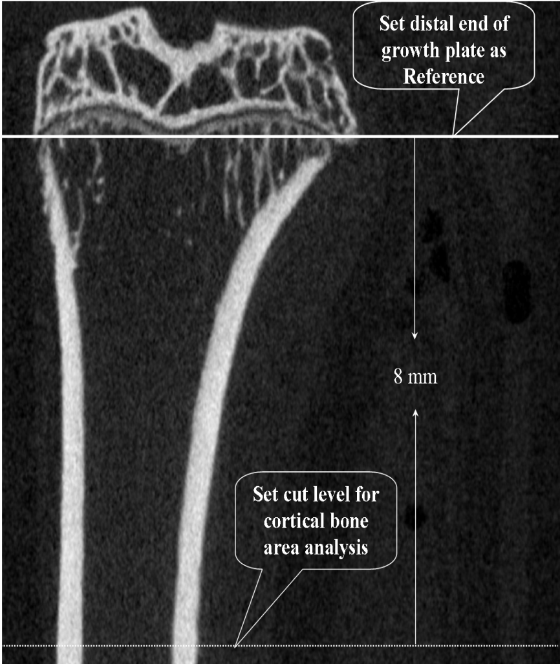
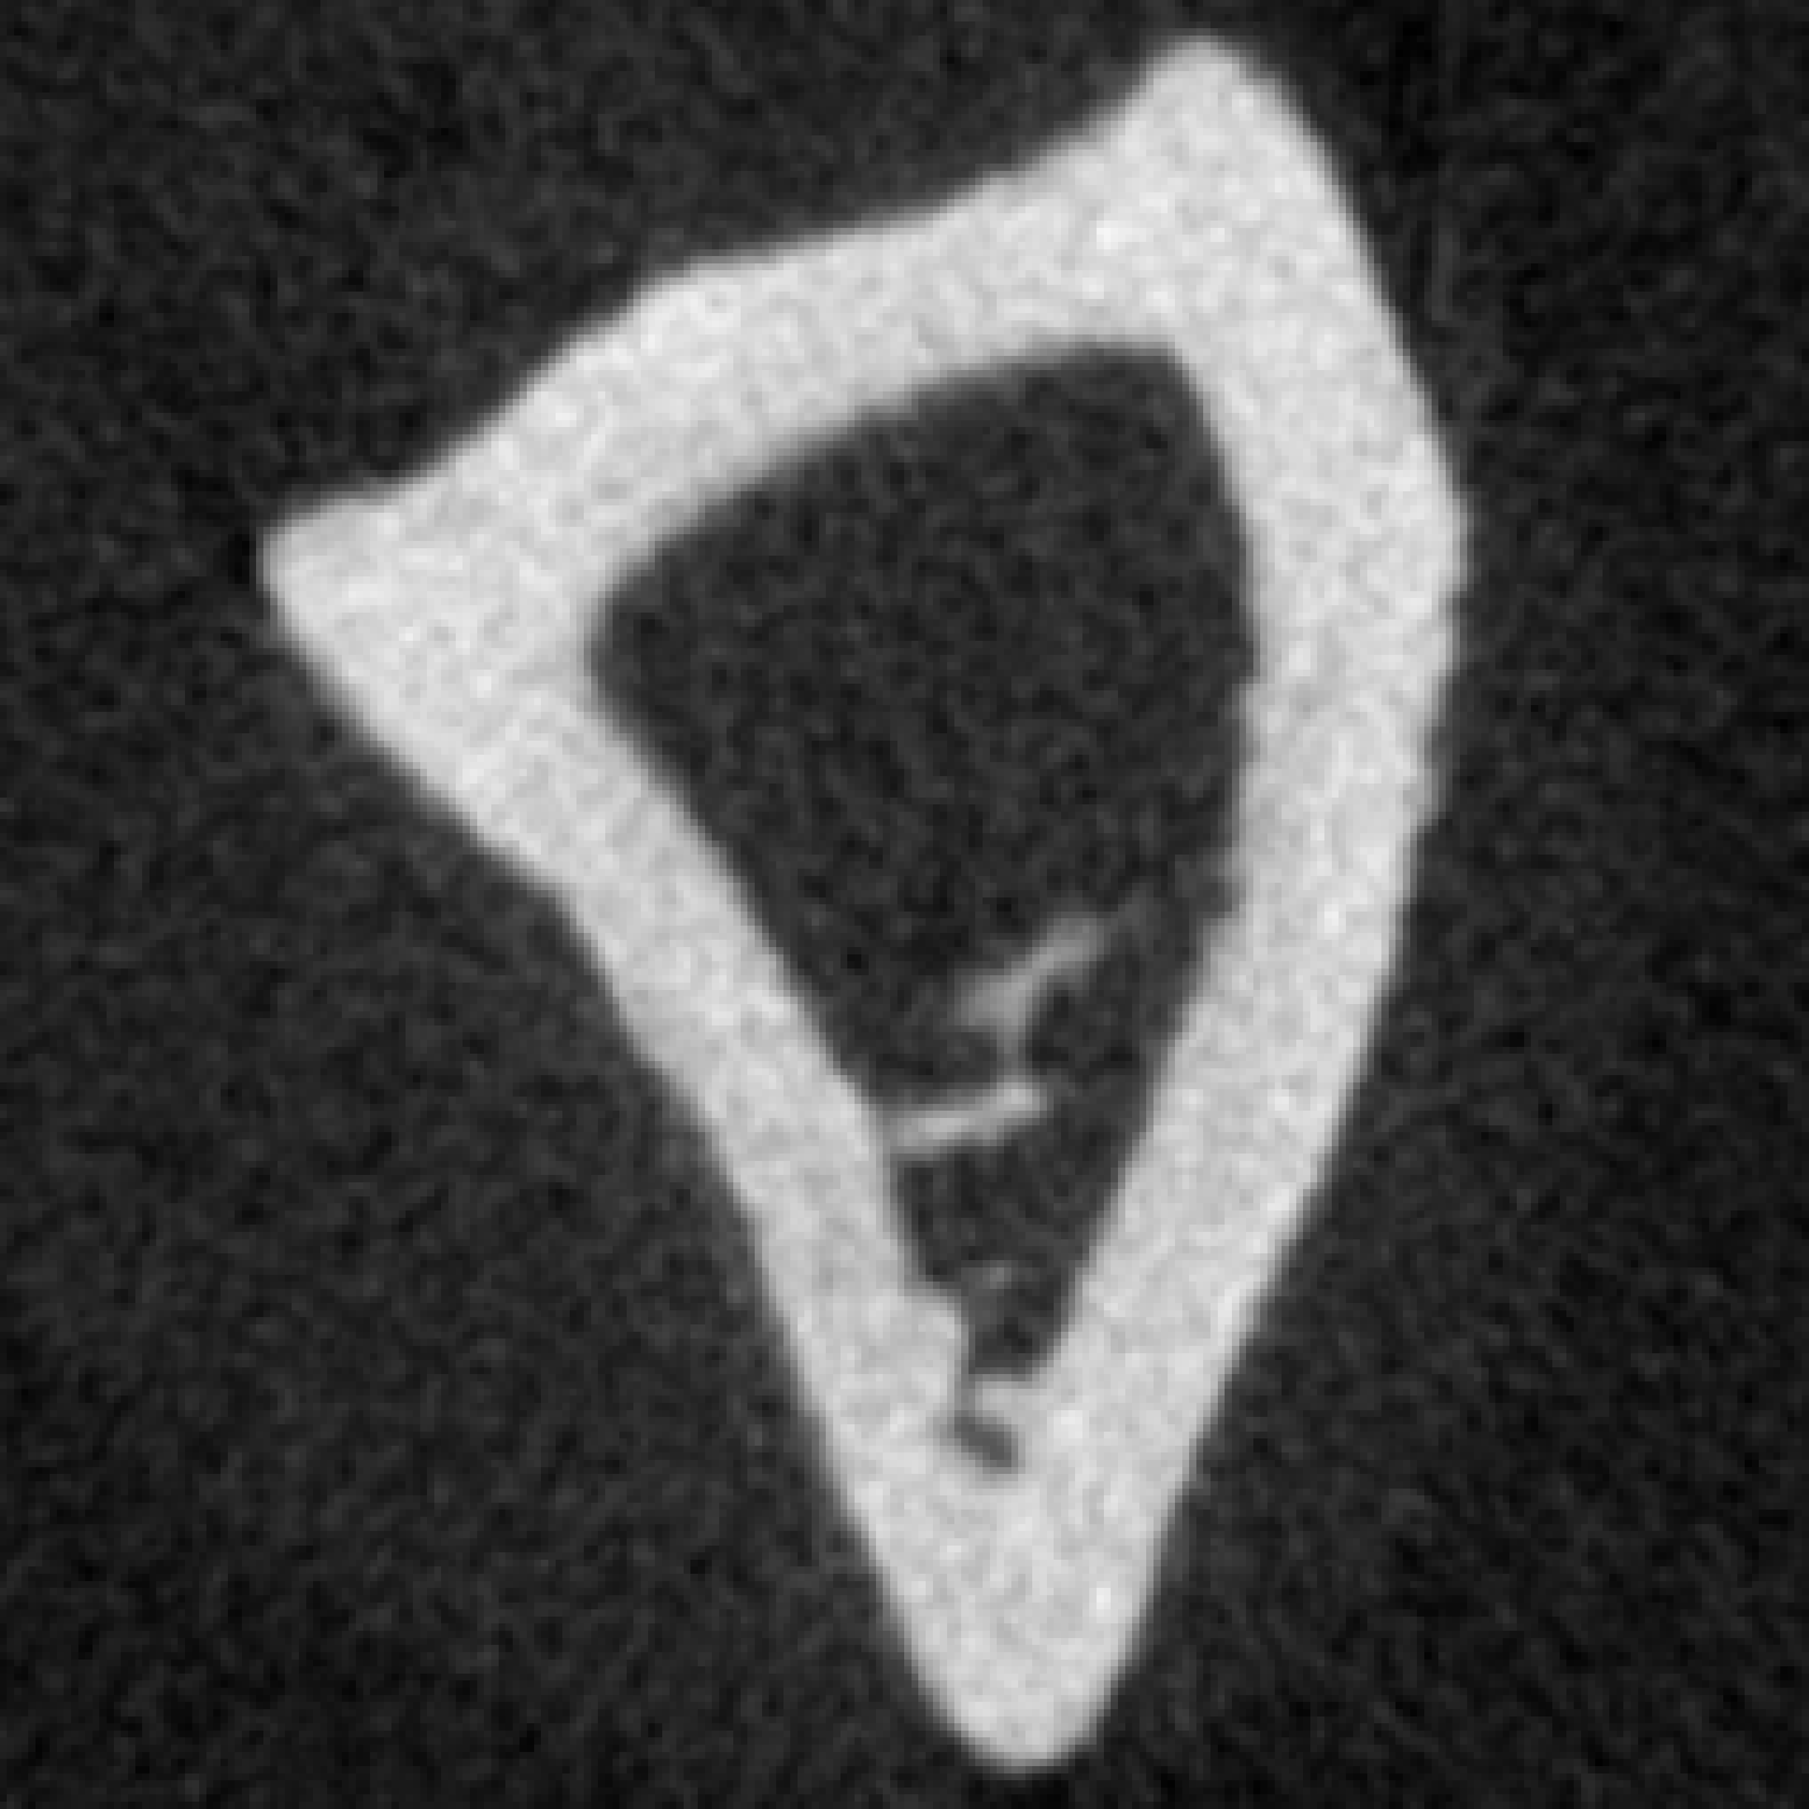
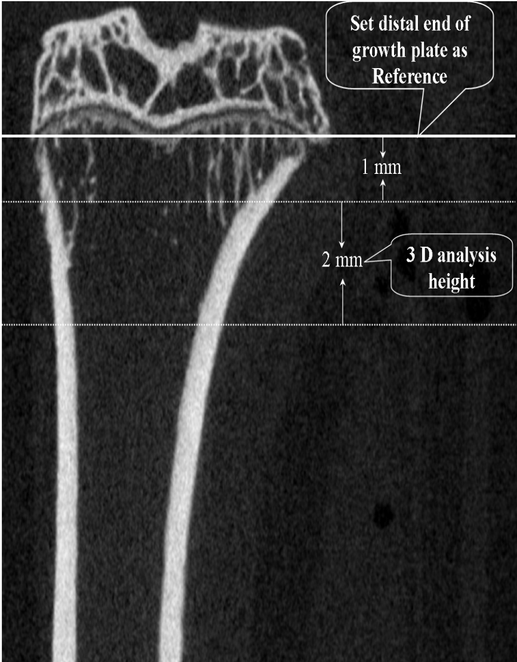
Additional file 4
Cortical bone of tibial shaft
Cavum medullare ossium
B
A
Additional file 4 Coronal image of proximal-medial tibia taken ex vivo by μ-CT. A. Set distal growth plate as reference level and 8 mm distal from distal growth plate as cortical area analysis cut level; B. related transaxial image of tibial diaphysis. C. Set distal growth plate as reference level and from the 1 mm distal to the distal growth plate to height of 2 mm region was used to evaluate trabecular microstructural properties of metaphysis of tibia.
C

