Slide 1

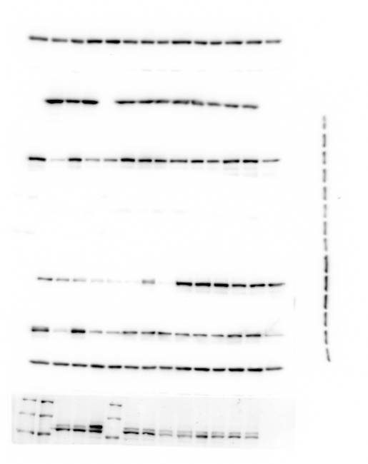
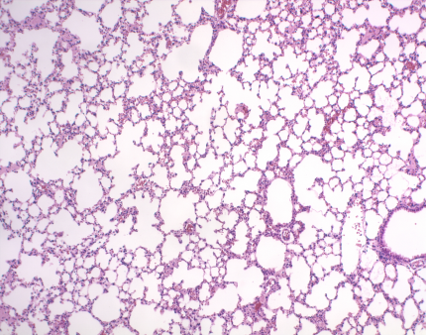
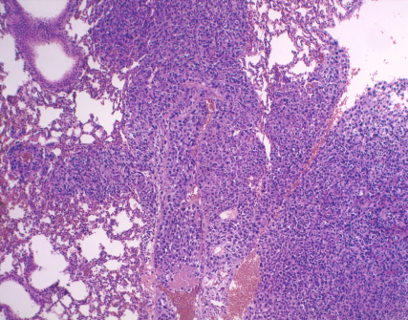
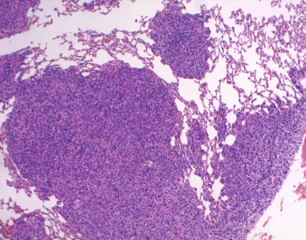
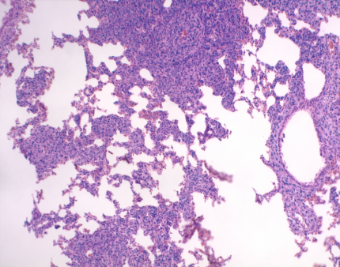
Supplementary Figure S5. Chen et al.
A
4T1
C
EV
BMK1
* p=0.001
1.00±0.24
8.69±1.92
BMK1
1.00±0.19
1.04±0.22
Number of nodules
GAPDH
DMEM
Mock
EV
BMK1
B
D
Primary tumor weight (g)
DMEM
MOCK
DMEM
Mock
EV
BMK1
EV
BMK1

