Slide 1
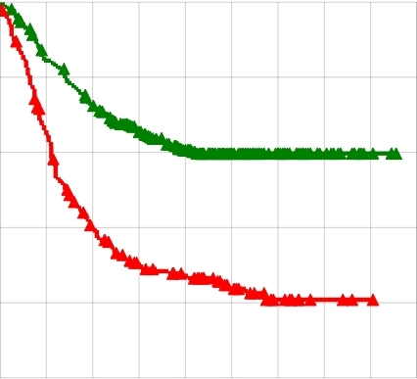
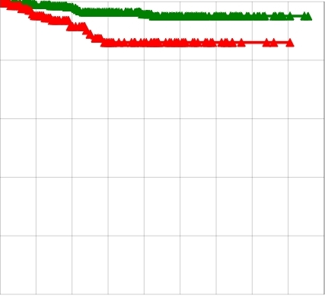
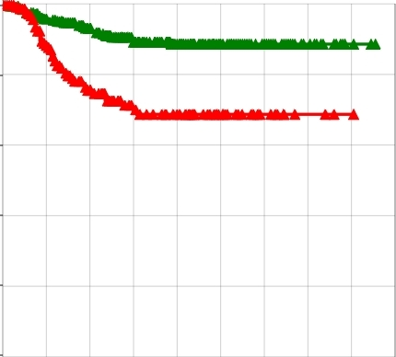
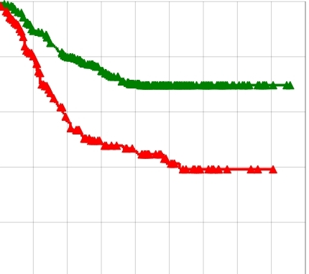
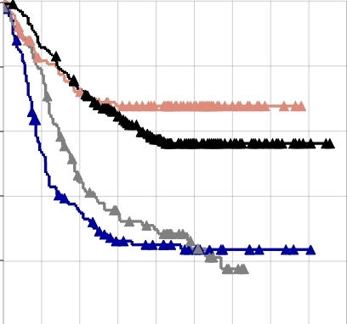
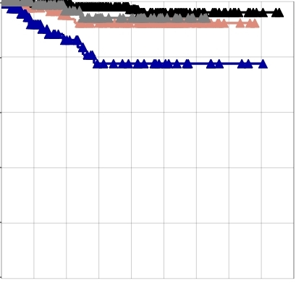
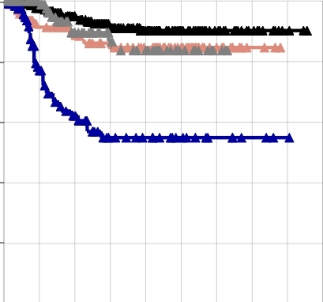
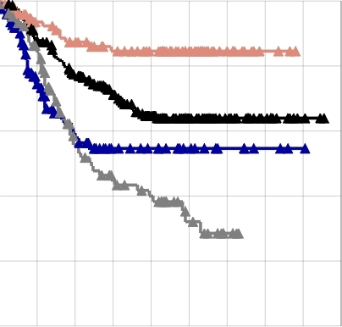
All metastasis
Brain metastasis
Lung metastasis
Bone metastasis
A
B
C
D
100%
low
low
80%
100%
100%
100%
low
high
80%
80%
80%
60%
low
60%
high
40%
60%
60%
20%
40%
40%
40%
high
20%
20%
20%
p = 1.9E-019
high
p = 0.0007
p = 2.2E-007
p = 5.2E-010
0%
0%
0%
0%
Percentage of metastasis-free survival
40
80
120
160
40
80
120
160
40
80
120
160
40
80
120
160
E
F
G
H
100%
100%
p = 0.2439
100%
p = 0.3100
100%
p = 0.0001
80%
p = 4.8E-009
80%
p = 0.0247
80%
80%
60%
60%
60%
p = 0.0001
60%
40%
40%
40%
40%
p = 2.6E-006
20%
p = 9.3E-010
20%
20%
20%
0%
40
80
120
160
0%
40
80
120
160
0%
40
80
120
160
0%
40
80
120
160
Months
Months
Months
Months
ER^{high}Rx2metagene^{high}
ER^{high}Rx2metagene^{low}
ER^{low}Rx2metagene^{low}
ER^{low}Rx2metagene^{high}
Supplemental Figure 2. Association of Runx2 activity with metastasis. Runx2 activity was defined as the average normalized expression of genes that Runx2 stimulated by ≥2 fold in the MCF7/Rx2^{dox} cell culture model. A cohort of 557 BCa tumors compiled from the GEO datasets GSE2034, GSE2603 and GSE12276, was dichotomized into groups expressing either high or low levels of Runx2 metagene, and Kaplan-Meier curves were constructed for the probability of overall or organ-specific metastasis-free survival in each group. A-D, Kaplan-Meier curves of overall, brain, lung and bone metastasis-free survival in the cohort of 557 patients according to Runx2 metagene expression status. E-H, Kaplan-Meier curves of overall, brain, lung and bone metastasis-free survival were generated for the 342 ERα-positive (gray and black curves) and 215 ERα-negative (blue and pink curves) tumors based on high versus low expression of the Runx2 metagene. Significance of association was determined by logrank test and the p-values are depicted for ERα-positive (green), and ERα-negative tumors (red).

