Slide 1
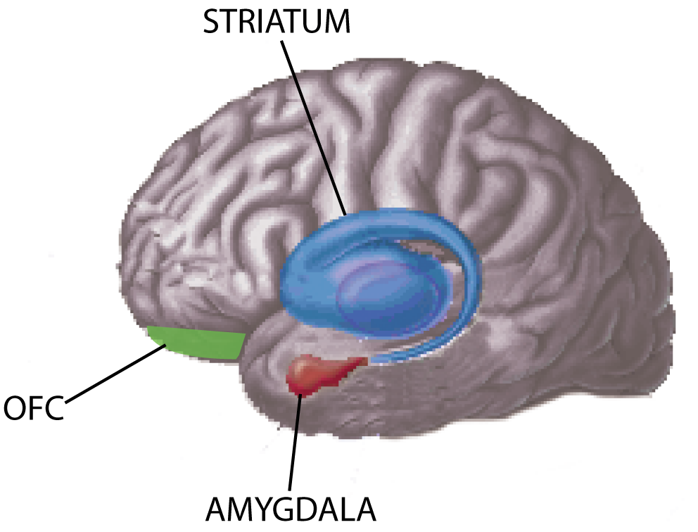
Behavioral manifestations
Social orienting
Innate attention to faces
- Automatic attention capture by social signals
- Eye contact effect
Seeking - Liking
- Incentive value of social reward stimuli
- Pleasure in collaboration
- Overjustification effect
Social maintaining
- Ingratiation strategies
(self- & other- enhancement)
- Reputation managment
- Chameleon effect
Biological mechanisms
Oxytocin
Dopamine
Opiods
PROXIMATE LEVEL
Pressure to be included in collaborative activities
associated with fitness benefits:
- Group hunting and herding
- Food foraging
- Exchanges and bartering
ULTIMATE LEVEL

