Slide 1
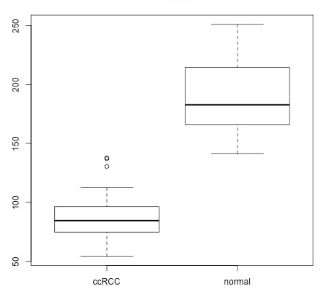
Expression values (GRHL2)
ccRCC
normal
Figure S1.

Slide 2














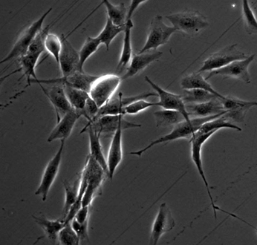
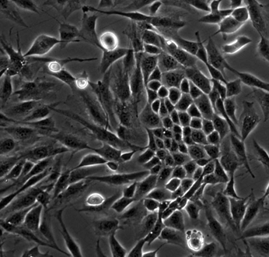
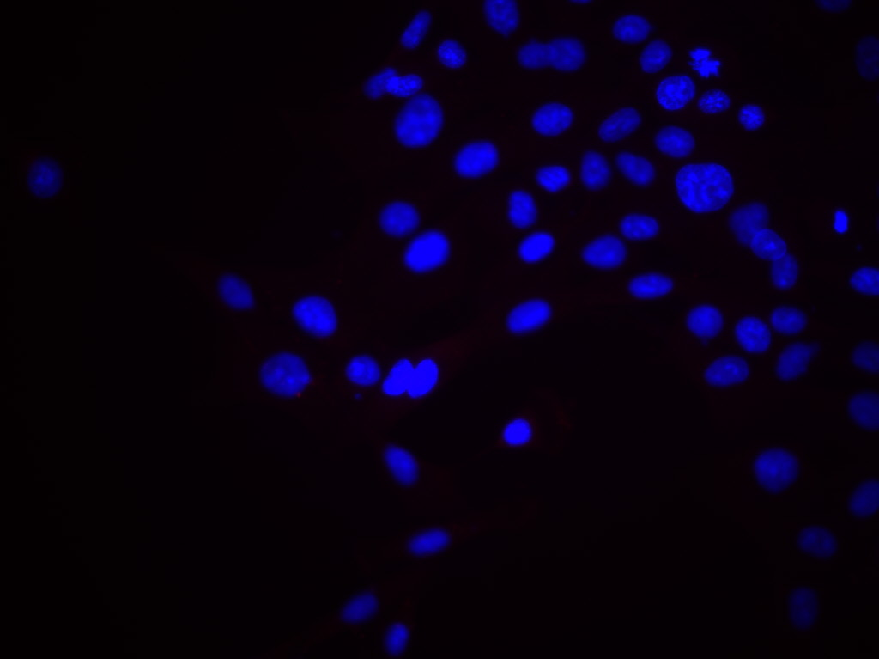
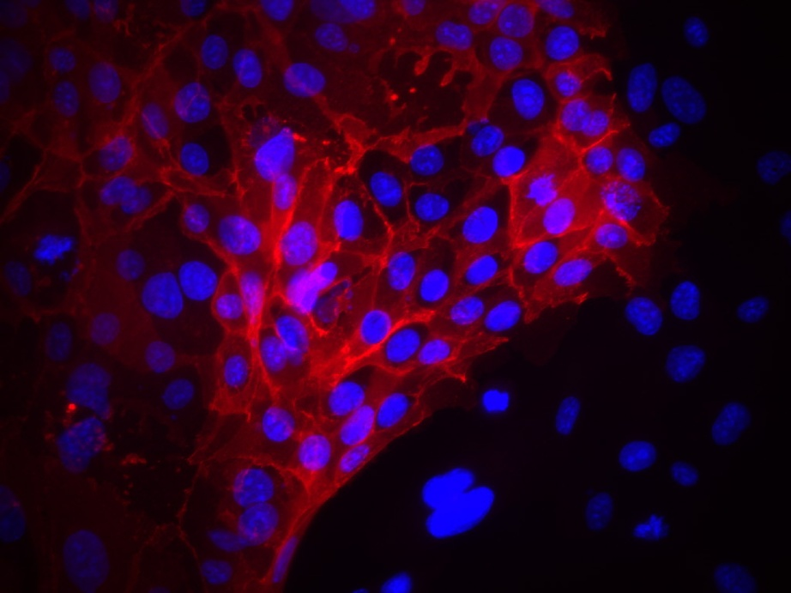
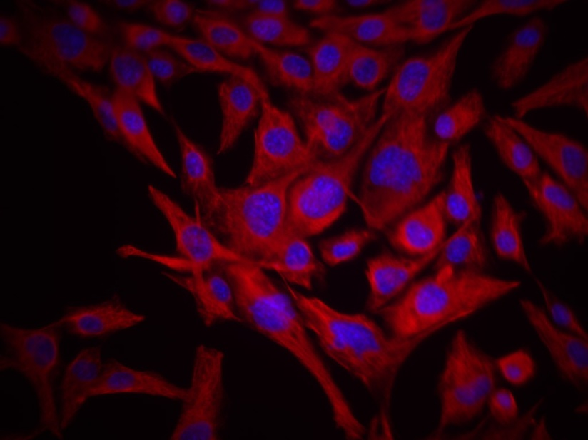
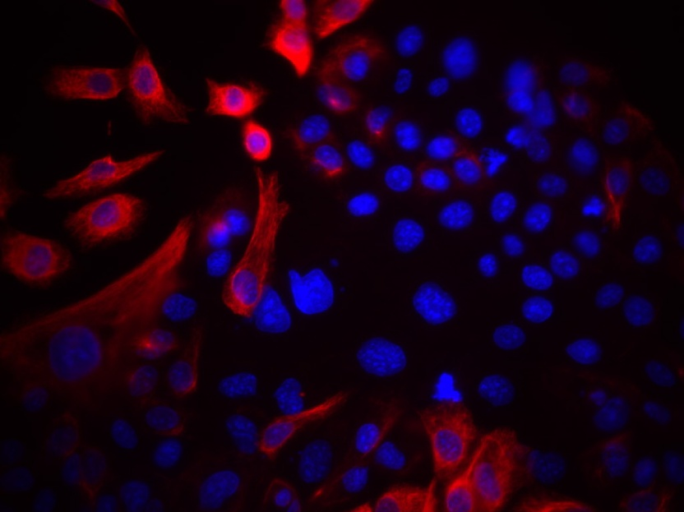
LY364947:
-
+
-
c.
4-OHT:
-
+
GRHL2-
N-Cadherin-
E-Cadherin-
Vimentin-
pSMAD2-
SMAD2-
merlin-
8 h
20 h
DMSO
LY364947
control
LY364947
E-cadherin
vimentin
Figure S2

Slide 3
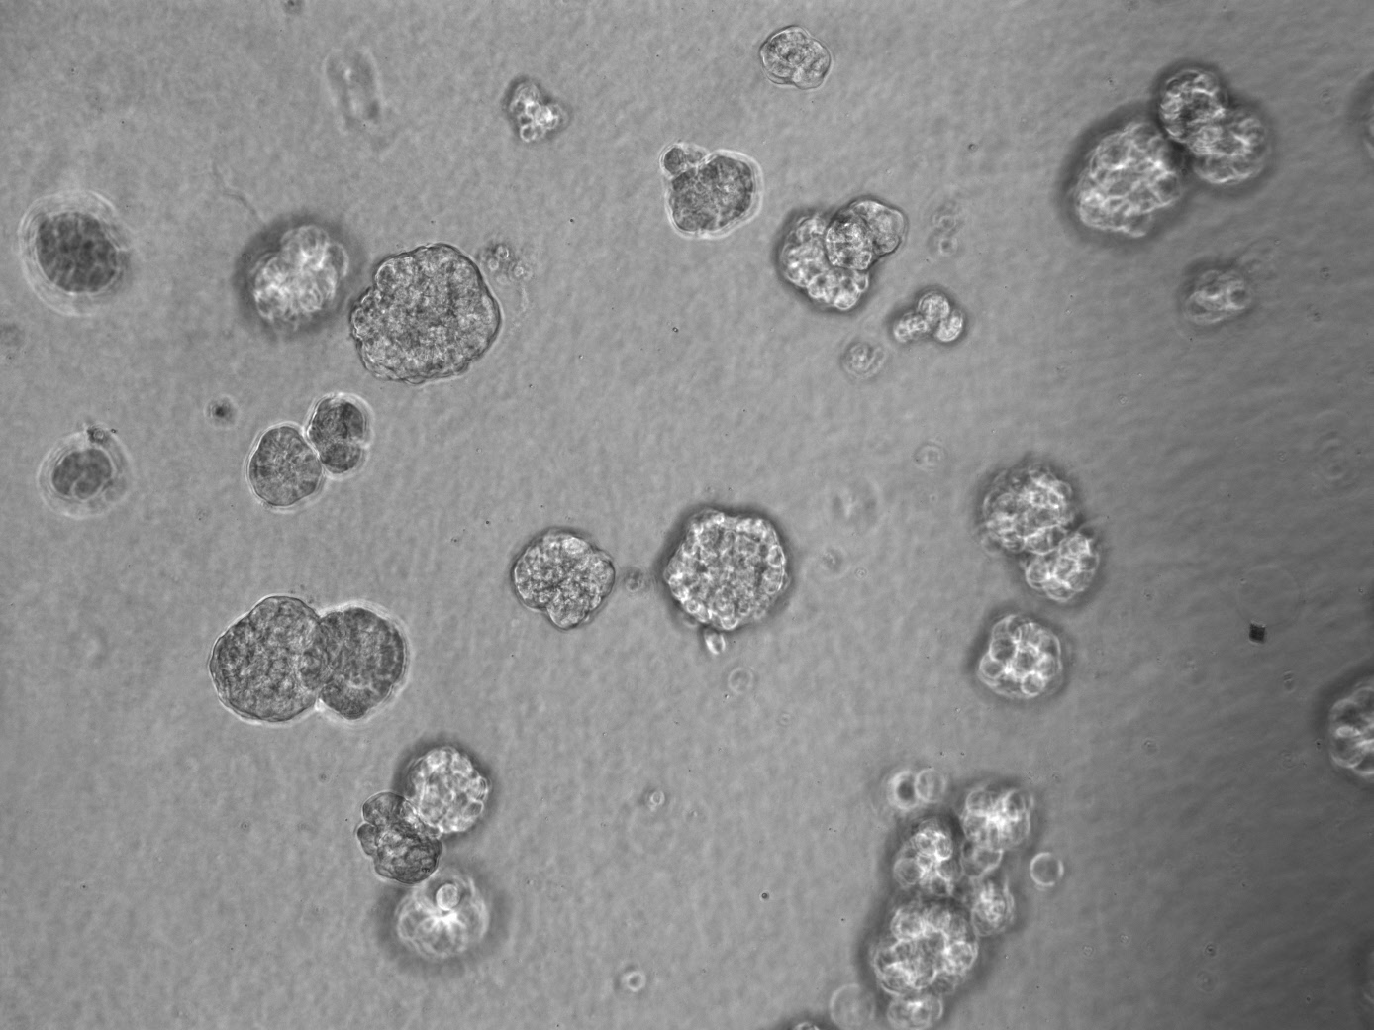
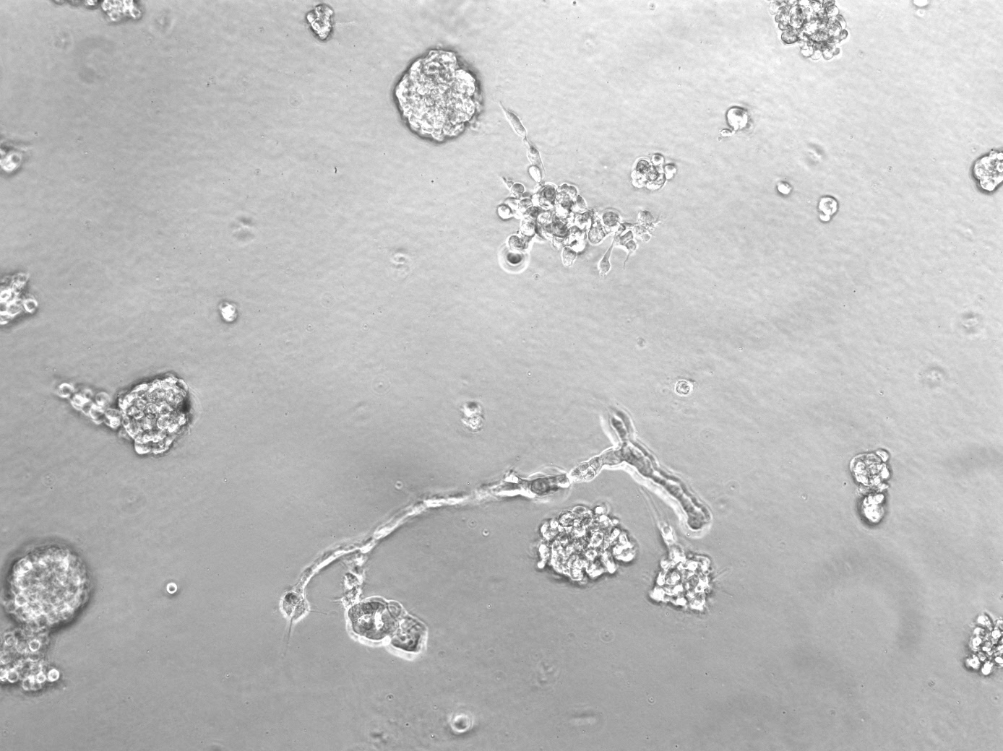
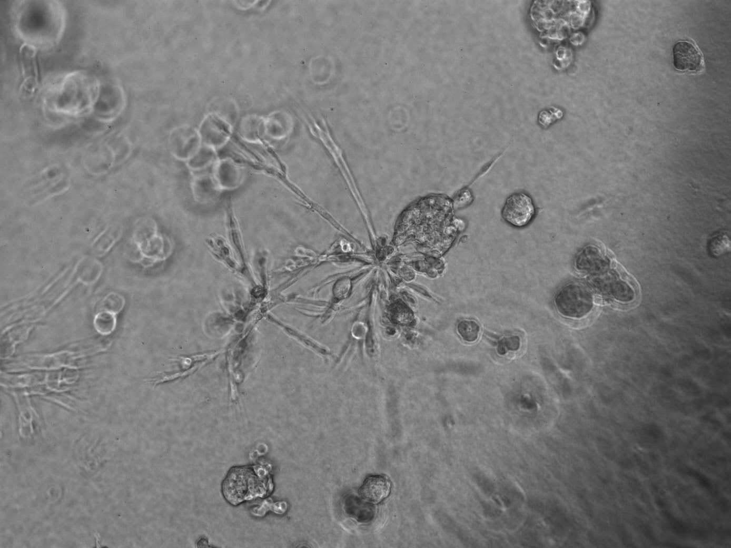
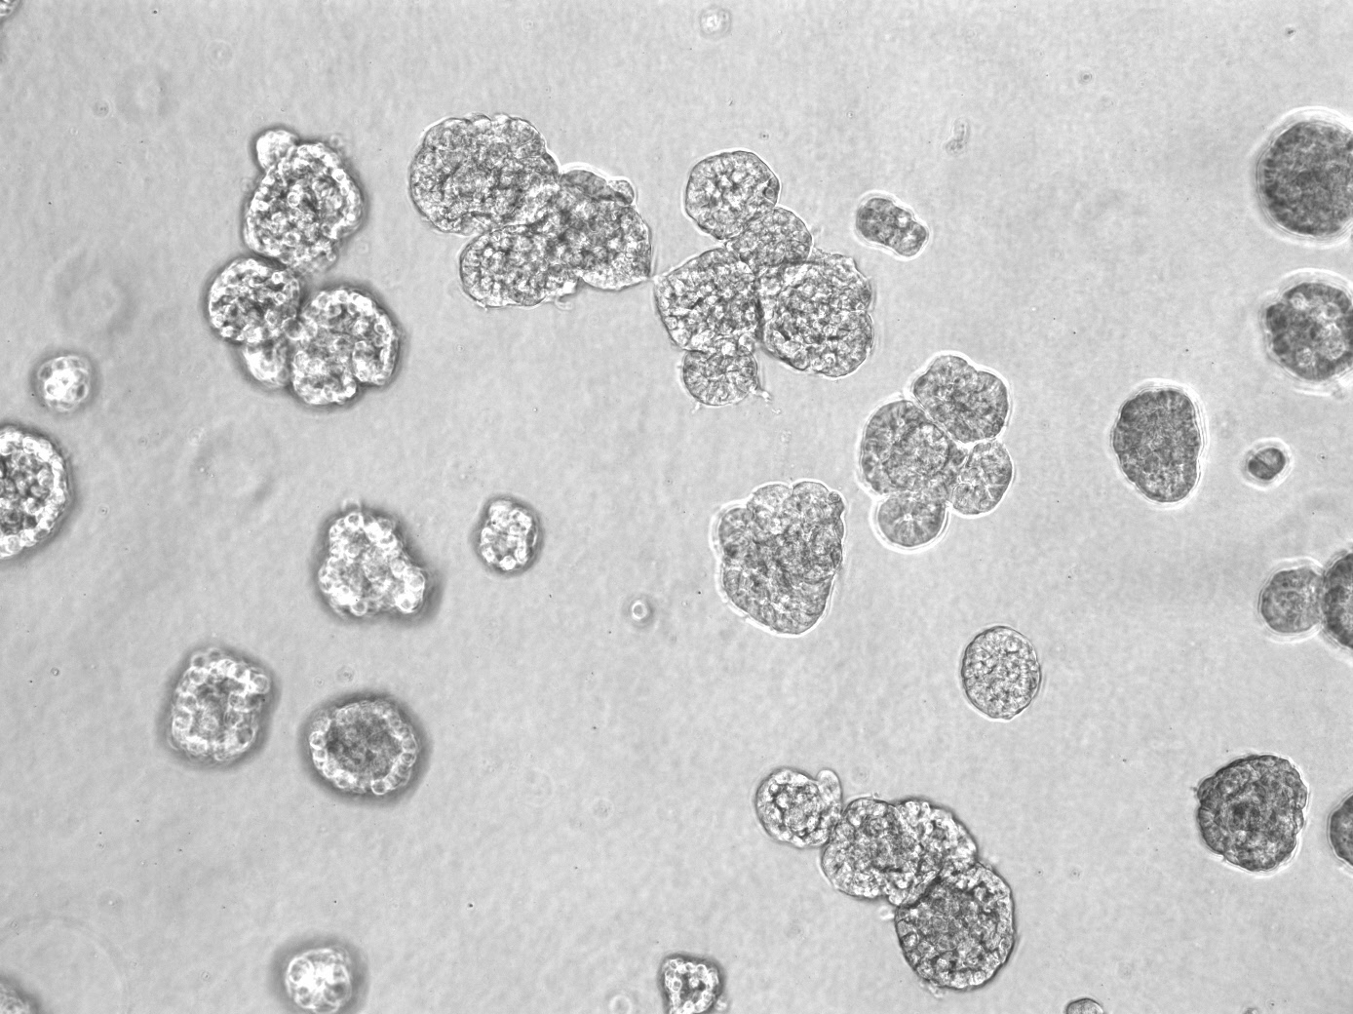
scrambled
shRNA
vector
GRHL2
shRNA
GRHL2
Figure S3.

Slide 4
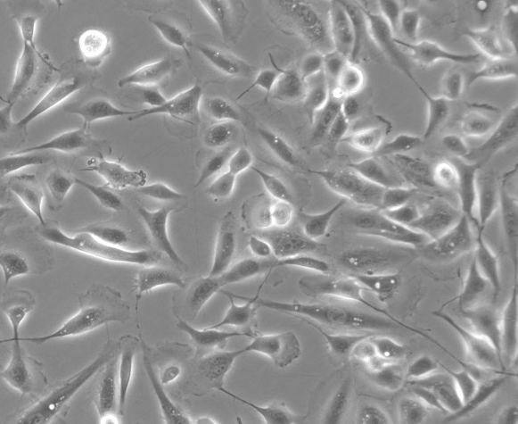
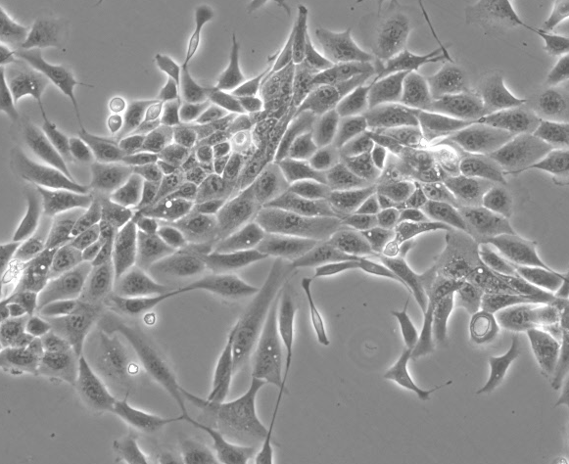



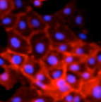
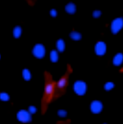
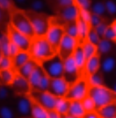


LY364947:
-
+
LY364947:
-
+
shRNA:
scr
GRHL2
scr
GRHL2
E-Cadherin-
HMLER+sh-GRHL2 cells
CD44-
GRHL2-
LY364947:
-
-
+
N-cadherin-
vimentin-
ZEB1-
shRNA:
scr
GRHL2-a
Akt-
Figure S4.

Slide 5




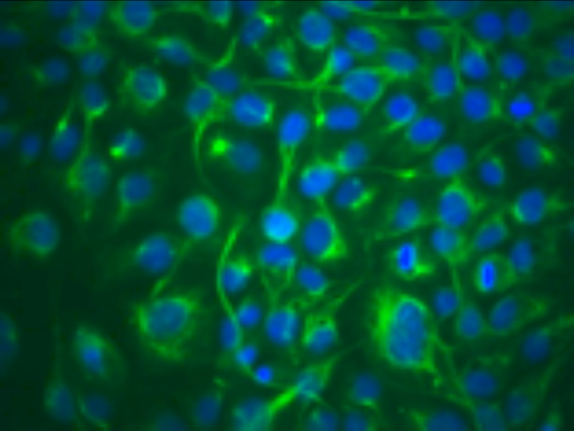
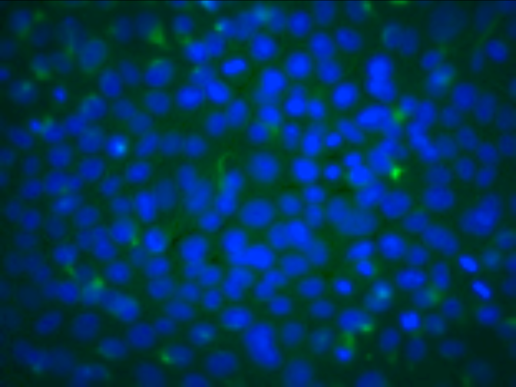
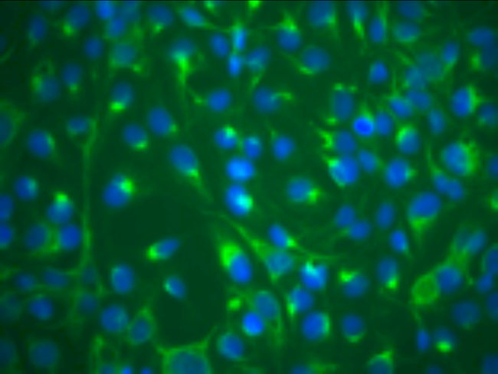
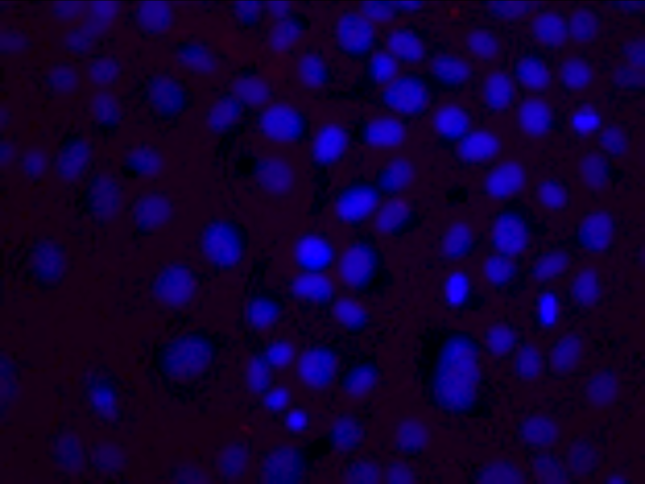
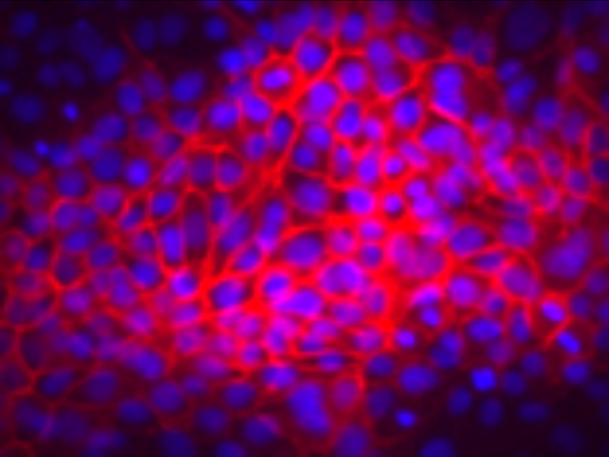
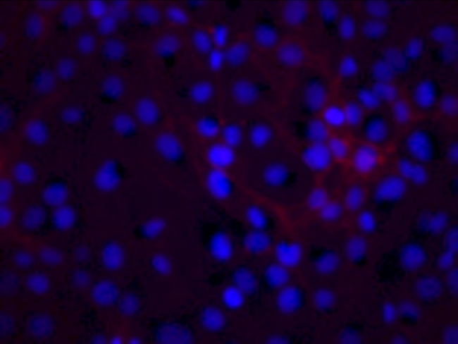
ZEB1:
-
-
+
GRHL2:
-
+
+
Zeb-1-
GRHL2-
AnkG-
E-cad-
CD44S-
N-cad-
Vimentin-
Akt-
GRHL2+
ZEB1
vector
GRHL2
vimentin
E-cadherin
Figure S5

Slide 6
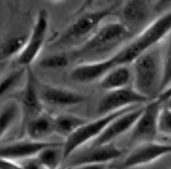
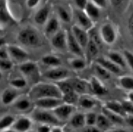
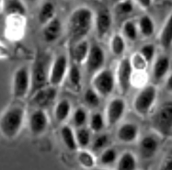


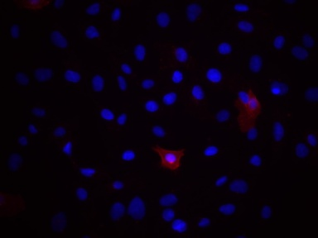
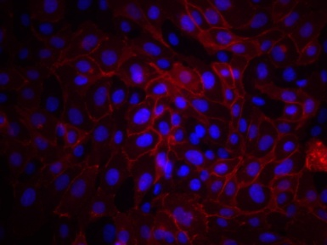
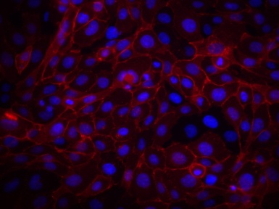
shRNA:
scr
ZEB1a
ZEB1b
Zeb1-
E-Cadherin-
AnkG-
shRNA:
scr
ZEB1a
ZEB1b
N-Cadherin-
CD44S-
TRIPZ-SCR
vimentin-
Akt-
E-cadherin
DAPI
shRNA:
scr
ZEB1a
ZEB1b
Figure S6

Slide 7

GRHL2-
Akt-
NMuMg
SCP2
EPH4
Figure S7

