Slide 1
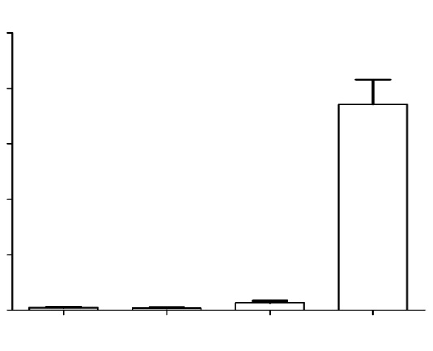
Figure S1
Frequency of Rif^{R} mutants (x 10⁻⁹)
1000
800
600
400
200
0
yfp-mutL
yfp-mutL
yfp-mutL
yfp-mutL
pBAD24
pBAD24MutH
pBAD24MutHE56A
Figure S1 The effects of overproducing wild-type MutH or mutant MutHE56A on the frequency of rifampicin resistant mutants, compared to controls. Error bars indicate the standard error of the mean.

