Slide 1
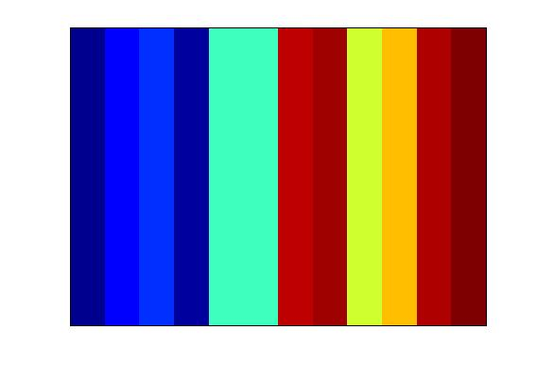
Supplementary Figure I
Control
TGFbeta
TGFβ
(GSE13986)
Control
TNFalpha
TNFα
(GSE19272)
Control
Ras
Ras
(GSE13986)
0.1 0.2 0.3 0.4 0.5 0.6 0.7 0.8 0.9
Color Scale

Slide 2
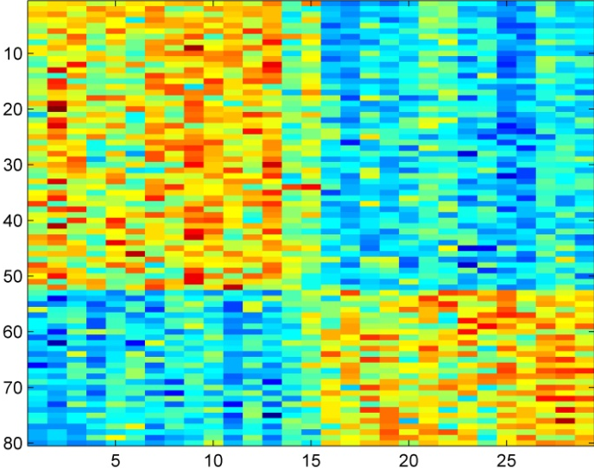
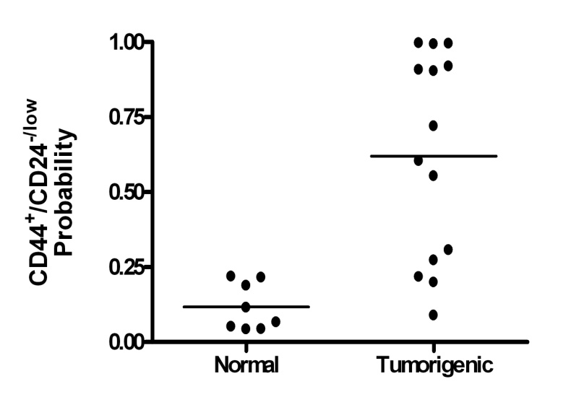
Supplementary Figure II
A.
C.
P= 0.0196

