Slide 1
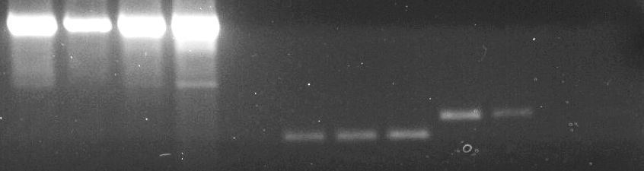
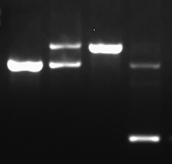
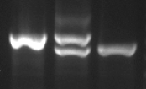
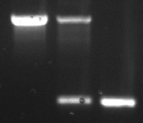
A.
F.
25
26
27
Wildtype allele
WT Rev3 transcripts absent in Rev3 KO
GAPDH
mutant Rev3
wild-type Rev3
25
26
Neo
27
+/+
Δ/+
Δ/Δ
Δ/Δ
+/+
Δ/+
Δ/Δ
Δ/Δ
+/+
Δ/+
Δ/Δ
Δ/Δ
Recombinant allele
25
26
27
Cre electroporation and selection of neo-deleted, exon 28 intact
1
2
25
27
Following cross to cre-recombinase transgenic
B.
Rev3 locus
25
26
27
25
27
CD19 promoter-driven
Gt(Rosa)26Sor locus
stop
EYFP
Cre-recombinase expression
EYFP
YFP+ Rev3KO
B cells
C.
wt
F/wt
F/F
F/wt
Cre+
D.
E.
wt
T/wt
T/T
wt
M/wt
M/M
floxed = 1630bp
Wt = 1330bp
600bp Wt
950bp Wt
YFP
genotyping
CD19
genotyping
del = 632bp
320bp Mutant
Supplemental Figure 1

Slide 2
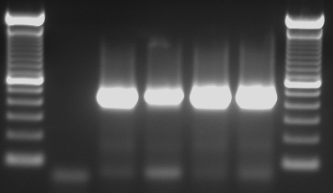
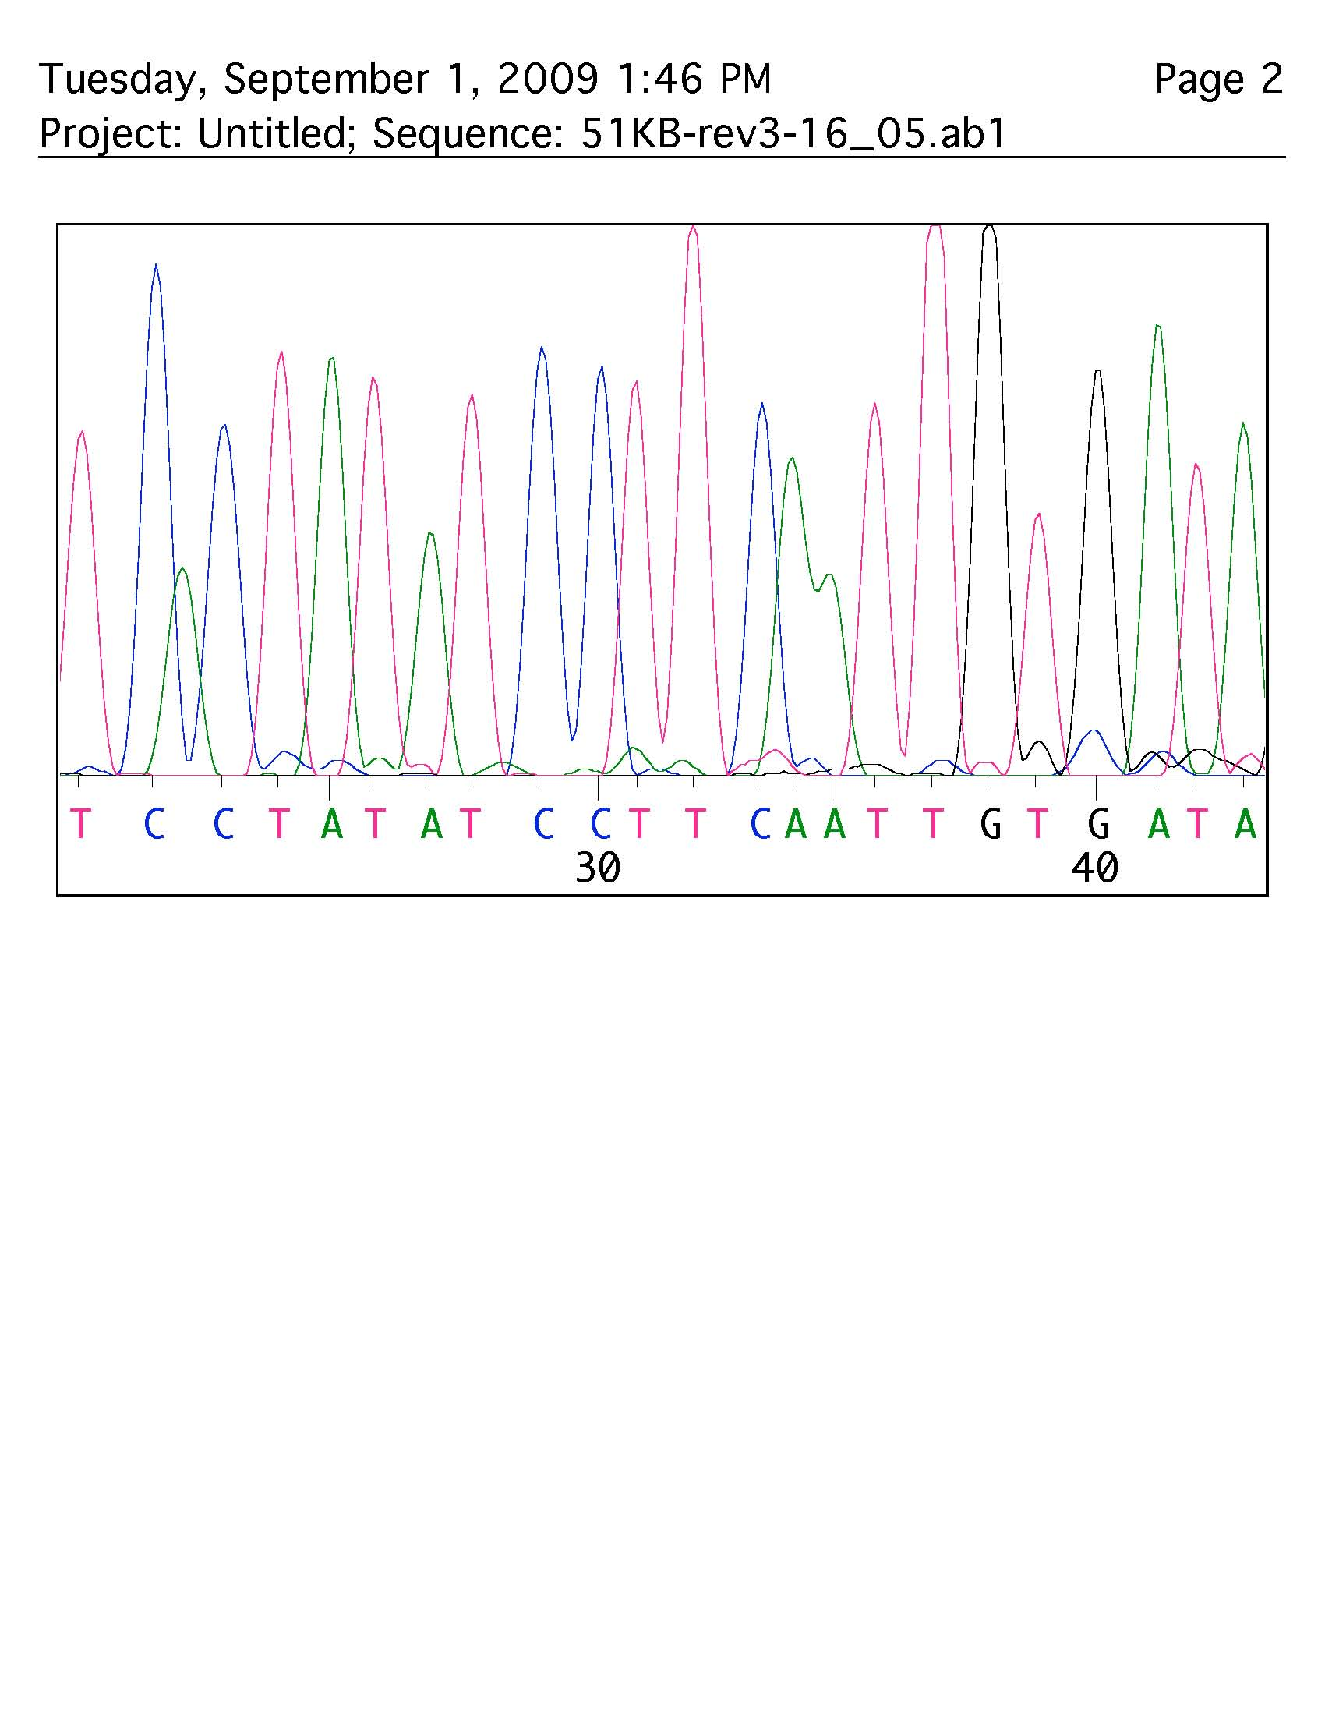
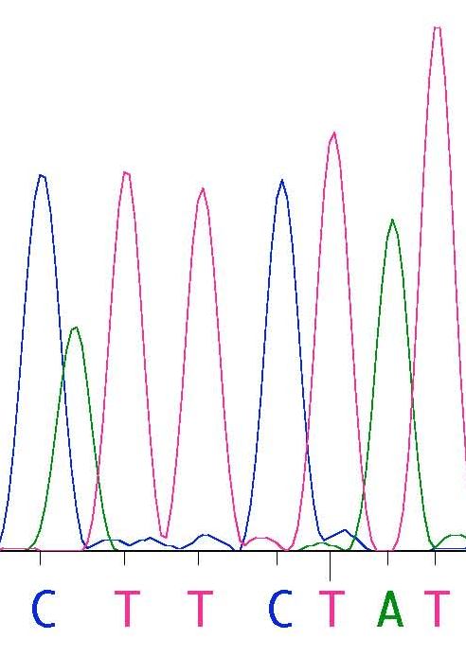
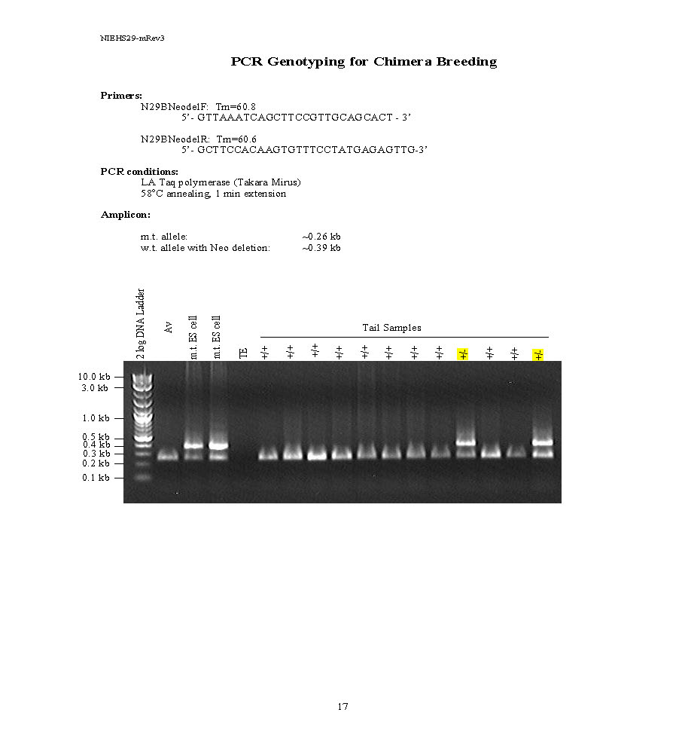
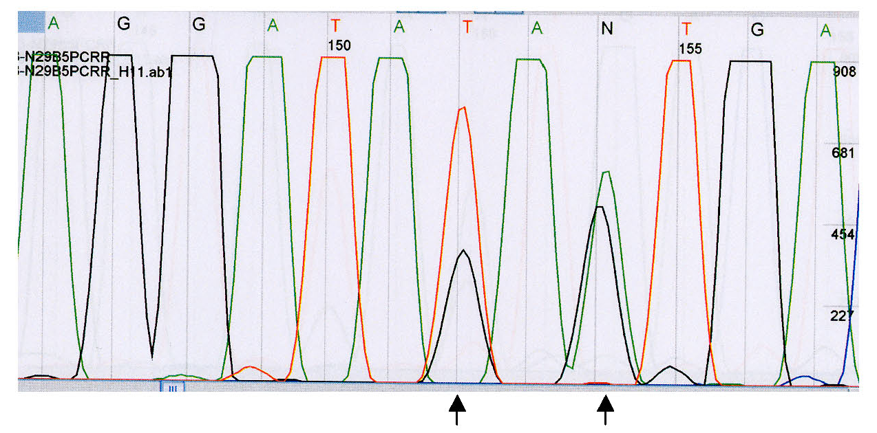
A.
D.
L to F mutation confirmation via PCR and sequencing
23
24
25
26
27
c
F4^{F F}
F5^{LL}
PCR
Mutagenesis
Wildtype allele
PCR
L2610F
600
400
NotI
HindIII
SacII
AscI
NruI
200
23
24
25
26
27
+NotI
+SacII
L2610F
+AscI
+NruI
23
24
25
Neo
26
27
A
A
Phe
Leu
B.
C.
Mut ES
cells
Het
Het
Confirmation of mutation in Neo-deleted clones
Leu CTA to PheTTC
Supplemental Figure 2
Notes:
Supplementary Figure 2. Rev3L2F construct. (a) Schematic showing the introduction, by site directed mutagnesis, of of L 2610 F mutation into exon 25. (b) Rev3 conditional KO Homologous recombination. Primary ES screening was performed with 5’ probe. 30 potential positive clones were identified for the presence of hybridization band corresponding to both the targeted allele and wildtype allele. Six clones (C9, C12, D5, D6, E11 and F2) were selected for ES clone expansion as potential positives.

Slide 3
A.
B.
4500
Rev3 Ko target domain
HUMAN DTKKWGARVVYGDTDSMFVL
mouse DTKKWGARVVYGDTDSMFVL
Drosophila NNEEWKVRVVYGDTDSMFVL
YEAST KDETWNAKVVYGDTDSLFVY
Neurospora SVQKWDADVVYGDTDSLFVS
Arabidopsis ANDNWNARVVYGDTDSMFVL
Wild Type
rad30, rev3L979F
4000
1200
1000
800
600
400
200
0
rad30
rad30, rev3ko
3500
3000
Can1 mutants per 10⁸
Rev3 Ki target domain
HUMAN LDFQSLYPSIVIAYNYCFST
mouse LDFQSLYPSIVIAYNYCFST
Drosophila LDFQSLYPSMIIAYNYCFST
YEAST LDFQSLYPSIMIGYNYCYST
Neurospora LDFQSLYPSVMIAYNYCYST
Arabidopsis LDFQSLYPSMIIAYNLCFST
2500
2000
Can1 mutants per 10⁶
1500
1000
Rev3 full Ko
Rev3-DTD KI
500
0
0
10
20
30
40
50
Dose
C.
D.
(J/m^2)
 | No of mutations | No of bp among mutated clones | Mutations per bp | No of Unique clones (No of mice)
Control Proximal | 347 | 18000 | 0.019 | 66 (20)
Rev3L2F Proximal | 469 | 13194 | 0.034 | 81 (8)
Control Distal | 51 | 12700 | 0.004 | 40 (20)
Rev3L2F Distal | 205 | 17980 | 0.014 | 75 (8)
Rev3KO Proximal | 5 | 7542* | 0.001 | 18 (4)
 | Total In/dels | Total Tandems
Control | 7 | 12
Rev3L2F | 32 | 45
* Includes all clones
Supplemental Figure 3

Slide 4
% clones
Number of mutations
% clones
Number of mutations
Supplemental Figure 4

