Slide 1

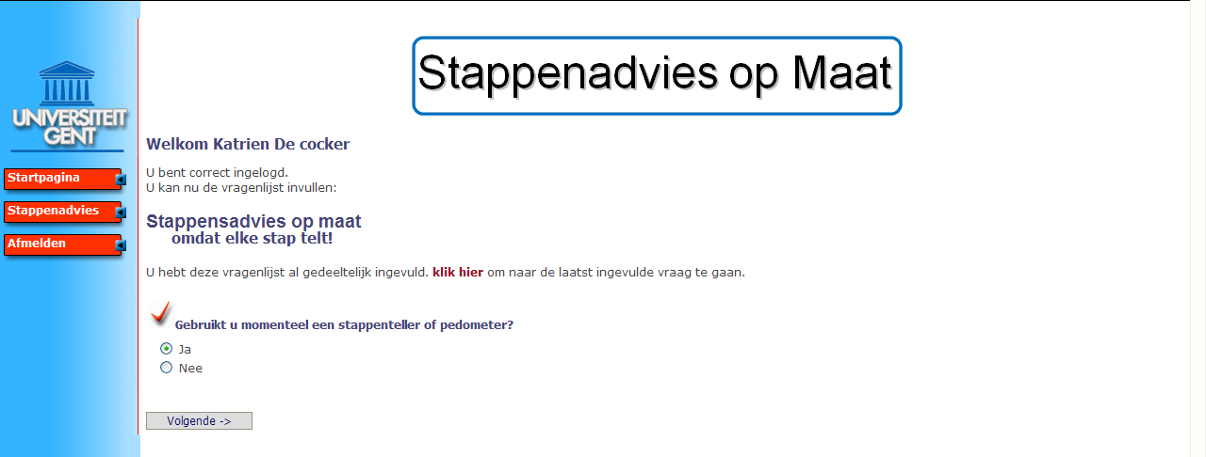

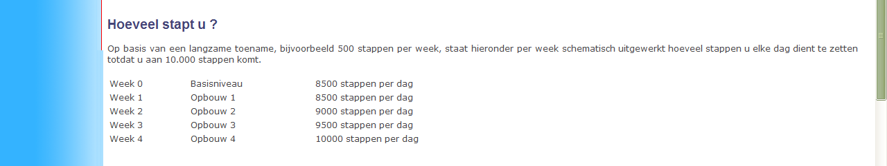
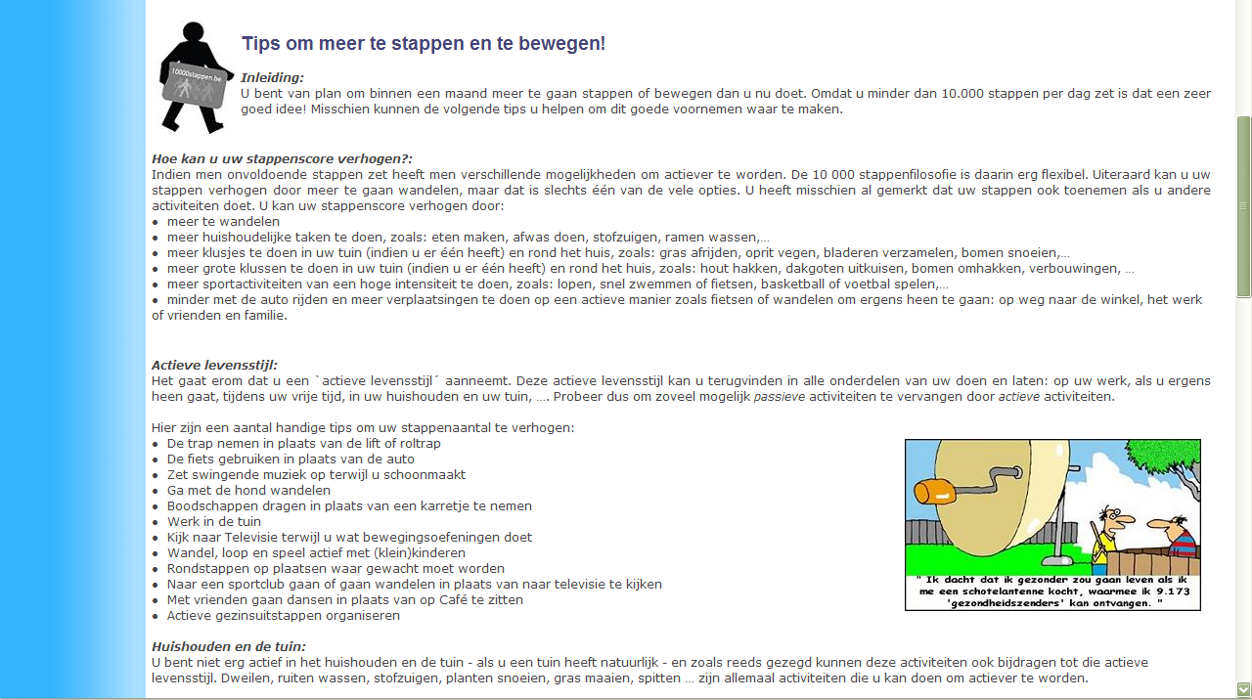
A) Home page
B) Start of the questionnaire
C) Introduction to the advice
D) Schedule to reach a personal step goal
E) Tips and suggestions

