Slide 1
Supplementary Figure 2
**
**
***
**
†
†
†

Slide 2
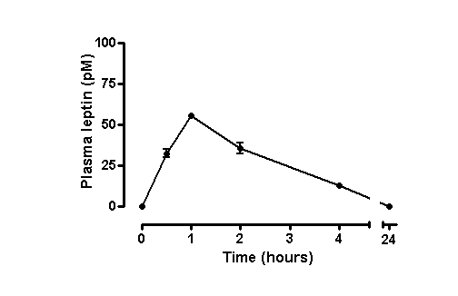
Supplementary Figure 1

