Slide 1
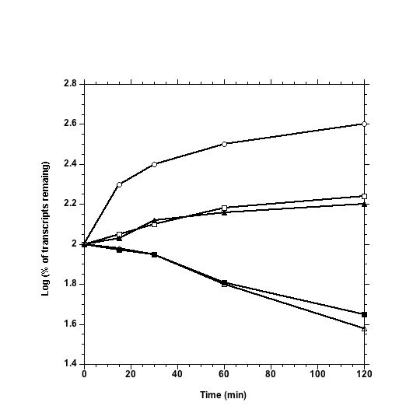
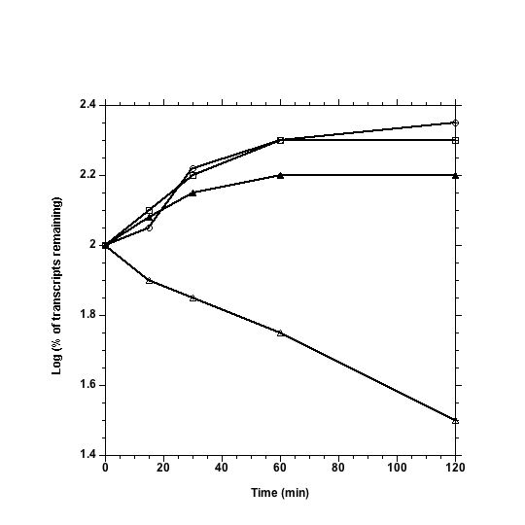
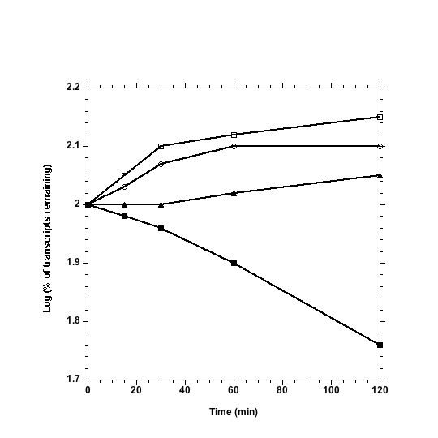
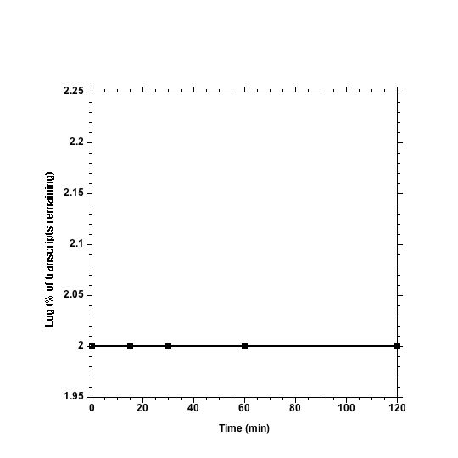
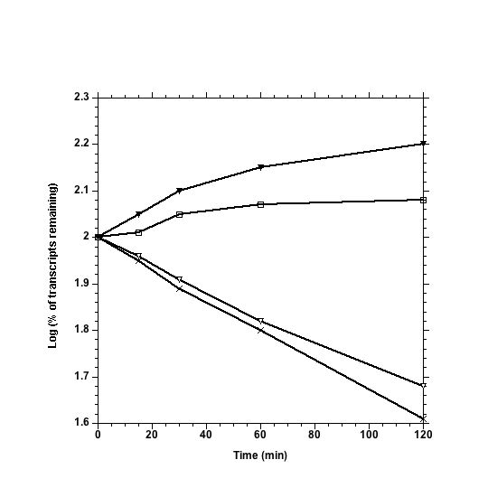
hisR
cysT
Log (% of transcripts remaining)
Time (min)
Time (min)
leuX
proK, proL, proM
Log (% of transcripts remaining)
Time (min)
Time (min)
5S rRNA
Log (% of transcripts remaining)
Time (min)

