Slide 1
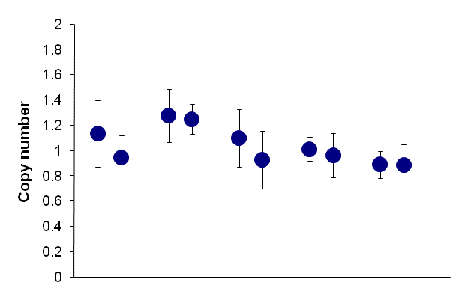
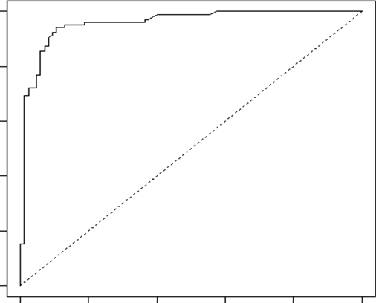
Supplemental Figure 1
A
B
C
D
P<0.001
Sensitivity
0.0 0.2 0.4 0.6 0.8 1.0
M P M P M P M P M P
0.0 0.2 0.4 0.6 0.8 1.0
ARL17B SCAPER EPHA3 ERBB4 WWOX
1-Specificity

