Slide 1
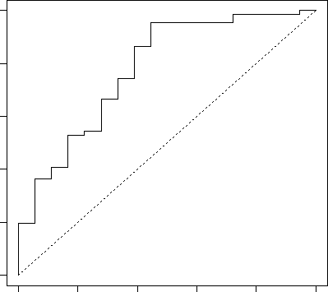
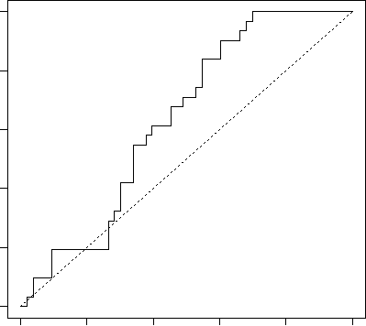
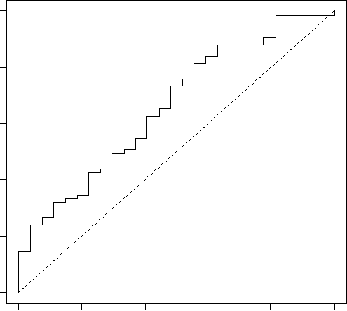
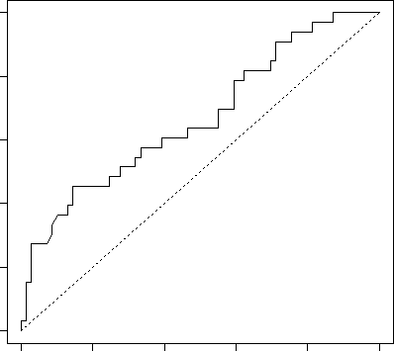
Supplemental Figure 2
A
B
p= 0.001
p= 0.014
blood
blood
Sensitivity
Sensitivity
0.0 0.2 0.4 0.6 0.8 1.0
0.0 0.2 0.4 0.6 0.8 1.0
0.0 0.2 0.4 0.6 0.8 1.0
0.0 0.2 0.4 0.6 0.8 1.0
1-Specificity
1-Specificity
C
D
p= 0.008
p= 0.004
Tumor
Tumor
Sensitivity
Sensitivity
0.0 0.2 0.4 0.6 0.8 1.0
0.0 0.2 0.4 0.6 0.8 1.0
0.0 0.2 0.4 0.6 0.8 1.0
0.0 0.2 0.4 0.6 0.8 1.0
1-Specificity
1-Specificity

