Slide 1
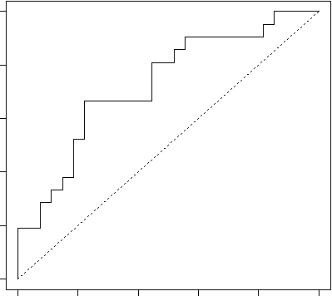
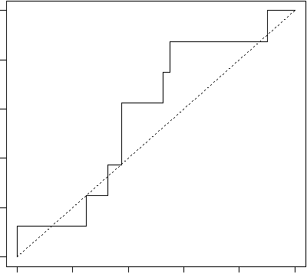
Supplemental Figure 3
A
P=0.004
B
p= 0.226
AT
AT
Sensitivity
Sensitivity
0.0 0.2 0.4 0.6 0.8 1.0
0.0 0.2 0.4 0.6 0.8 1.0
0.0 0.2 0.4 0.6 0.8 1.0
0.0 0.2 0.4 0.6 0.8 1.0
1-Specificity
1-Specificity

