Slide 1
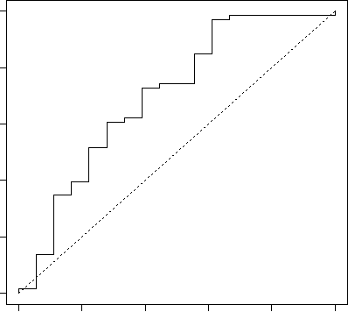
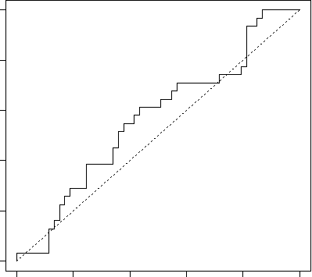
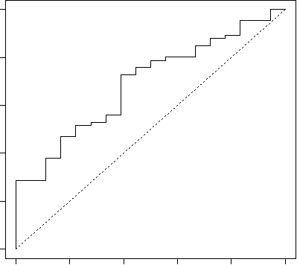
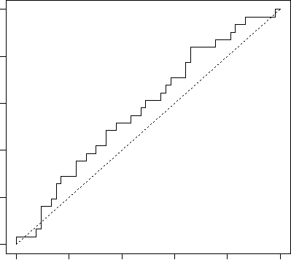
Supplemental Figure 4
A
p= 0.003
B
p= 0.131
blood
blood
Sensitivity
Sensitivity
0.0 0.2 0.4 0.6 0.8 1.0
0.0 0.2 0.4 0.6 0.8 1.0
0.0 0.2 0.4 0.6 0.8 1.0
0.0 0.2 0.4 0.6 0.8 1.0
C
1-Specificity
D
1-Specificity
p= 0.005
p= 0.098
blood
blood
Sensitivity
Sensitivity
0.0 0.2 0.4 0.6 0.8 1.0
0.0 0.2 0.4 0.6 0.8 1.0
0.0 0.2 0.4 0.6 0.8 1.0
0.0 0.2 0.4 0.6 0.8 1.0
1-Specificity
1-Specificity

