Slide 1
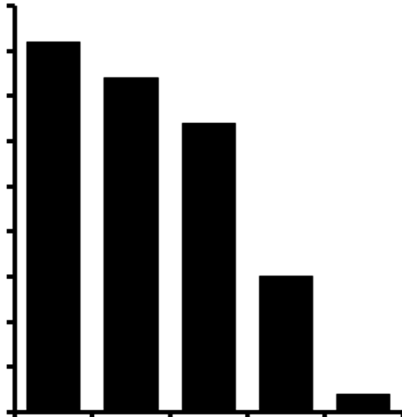
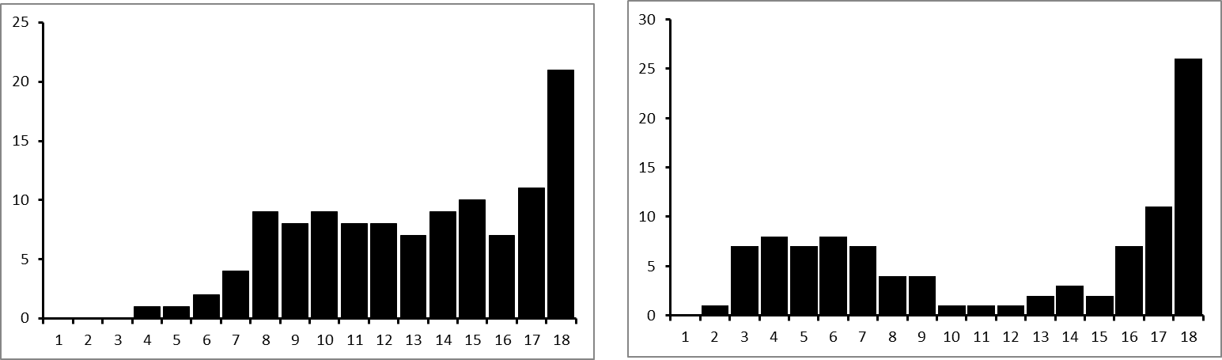
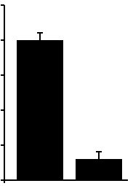
Paired
centromeres
A
600
Chiasma
Number of chromosomes
300
Paired
centromeres
0
B
25
25
20
20
15
15
Percent of foci for chromosomes
with 1 MLH1 foci
Number of bivalents per cell
10
10
5
5
0
Wt
Hfm1
0
0
50
100
Position of MLH1 foci (distance from centromere
as percent of SC length)

