Slide 1
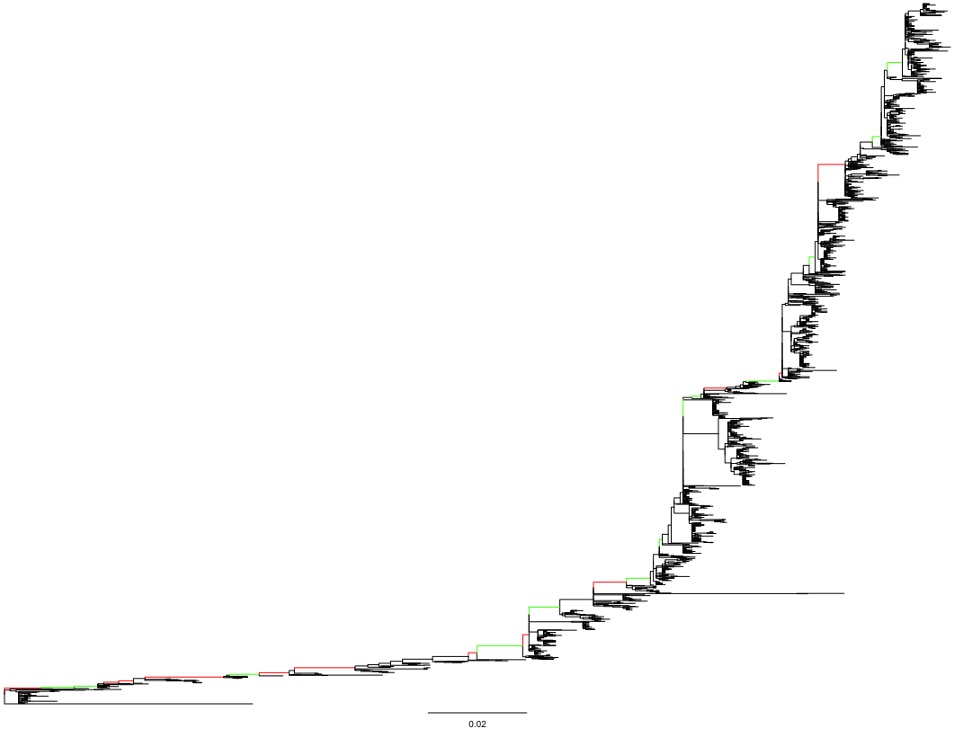
-1
-2
+1
-1
+1
+3
-2
-1
-1
N144
N133
N122
-1
1997-2010
(part II)
N126
N276
-1
N81
N276
+3(+2)
-1
N63
N246
+2
+2
-3
1968-1998
(part I)
+1(0)
+1
-1
+2
+3
+1(0)
+2
-1
-1

