Slide 1
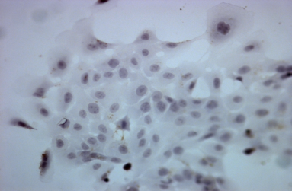
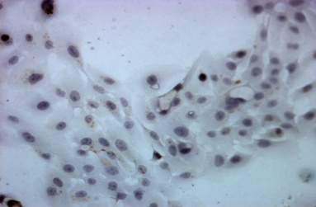
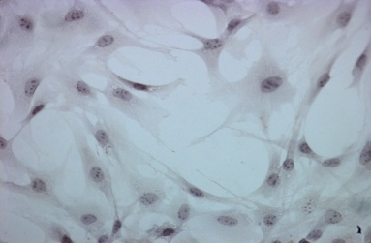
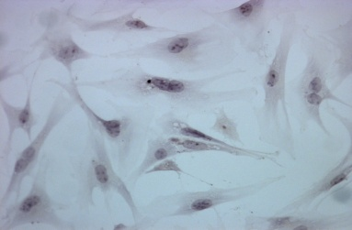
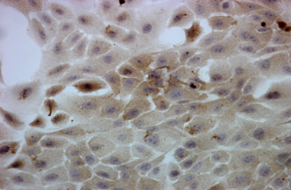
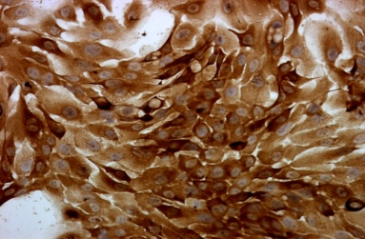
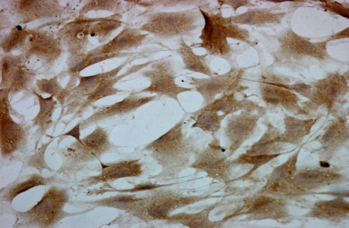
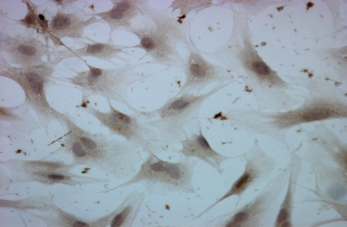

Supplementary Fig. 1
a
76N.TERT.V
76N.TERT.Ecd
c
MEF. Ecd+/+
MEF.Ecd-/-
IgG
IgG
Ecd
antibody
Ecd
antibody
76N.TERT.V
76N.TERT.Ecd
MEF mEcd+/+
b
d
MEF mEcd-/-
hEcd
mEcd
β-actin
β-actin

Slide 2
Supplementary Fig.1 Characterization of Ecd antibody specificity for IHC staining. (A). 76NTERT cells expressing either vector (76NTERT.V) or Ecd (76NTERT.Ecd) were analyzed by IHC staining using either mouse IgG (as control) or anti-Ecd antibodies (B) Western blot analysis of cells used in Fig. A (C). IHC staining of mouse embryonic fibroblasts expressing wild type Ecd (Ecd+/+) or cre-adenovirus infected MEFs where Ecd was deleted (Ecd-/-). Mouse IgG was used as negative control. (D) Western blotting of cells used in Figure C.

