Slide 1
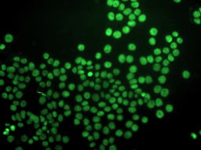


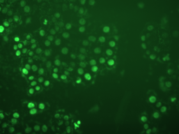
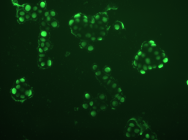
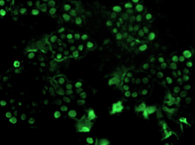
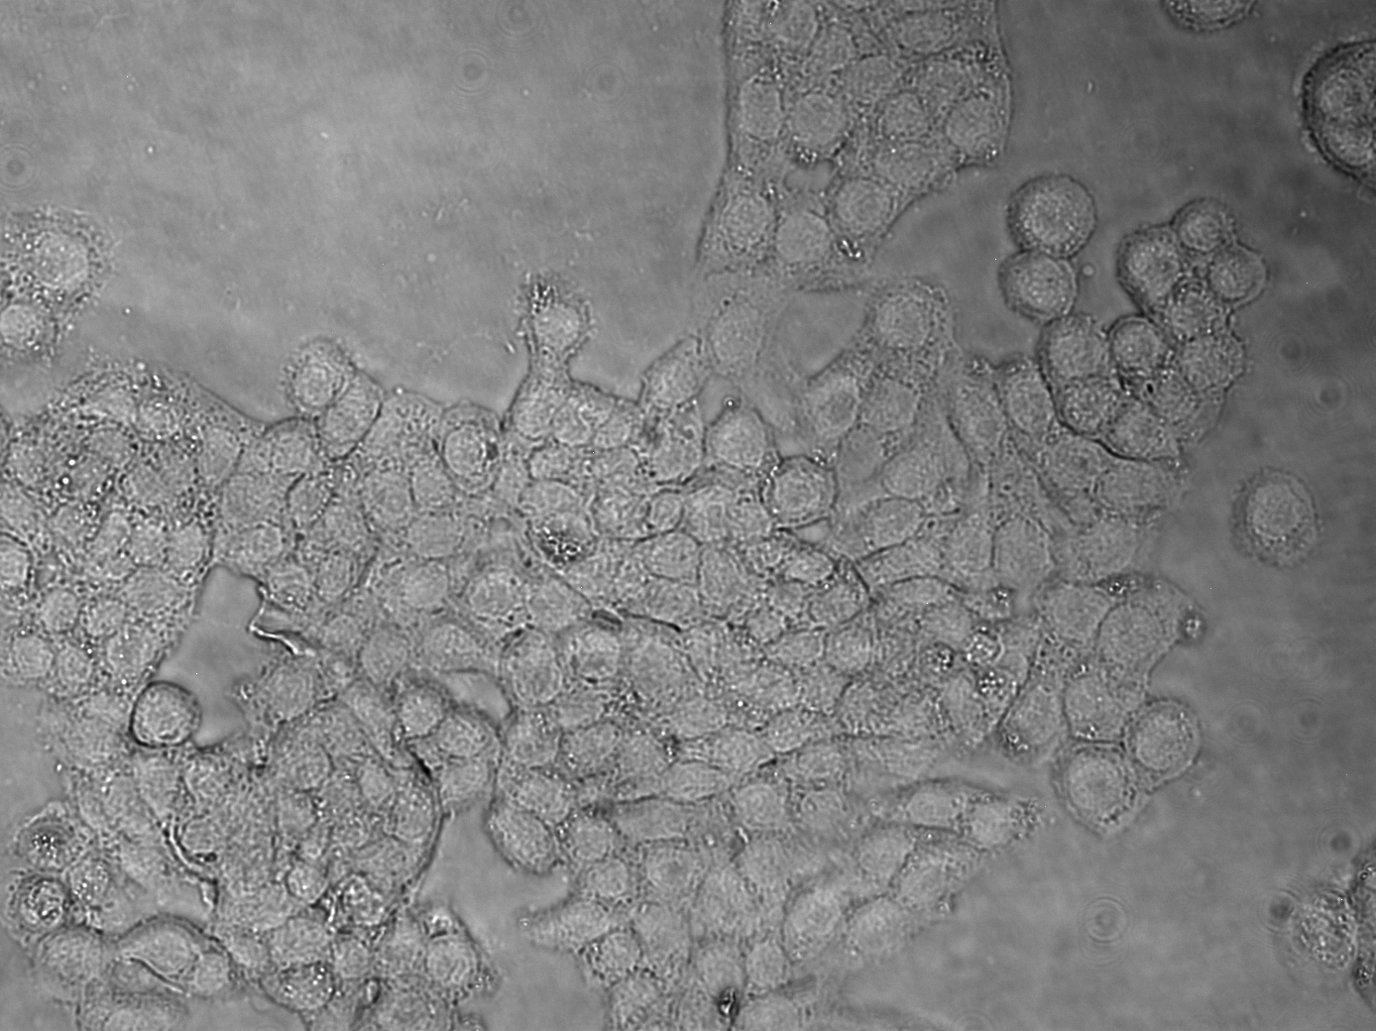
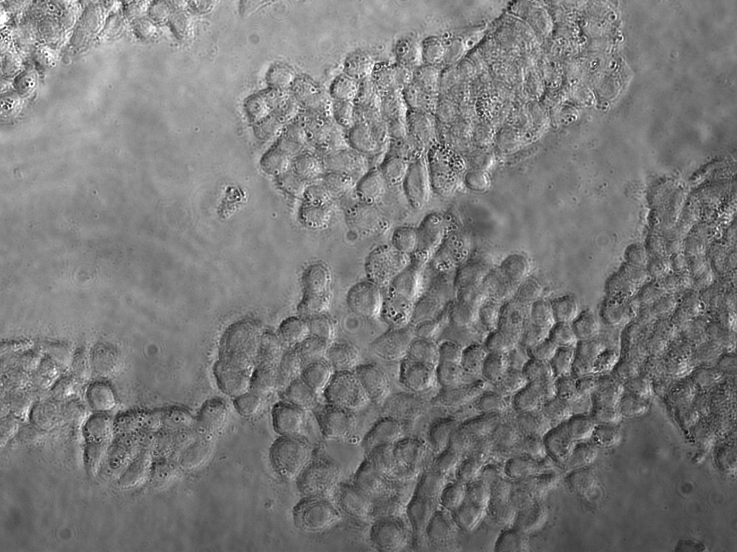
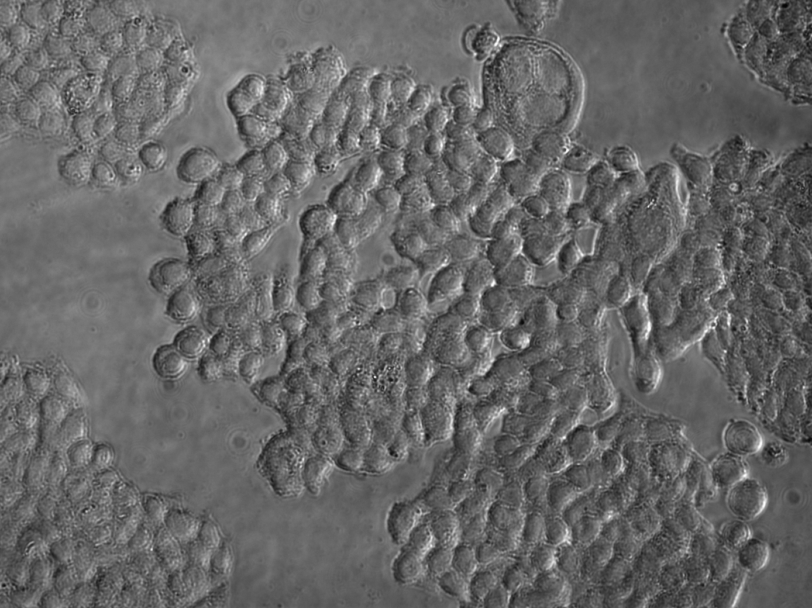
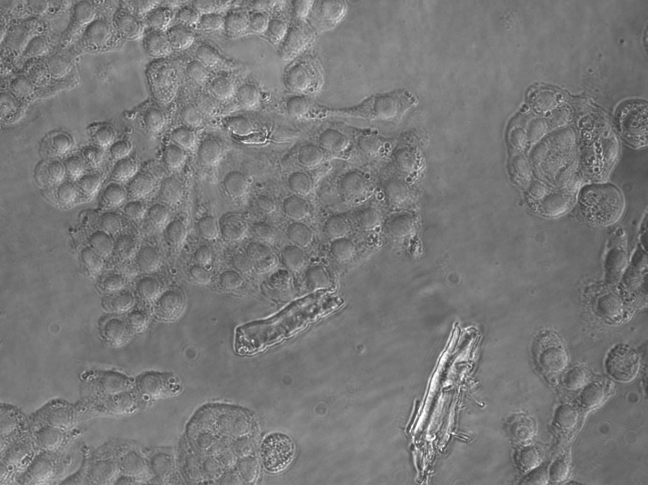
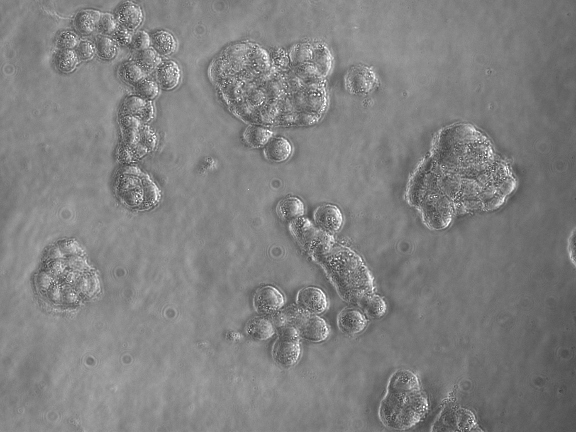
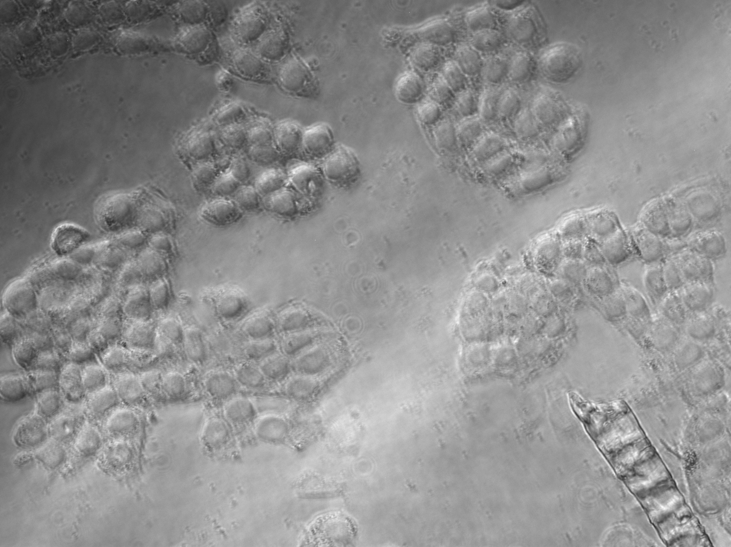
Supplemental Figure 5
A
Normoxia
Hypoxia
C
+siNeg
+siPOX
PARP
24 hr
PARP-cv
β-actin
PARP
48 hr
PARP-cv
β-actin
PARP
72 hr
PARP-cv
β-actin
B
Positive Ctr
Negative Ctr
Normoxia
Hypoxia
+siPOX
+siNeg

