Slide 1
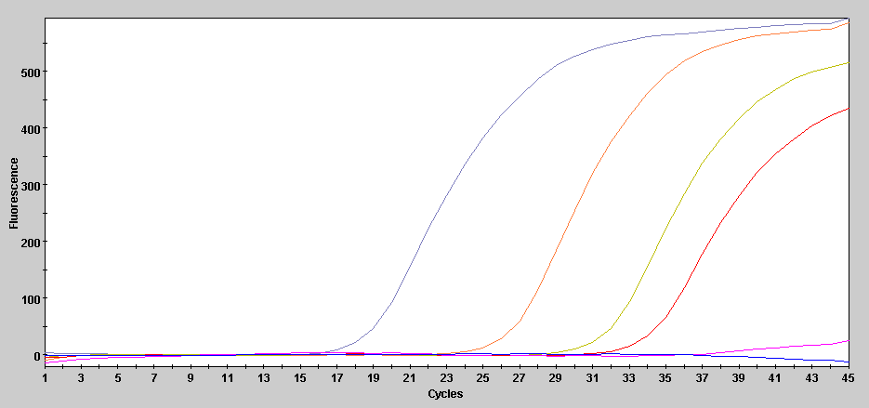
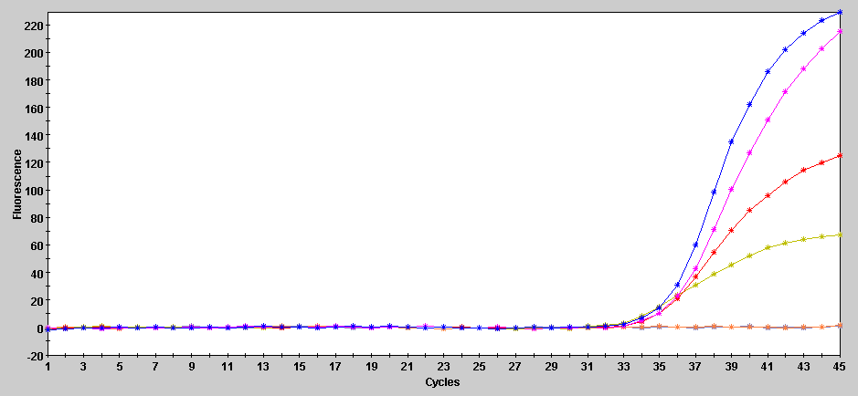
Supplemental Figure 1 – Example of a typical DPE-PCR assay readout and brief description of routine controls
Target Curves (FAM)
No Input Control (NIC)
DNA polymerase extension
reagents without DNA polymerase
added.
Signal A
Signal B
Signal C
Signal D
PCR blank
Contains qPCR reagents only.
Does not contain DNA polymerase
extension reagents. There is no
DNA polymerase extension substrate
present here.
Corresponding competitive Internal Control curves (TxRed)
[40 copies/qPCR]
PCR blank
No Input Control (NIC)
Signal D
Signal C
Signal A and B

Slide 2
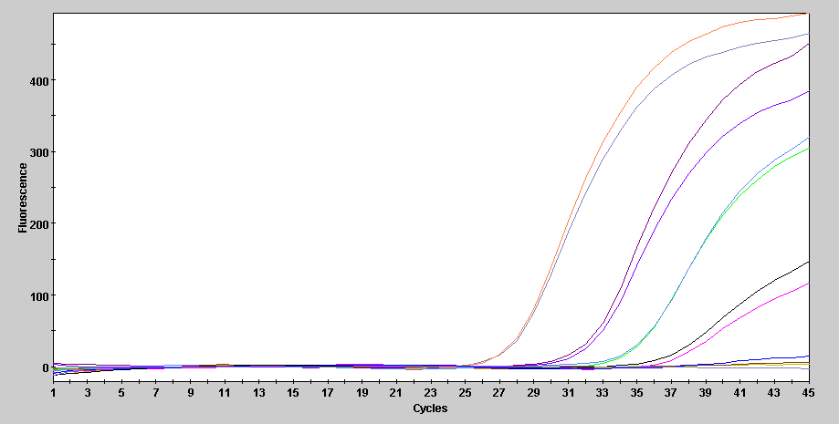
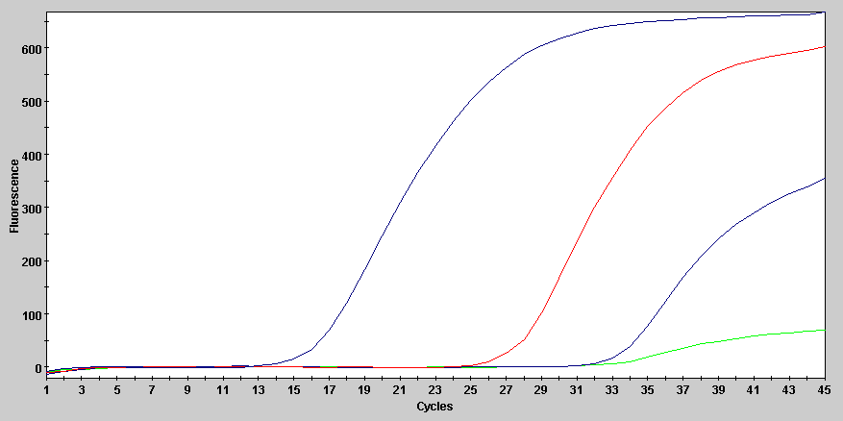
Supplemental Figure 2
(A) Example of “contaminant” DNA polymerase activity detected in DNA polymerase extension stock reagents and its
elimination/reduction after reagent pre-heat treatment.
(B) UDG within the qPCR mastermix is essential for elimination of Taq-dependent background noise.
A dilution of UDG within the qPCR mastermix is also presented.
A
No Input Control DPE-PCR curves from duplicate DNA polymerase
extension reactions containing 3 separate lots of
BSA +/- pre-heat treatment
Lot 1 (-)
Lot 2 (-)
Lot 3 (-)
Lot 3 ( + )
Lot 1 and 2 ( + )
B
No Input Control DPE-PCR curves from qPCR reactions
containing the indicated amounts of UDG
No UDG
0.00012 Units UDG (1:10,000)
0.012 Units UDG (1:100)
1.2 Units UDG (standard)

Slide 3
Supplemental Figure 3
Raw data used to generate linearity graphs for DNA Pol I LOD depicted in Figure 2B
Raw data from triplicate reactions of Figure 2C
A
Units of DNA pol I per reaction | Run 1a Target-Ct (FAM) | Run 1b Target-Ct (FAM) | Run 2a Target-Ct (FAM) | Run 2b Target-Ct (FAM) | Avg Target-Ct (FAM) | StdDev Target-Ct (FAM)
2e-5 | 16.2 | 16.4 | 17.4 | 17.5 | 16.875 | 0.67
2e-6 | 20 | 20.1 | 20.8 | 20.8 | 20.425 | 0.43
2e-7 | 23.5 | 23.9 | 24.8 | 24.9 | 24.275 | 0.68
2e-8 | 27.9 | 27.9 | 28.6 | 28.6 | 28.25 | 0.40
2e-9 | 31.8 | 31.1 | 32.2 | 32.8 | 31.975 | 0.71
2e-10 | 34.3 | 35.1 | 35.8 | 35.3 | 35.125 | 0.62
2e-11 | 36.6 | 36.7 | 37.8 | 36.7 | 36.95 | 0.57
NIC | 38.1 | ND | ND | 37.5 | NA | NA
PCR blank | ND | ND | ND | ND | NA | NA
B
Sample Assayed | Reaction 1-Target Ct (FAM) | Reaction 2-Target Ct (FAM) | Reaction 3-Target Ct (FAM) | Avg Ct | StdDev-Ct
Pol I | 25.5 | 25.1 | 25.8 | 25.47 | 0.35
Klenow | 23.7 | 26.3 | 23.9 | 24.63 | 1.45
Klenow exo- | 25.1 | 23.8 | 23.3 | 24.07 | 0.93
Ligase | ND | ND | ND | NA | NA
NIC | 36.9 | 37.9 | ND | 37.40 | NA

Slide 4
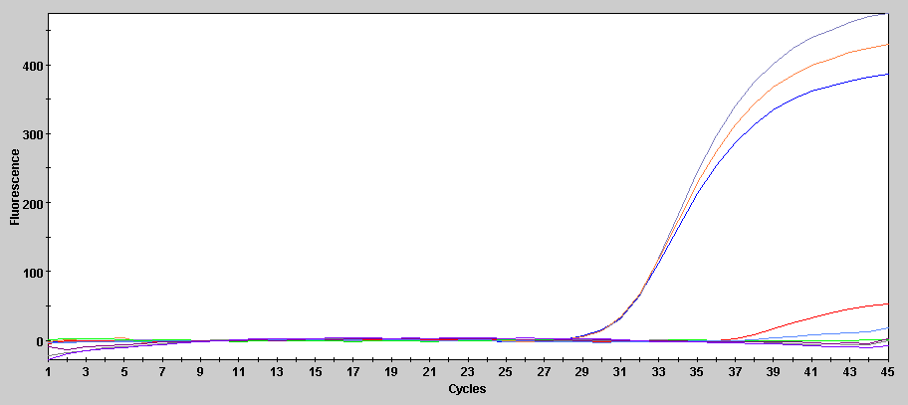
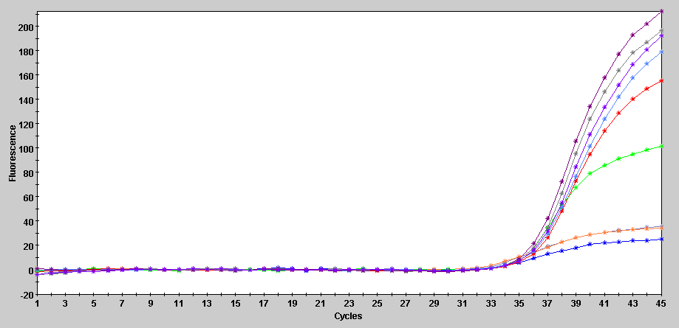
Supplemental Figure 4
(A) Raw data from triplicate DPE-PCR reactions containing DNA pol I reactions with dCTP or ddCTP shown in Figure 2D. PCR blank controls are included to demonstrate that the minor amounts of ddCTP carried from the DNA polymerase extension reaction into the qPCR reaction are not inhibitory for Taq. See Supplemental Figure 1 for an example of a typical DPE-PCR readout.
(B) Corresponding Target (FAM) curves
(C) Corresponding competitive Internal Control (TxRed) curves
B
Target (FAM) curves
Pol-dCTP
A
Pol-ddCTP
and PCR blanks
Sample ID | Target-Ct | Internal Control - Ct
Pol-dCTP | 31.2 | 32.2
Pol-dCTP | 31.7 | 32.8
Pol-dCTP | 31.4 | 32.7
Pol-ddCTP | 37 | 36.6
Pol-ddCTP | ND | 35.6
Pol-ddCTP | ND | 36.5
PCR blank | ND | 36.6
PCR blank | ND | 36.3
PCR blank | ND | 36.7
C
Competitive Internal Control curves (TxRed)
Pol-ddCTP
and PCR blanks
40 copies of competitive Internal Control
DNA is still detected in the presence of
ddCTP carryover
Pol-dCTP
“Flattened” competitive Internal control curves derived from Pol-dCTP are given a Ct of ≈ 32.5 by SMART Cycler software

Slide 5
Supplemental Figure 5
Raw data from triplicate reactions used to generate linearity graphs for E. coli in Figure 4B
Results from triplicate cfu plating
(C) Raw data from triplicate reactions of E. coli gene specific PCR. Data was generated from the same lysates used
to determine DNA polymerase activity
A
Polymerase Activity Detection - FAM Ct Value
Targeted cfu input | Reaction-1 | Reaction-2 | Reaction-3 | Avg Ct | StdDev Ct
e5 | 20.3 | 19.9 | 19.7 | 19.97 | 0.31
e4 | 22.9 | 23.1 | 23.3 | 23.10 | 0.20
e3 | 26.1 | 26.3 | 27.7 | 26.70 | 0.87
e2 | 30.6 | 29.8 | 29.8 | 30.07 | 0.46
e1 | 34.8 | 33.2 | 34 | 34.00 | 0.80
e0 | ND | 36.8 | ND | NA | NA
NIC | ND | 37.2 | 37 | 37.10 | 0.14
B
Colony Count Plating - cfu observed
Targeted cfu input | Plate 1 | Plate 2 | Plate 3 | Avg | StdDev
e5 | TNTC | TNTC | TNTC | NA | NA
e4 | TNTC | TNTC | TNTC | NA | NA
e3 | TNTC | TNTC | TNTC | NA | NA
e2 | 95 | 92 | 152 | 113.00 | 33.81
e1 | 8 | 6 | 19 | 11.00 | 7.00
e0 | 1 | 1 | 0 | 1.00 | NA
C
Gene Specific PCR - FAM Ct value
Targeted cfu input | Reaction-1 | Reaction-2 | Reaction-3 | Avg Ct | StdDev Ct
e5 | 26.31 | 26.57 | 26.94 | 26.61 | 0.32
e4 | 29.87 | 30.04 | 30.25 | 30.05 | 0.19
e3 | 33.5 | 33.33 | 33.82 | 33.55 | 0.25
e2 | 36.48 | 37 | 37.95 | 37.14 | 0.75
e1 | ND | 38.59 | ND | NA | NA
e0 | ND | ND | ND | NA | NA
NIC | ND | ND | ND | NA | NA
ND = None Detected
NA = Not Applicable
TNTC = Too Numerous To Count

Slide 6
Supplemental Figure 6
Raw data from triplicate reactions used to generate linearity graphs for S. aureus in Figure 4D
Results from triplicate cfu plating
(C) Raw data from triplicate reactions of S. aureus gene specific PCR. Data was generated from the same lysates used
to determine DNA polymerase activity
A
Polymerase Activity Detection - FAM Ct Value
Targeted cfu input | Reaction-1 | Reaction-2 | Reaction-3 | Avg Ct | StdDev Ct
e5 | 19.8 | 19.4 | 19.8 | 19.67 | 0.23
e4 | 22.1 | 23.8 | 23.7 | 23.20 | 0.95
e3 | 26 | 26 | 26.6 | 26.20 | 0.35
e2 | 29.3 | 29.6 | 29.5 | 29.47 | 0.15
e1 | 32.3 | 33 | 32.8 | 32.70 | 0.36
e0 | 34.6 | 35.5 | 35.6 | 35.23 | 0.55
NIC | ND | ND | ND | NA | NA
B
Colony Count Plating - cfu Observed
Targeted cfu input | Plate 1 | Plate 2 | Plate 3 | Avg | StdDev
e5 | TNTC | TNTC | TNTC | NA | NA
e4 | TNTC | TNTC | TNTC | NA | NA
e3 | TNTC | TNTC | TNTC | NA | NA
e2 | 304 | 374 | 348 | 342.00 | 35.38
e1 | 21 | 42 | 41 | 34.67 | 11.85
e0 | 4 | 2 | 10 | 5.33 | 4.16
C
Gene Specific PCR - FAM Ct Value
Targeted cfu input | Reaction-1 | Reaction-2 | Reaction-3 | Avg Ct | StdDev Ct
e5 | 23.15 | 22.7 | 23.4 | 23.08 | 0.35
e4 | 27.67 | 26.52 | 27.91 | 27.37 | 0.74
e3 | 30.63 | 21.51 | 31.02 | 27.72 | 5.38
e2 | 33.92 | 35.36 | 34.16 | 34.48 | 0.77
e1 | 36.94 | 36.41 | 36.75 | 36.70 | 0.27
e0 | ND | ND | ND | NA | NA
NIC | ND | ND | ND | NA | NA
ND = None Detected
NA = Not Applicable
TNTC = Too Numerous To Count

Slide 7
Supplemental Figure 7
Raw data from triplicate reactions used to generate dCTP rescue graphs for E. coli in Figure 5C
Raw data from triplicate reactions of E. coli gene specific PCR. Data was generated from the same lysates used
to determine DNA polymerase activity
A
E coli DPE-PCR data
Sample ID | Target-Ct (FAM) | Internal Control-Ct (TxRed) | Avg Target-Ct (FAM) | StdDev Target-Ct (FAM)
dCTP | 25.1 | ND | 25.63 | 0.46
dCTP | 25.9 | ND | ― | ―
dCTP | 25.9 | ND | ― | ―
ddCTP | ND | 34.8 | NA * | NA
ddCTP | ND | 37 | ― | ―
ddCTP | ND | 37.3 | ― | ―
ddCTP +50uM dCTP | 26.2 | ND | 26.03 | 0.29
ddCTP +50uM dCTP | 25.7 | ND | ― | ―
ddCTP +50uM dCTP | 26.2 | ND | ― | ―
ddCTP +5uM dCTP | 27 | ND | 27.00 | 0.10
ddCTP +5uM dCTP | 26.9 | ND | ― | ―
ddCTP +5uM dCTP | 27.1 | ND | ― | ―
ddCTP +0.5uM dCTP | 30.1 | ND | 29.90 | 0.26
ddCTP +0.5uM dCTP | 29.6 | ND | ― | ―
ddCTP +0.5uM dCTP | 30 | ND | ― | ―
ddCTP +0.05uM dCTP | 35.7 | 35.7 | 35.73 | 0.35
ddCTP +0.05uM dCTP | 35.4 | 35.8 | ― | ―
ddCTP +0.05uM dCTP | 36.1 | 36.4 | ― | ―
NIC | ND | 36.1 | NA | NA
NIC | ND | 36.6 | ― | ―
NIC | 37.5 | 36.3 | ― | ―
B
E coli-gsPCR Data
Sample ID | Target-Ct (FAM) | Avg Target-Ct (FAM) | StdDev Target-Ct (FAM)
dCTP | 34.3 | 34.00 | 0.89
dCTP | 34.7 | ― | ―
dCTP | 33 | ― | ―
ddCTP | 33.6 | 34.43 | 0.72
ddCTP | 34.8 | ― | ―
ddCTP | 34.9 | ― | ―
ddCTP +50uM dCTP | 34.3 | 34.80 | 0.44
ddCTP +50uM dCTP | 35.1 | ― | ―
ddCTP +50uM dCTP | 35 | ― | ―
ddCTP +5uM dCTP | 33.8 | 34.30 | 0.50
ddCTP +5uM dCTP | 34.8 | ― | ―
ddCTP +5uM dCTP | 34.3 | ― | ―
ddCTP +0.5uM dCTP | 35.3 | 34.90 | 0.36
ddCTP +0.5uM dCTP | 34.6 | ― | ―
ddCTP +0.5uM dCTP | 34.8 | ― | ―
ddCTP +0.05uM dCTP | 35.2 | 34.37 | 0.72
ddCTP +0.05uM dCTP | 33.9 | ― | ―
ddCTP +0.05uM dCTP | 34 | ― | ―
NIC | ND | NA | NA
NIC | ND | ― | ―
NIC | ND | ― | ―
No inhibition of competitive
qPCR internal control due to
ddCTP carryover
* Depicted as 45 Ct in graph to provide
baseline for dCTP rescue curves. No actual
Ct was calculated by the SmartCycler
ND = None Detected

Slide 8
Supplemental Figure 8
Raw data from triplicate reactions used to generate dCTP rescue graphs for S. aureus in Figure 5F
Raw data from triplicate reactions of S. aureus gene specific PCR. Data was generated from the same lysates used
to determine DNA polymerase activity
A
S. aureus DPE-PCR data
Sample ID | Target-Ct (FAM) | Internal Control-Ct (TxRed) | Avg Target-Ct (FAM) | StdDev Target-Ct (FAM)
dCTP | 24.8 | ND | 24.83 | 0.15
dCTP | 24.7 | ND | ― | ―
dCTP | 25 | ND | ― | ―
ddCTP | ND | 36.2 | NA * | NA
ddCTP | ND | 36.4 | ― | ―
ddCTP | ND | 36.6 | ― | ―
ddCTP +50uM dCTP | 24.7 | ND | 24.67 | 0.15
ddCTP +50uM dCTP | 24.5 | ND | ― | ―
ddCTP +50uM dCTP | 24.8 | ND | ― | ―
ddCTP +5uM dCTP | 24.6 | ND | 26.00 | 2.69
ddCTP +5uM dCTP | 29.1 | ND | ― | ―
ddCTP +5uM dCTP | 24.3 | ND | ― | ―
ddCTP +0.5uM dCTP | 25.9 | ND | 25.90 | 0.00
ddCTP +0.5uM dCTP | 25.9 | ND | ― | ―
ddCTP +0.5uM dCTP | 25.9 | ND | ― | ―
ddCTP +0.05uM dCTP | 30 | 32 | 30.70 | 0.62
ddCTP +0.05uM dCTP | 31.2 | 31.8 | ― | ―
ddCTP +0.05uM dCTP | 30.9 | 33.7 | ― | ―
NIC-dCTP | ND | 36.5 | NA | NA
NIC-dCTP | ND | 36.8 | ― | ―
NIC-dCTP | 37.8 | 36.3 | ― | ―
B
S. aureus-gsPCR Data
Sample ID | Target-Ct (FAM) | Avg Target-Ct (FAM) | StdDev Target-Ct (FAM)
dCTP | 31.1 | 31.20 | 0.10
dCTP | 31.3 | ― | ―
dCTP | 31.2 | ― | ―
ddCTP | 31.4 | 31.40 | 0.20
ddCTP | 31.2 | ― | ―
ddCTP | 31.6 | ― | ―
ddCTP +50uM dCTP | 31.2 | 31.40 | 0.20
ddCTP +50uM dCTP | 31.4 | ― | ―
ddCTP +50uM dCTP | 31.6 | ― | ―
ddCTP +5uM dCTP | 31.4 | 32.17 | 1.69
ddCTP +5uM dCTP | 34.1 | ― | ―
ddCTP +5uM dCTP | 31 | ― | ―
ddCTP +0.5uM dCTP | 31.1 | 30.93 | 0.15
ddCTP +0.5uM dCTP | 30.8 | ― | ―
ddCTP +0.5uM dCTP | 30.9 | ― | ―
ddCTP +0.05uM dCTP | 31.1 | 31.90 | 0.75
ddCTP +0.05uM dCTP | 32.6 | ― | ―
ddCTP +0.05uM dCTP | 32 | ― | ―
NIC | ND | NA | NA
NIC | ND | ― | ―
NIC | ND | ― | ―
No inhibition of competitive
qPCR internal control due to
ddCTP carryover
* Depicted as 45 Ct in graph to provide
baseline for dCTP rescue curves. No actual
Ct was calculated by the SmartCycler
ND = None Detected

Slide 9
Supplemental Figure 9
Source and growth media for the 17 additional microorganisms tested by DPE-PCR
A
Microorganism | ATCC # | Liquid Growth Media | Solid Growth Media
Klebsiella pneumoniae | 700721 | Brain Heart Infusion | Brain Heart Infusion
Pseudomonas aeruginosa | 10145 | Brain Heart Infusion | Brain Heart Infusion
Enterobacter cloacae | 13047 | Brain Heart Infusion | Brain Heart Infusion
Acinetobacter baumannii | 15308 | Brain Heart Infusion | Brain Heart Infusion
Haemophilus influenzae | 35039 | Resuspended Colony | 814GC
Serratia marcescens | 13880 | Brain Heart Infusion | Brain Heart Infusion
Enterococcus faecalis | 51299 | Brain Heart Infusion | Brain Heart Infusion
Enterococcus faecium | 19434 | Brain Heart Infusion | Brain Heart Infusion
Streptococcus pyogenes | 19615 | Brain Heart Infusion | Brain Heart Infusion
Streptococcus agalactiae | 13813 | Brain Heart Infusion | Brain Heart Infusion
Streptococcus pneumoniae | 6303 | Resuspended Colony | Blood Agar
Staphylococcus epidermidis | 12228 | Brain Heart Infusion | Brain Heart Infusion
Candida albicans | 11006 | YM | YM
Candida tropicalis | 750 | YM | YM
Candida glabrata | 66032 | YM | YM
Candida parapsilosis | 22019 | YM | YM
Candida krusei | 14243 | YM | YM

Slide 10
Supplemental Figure 10
- Parallel plating results for 17 additional microorganisms tested
Microorganism | Target cfu assayed by DPE-PCR | cfu counted after parallel plating of 100 target | cfu counted after parallel plating of 10 target (A) | cfu counted parallel plating of 10 target (B) | cfu counted after parallel plating of 10 target (C) | cfu counted after parallel plating of 1 target (A) | cfu counted after parallel plating of 1 target (B) | cfu counted after parallel plating of 1 target (C)
Klebsiella pneumoniae | [10,000] [1,000] [100] [10] [1] | 105 | 16 | 13 | 6 | 1 | 3 | 0
Pseudomonas aeruginosa | [10,000] [1,000] [100] [10] [1] | 188 | 21 | 29 | 28 | 3 | 4 | 5
Enterobacter cloacae | [10,000] [1,000] [100] [10] [1] | 290 | 39 | 49 | 41 | 8 | 4 | 0
Acinetobacter baumannii | [10,000] [1,000] [100] [10] [1] | 111 | 17 | 16 | 14 | 2 | 1 | 1
Haemophilus influenzae | [10,000] [1,000] [100] [10] [1] | ≈ 500 | 105 | 101 |  | 4 | 10 | 6
Serratia marcescens | [10,000] [1,000] [100] [10] [1] | 160 | 12 | 25 | 11 | 3 | 1 | 2
Enterococcus faecalis | [10,000] [1,000] [100] [10] [1] | 170 | 23 | 17 | 16 | 6 | 3 | 3
Enterococcus faecium | [10,000] [1,000] [100] [10] [1] | 53 | 3 | 5 | 8 | 0 | 0 | 0
Streptococcus pyogenes | [10,000] [1,000] [100] [10] [1] | 85 | 13 | 15 | 9 | 0 | 7 | 0
Streptococcus agalactiae | [10,000] [1,000] [100] [10] [1] | 235 | 41 | 36 | 25 | 9 | 1 | 2
Streptococcus pneumoniae | [10,000] [1,000] [100] [10] [1] | 41 | 7 | 5 | 7 | 0 | 1 | 0
Staphylococcus epidermidis | [10,000] [1,000] [100] [10] [1] | 195 | 25 | 24 | 27 | 4 | 4 | 5
Candida albicans | [100,000] [10,000] [1,000] [100] [10] | ≈ 200 | 18
Candida tropicalis | [100,000] [10,000] [1,000] [100] [10] | 90 | 18
Candida glabrata | [100,000] [10,000] [1,000] [100] [10] | ≈ 300 | 36
Candida parapsilosis | [100,000] [10,000] [1,000] [100] [10] | ≈ 200 | 20
Candida krusei | [100,000] [10,000] [1,000] [100] [10] | 65 | 13

Slide 11
Supplemental Figure 11
- DPE-PCR results for 17 additional microorganisms tested
Microorganism | DPE-PCR Result at 100,000 cfu target level | DPE-PCR Result at 10,000 cfu target level | DPE-PCR Result at 1,000 cfu target level | DPE-PCR Result at 100 cfu target level | DPE-PCR Result at 10 cfu target level | DPE-PCR Result at 1 cfu target level
Klebsiella pneumoniae |  | Positive | Positive | Positive | 3 of 3 | 1 of 3
Pseudomonas aeruginosa |  | Positive | Positive | Positive | 3 of 3 | 2 of 3
Enterobacter cloacae |  | Positive | Positive | Positive | 3 of 3 | 2 of 3
Acinetobacter baumannii |  | Positive | Positive | Positive | 3 of 3 | 3 of 3
Haemophilus influenzae |  | Positive | Positive | Positive | 3 of 3 | 3 of 3
Serratia marcescens |  | Positive | Positive | Positive | 3 of 3 | 3 of 3
Enterococcus faecalis |  | Positive | Positive | Positive | 3 of 3 | 2 of 3
Enterococcus faecium |  | Positive | Positive | Positive | 3 of 3 | 2 of 3
Streptococcus pyogenes |  | Positive | Positive | Positive | 3 of 3 | 1 of 3
Streptococcus agalactiae |  | Positive | Positive | Positive | 3 of 3 | 1 of 3
Streptococcus pneumoniae |  | Positive | Positive | Positive | 3 of 3 | 1 of 3
Staphylococcus epidermidis |  | Positive | Positive | Positive | 3 of 3 | 3 of 3
Candida albicans | Positive | Positive | Positive | 2 of 2 * | 2 of 2 *
Candida tropicalis | Positive | Positive | Positive | 2 of 2 * | 2 of 2 *
Candida glabrata | Positive | Positive | Positive | 1 of 2 * | 1 of 2 *
Candida parapsilosis | Positive | Positive | Positive | 2 of 2 * | 1 of 2 *
Candida krusei | Positive | Positive | Positive | 2 of 2 * | 2 of 2 *
* Detection of Candida species becomes non-linear below 1000 cfu and positivity is dependent upon the weak background noise associated with each specific DPE-PCR run.

Slide 12
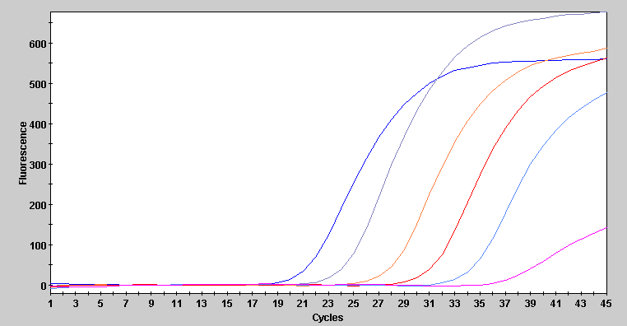
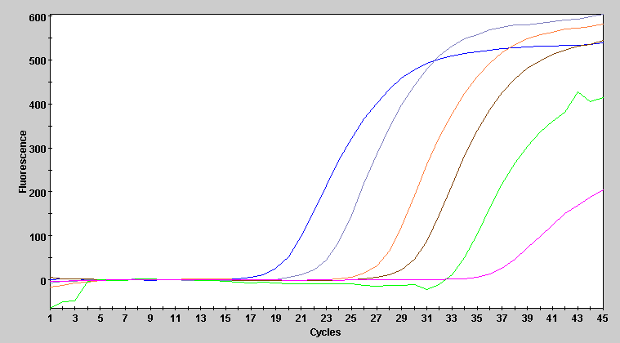
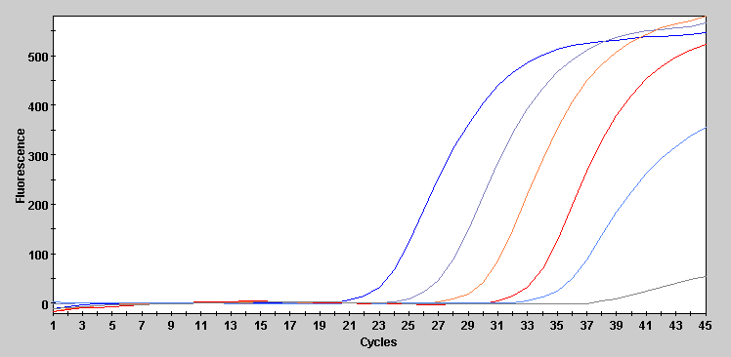
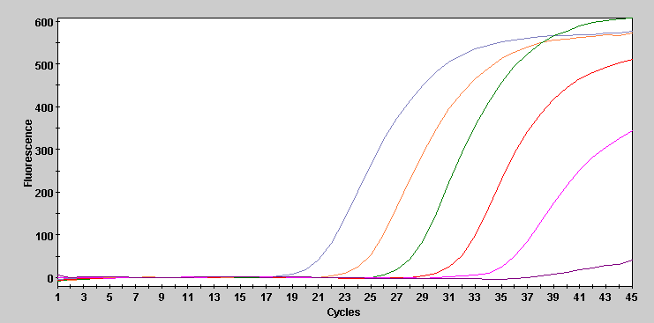
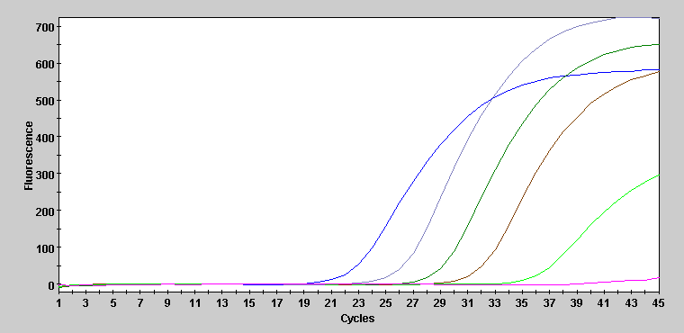
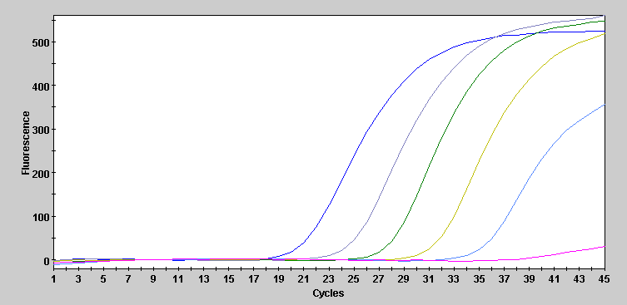
Supplemental Figure 12
- Selected DPE-PCR curves for 6 additional gram negative bacteria
E. cloacae
P. aeruginosa
e4
e3
e2
e1
e0
NIC
e4
e3
e2
e1
e0
NIC
A. baumannii
H. influenzae
e4
e3
e2
e1
e0
NIC
e4
e3
e2
e1
e0
NIC
K. pneumoniae
S. marcescens
e4
e3
e2
e1
e0
e4
e3
e2
e1
e0
NIC
NIC

Slide 13
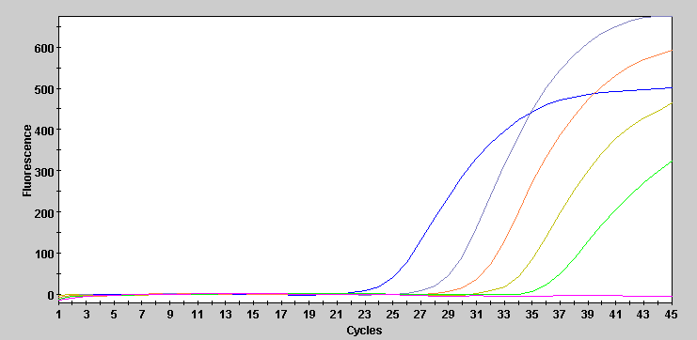
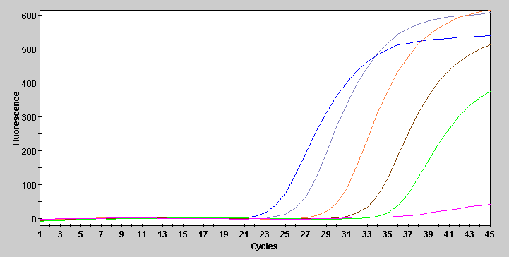
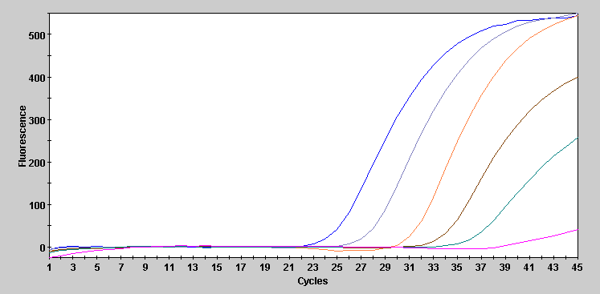
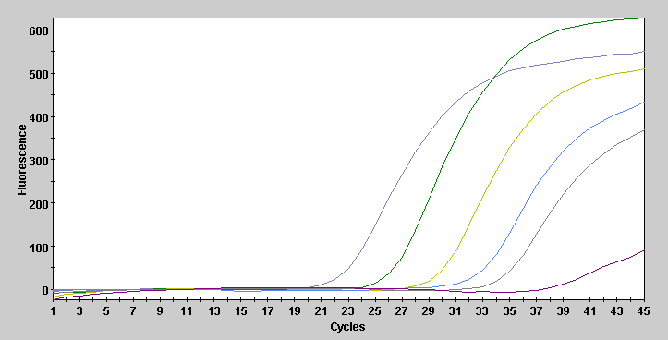
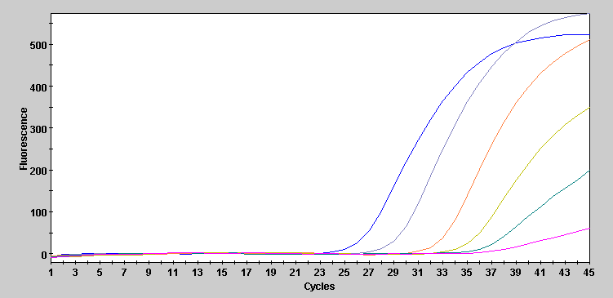
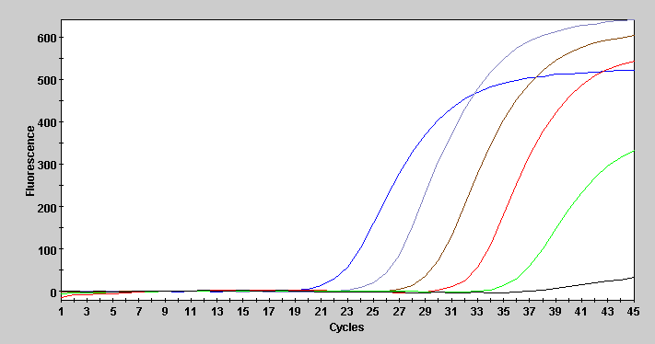
Supplemental Figure 13
- Selected DPE-PCR curves for 6 additional gram positive bacteria
E. faecium
S. pyogenes
e4
e3
e2
e1
e0
e4
e3
e2
e1
e0
NIC
NIC
E. faecalis
S. pneumoniae
e4
e3
e2
e1
e0
e4
e3
e2
e1
e0
NIC
NIC
S. agalactiae
S. epidermidis
e4
e3
e2
e1
e0
e4
e3
e2
e1
e0
NIC
NIC

Slide 14
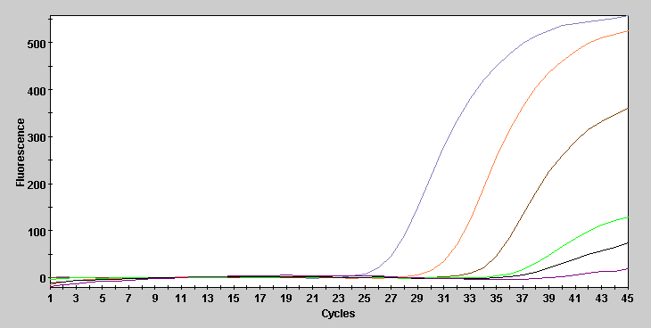
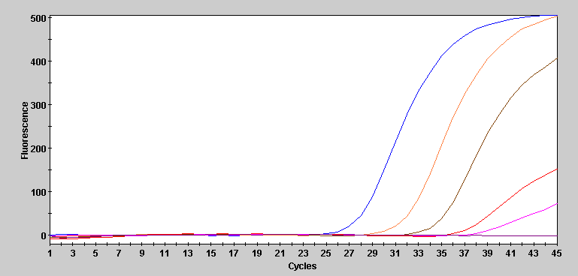
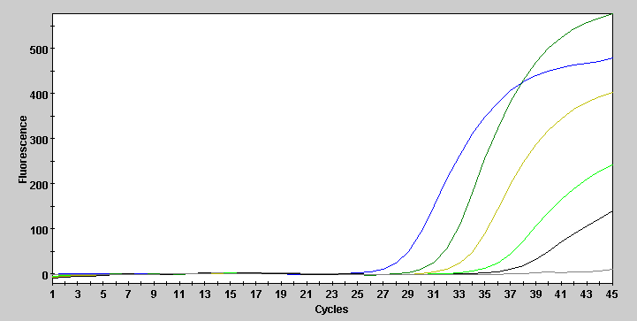
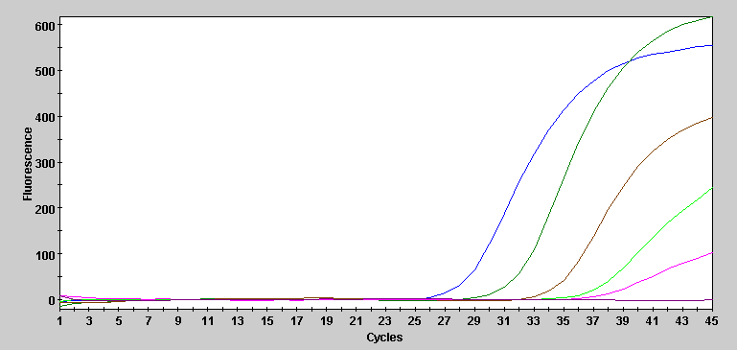
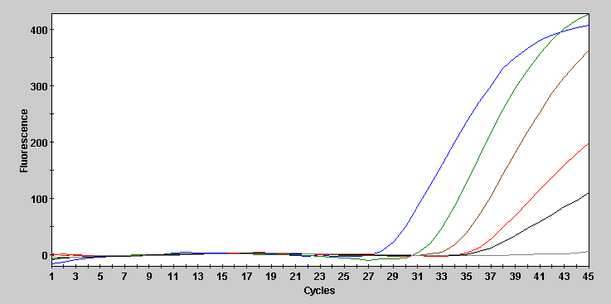
Supplemental Figure 14
C. glabrata
- Selected DPE-PCR curves for 5 Candida species
e5
e4
e3
e2
e1
NIC
C. albicans
C. krusei
e5
e4
e3
e2
e5
e4
e3
e2
e1
e1
NIC
NIC
C. tropicalis
C. parapsilosis
e5
e4
e3
e2
e1
e5
e4
e3
e2
e1
NIC
NIC

Slide 15
Supplemental Figure 15
Primer and probe sequences used for gene specific PCR-mediated detection of E. coli genomic DNA
Primer and probe sequences used for gene specific PCR-mediated detection of S. aureus genomic DNA
Thermoprofile for both gene specific PCR assays
A
uidA gene of E. coli
Forward Primer: 5’ caccgacatgtggagtgaag 3’
Reverse Primer: 5’ cgggtgaagatccctttctt 3’
Probe (5’ FAM labeled): 5’ ccgcgtctttgatcgcgtca 3’
B
nuc gene of S. aureus
Forward Primer: 5’ ctgaagcaagtgcatttacgaa 3’
Reverse Primer: 5’ agccaagccttgacgaactaa 3’
Probe (5’ FAM labeled): 5’ tatgctgatggaaaaatggtaaacaaagc 3’
C
Pre PCR 45 cycles
95 ° C 95 ° C
5 min. 5 sec. 60 ° C
1 min.

