Slide 1
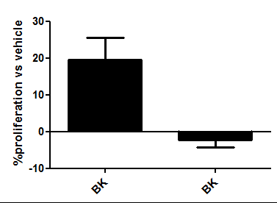
NTC siRNA
PDK1 siRNA
Supplementary Figure 1

