Slide 1
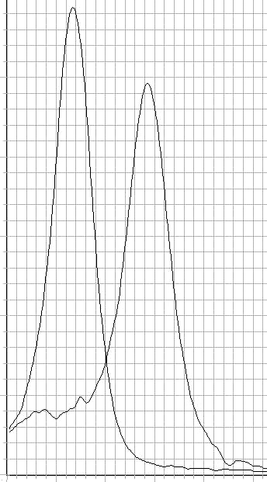
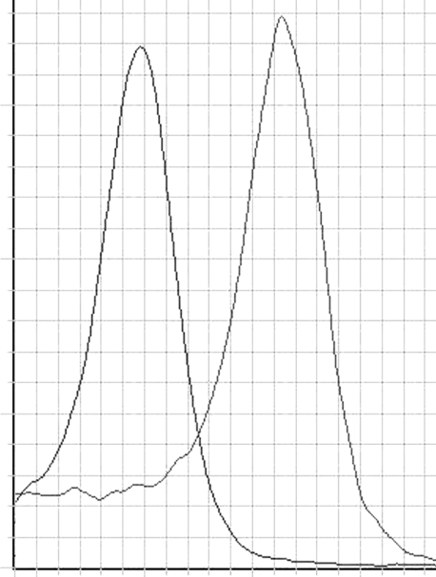
A
B
5
3
1
V3F
3
2
1
V3R
V3RL
V3FL
Derivative Reporter (Rn) 10⁶
Derivative Reporter (Rn) 10⁶
60 65 70 75 80 85 ºC
70 75 80 85 ºC
Figure 1

