Slide 1
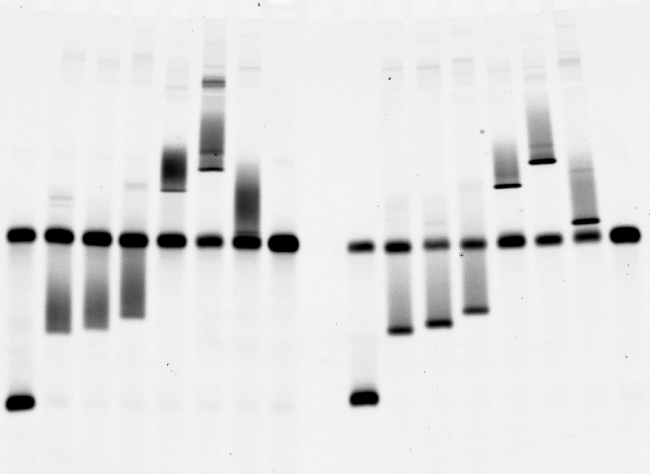
1 2 3 4 5 6 7 p 1 2 3 4 5 6 7 p
DNA/DNA duplexes
DNA/LNA duplexes
Figure 2

