Slide 1
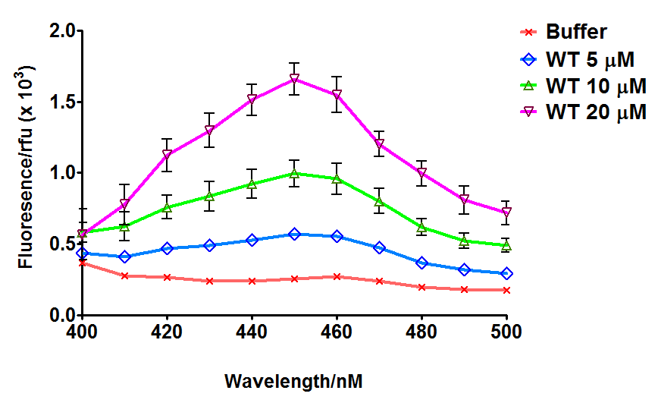
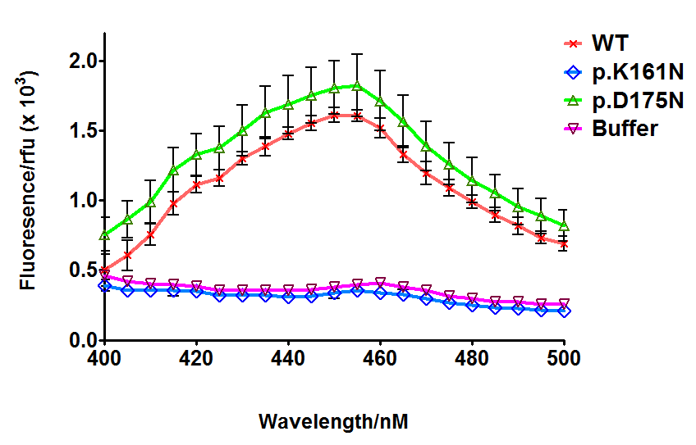
(a)
(b)
Wavelength/nm
Wavelength/nm

