Slide 1
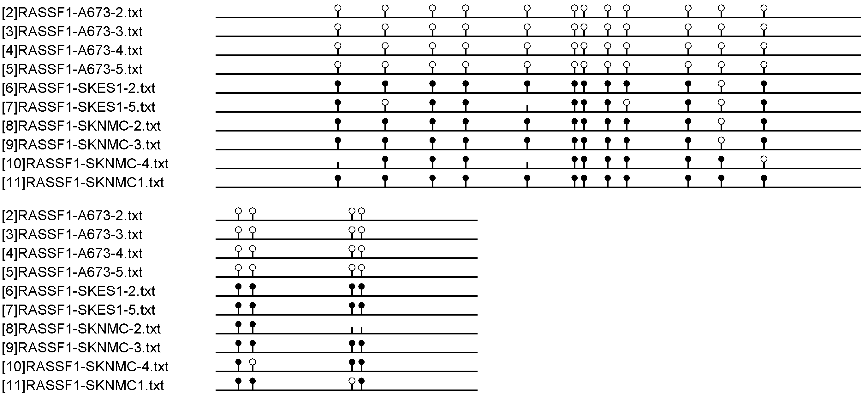
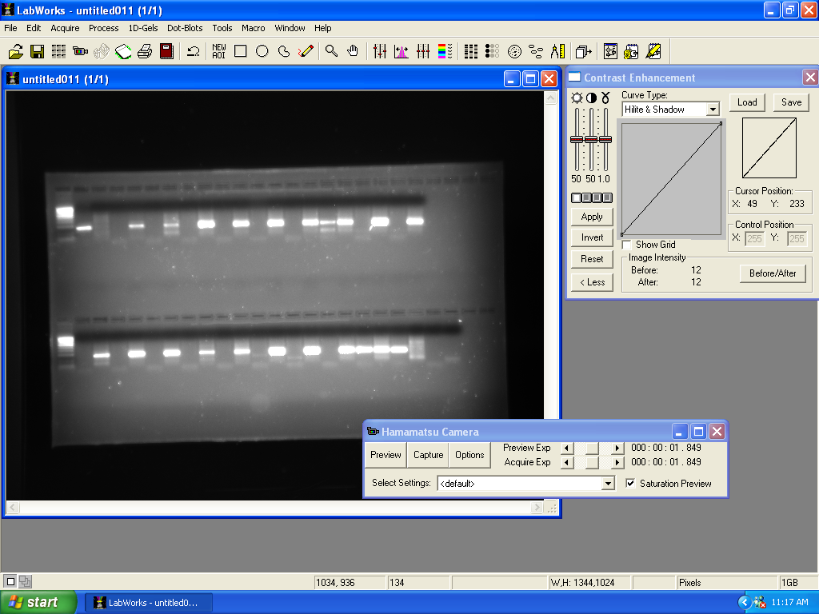
A.
Patel et al
Supplemental Figure S5
Tss
MSP CpGs
Bead chip CpG
Bisulfite sequencing Primers (-27 to +162 bp)
CpG Island
MSP Primers (--73 bp to +96 bp)
B.
A673
SK-N-MC
SK-ES-1
C.
Sssi
WGA
EWS1
EWS2
EWS3
EWS4
EWS5
EWS6
EWS7
EWS8
EWS9
EWS10
EWS11
EWS12
EWS13
M
U
M
U
M
U
M
U
M
U
M
U
M
U
M
U
M
U
M
U
M
U
M
U
M
U
M
U
M
U
A673
ES-1
N-MC
27a
M
U
M
U
M
U
M
U
D.
Supplementary Fig. S5: RASSF1A methylation analysis in EWS cell lines. A.) Schematic representing RASSF1A locus showing location of MSP primers, bisulfite sequencing primers, and bead chip CpG. Tss = transcription start site. B.) Bisulfite sequencing analysis of EWS cell lines. Bisulfite sequencing primers were designed using MethPrimer (F: 5’ GTAGTTTAATGAGTTTAGGTTTTTT 3’; R: 5’ ATCCCTACACCCAAATTTCCATTAC 3’). Filled lollipops denote methylated CpGs; empty lollipops denote unmethylated CpGs. C.) MSP analysis of EWS cell lines A673, SK-ES-1 (ES-1), and SK-N-MC (N-MC), and hMSC cell line HS-27a (27a) were determined using primers designed for methylated (F: 5’ GGGTTTTGCGAGAGCGCG 3’; R: 5’ GCTAACAAACGCGAACCG 3’) and unmethylated (F:5’ GGTTTTGTGAGAGTGTGTTTAG 3’; R: 5’ CACTAACAAACACAAACCAAAC 3’ ) RASSF1A. Positive (SssI treated DNA) and negative controls (WGA amplified DNA) are shown. M= methylated; U= unmethylated D.) RASSF1A methylation comparison of EWS primary tumors and cell lines.

