Slide 1
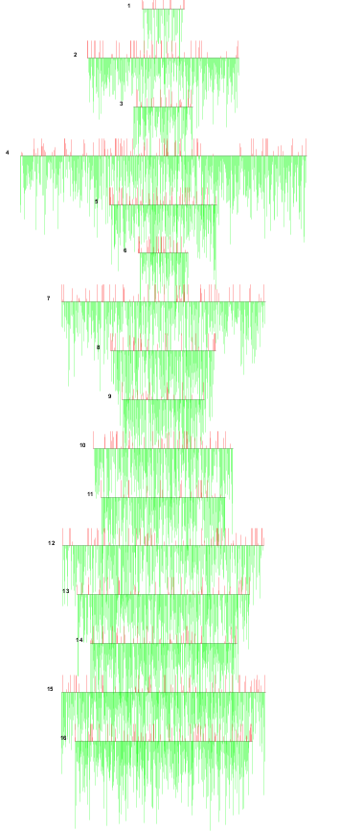
I
II
III
IV
V
IX
X
VI
XI
VII
XII
VIII
XIII
XIV
XV
XVI
Notes:
Additional file 6. Caryoscope representation of microarray data of S.kudriavzevii IFO1802. Array CGH data are shown in numerical order with chromosome I at the top and chromosome XVI at the bottom. Red signal indicates hybridization signal but it’s important to note the high normalization factor applied to the red signal (2) and the correction applied to the green one (0.49). This figure indicate that no cross hybridization has occurred between S. kudriavzevii genes and S. cerevisiae genes.

