Slide 1
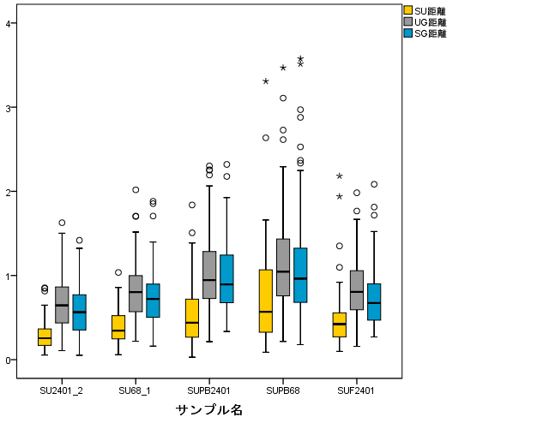
SU
4
UG
SG
3
Relative distance [μm]
2
1
0
F-LCL
M-LCL
F-PB
M-PB
F-FB
Notes:
ESD_2 Fig.3 Original data

