Slide 1
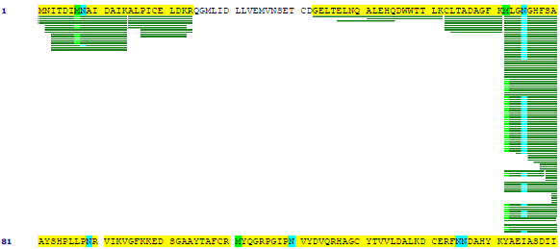
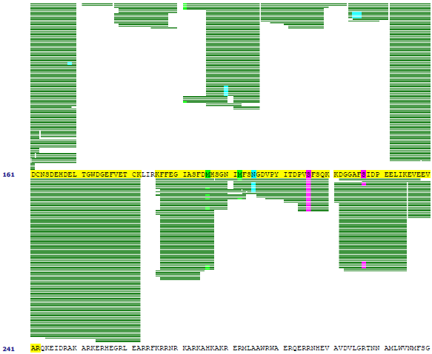
Supplemental Figure 2. Mass spectrometric analysis of tryptic peptides of
T7PK autophosphorylated in vitro
Supplemental Figure 2
Gone & Nicholson

Slide 2
Shown in green are aligned tryptic fragments of T7PK autophosphorylated in vitro. Ser216 is indicated by the star, and both Ser216 and Ser227 are shaded in pink. The sites of phosphorylation in the tryptic fragments also are shown in pink. Asparagine deamidation is indicated by light blue shading, and methionine oxidation by light green. See Materials and Methods for experimental details.

