Slide 1
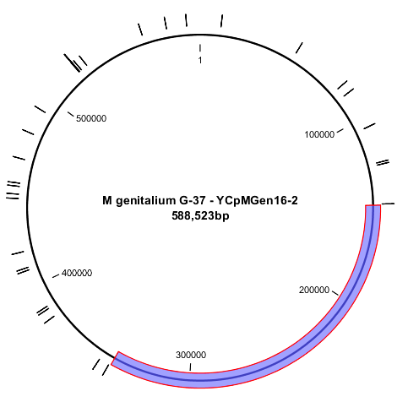
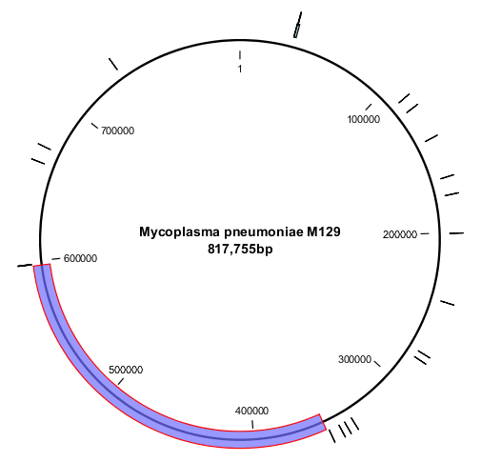
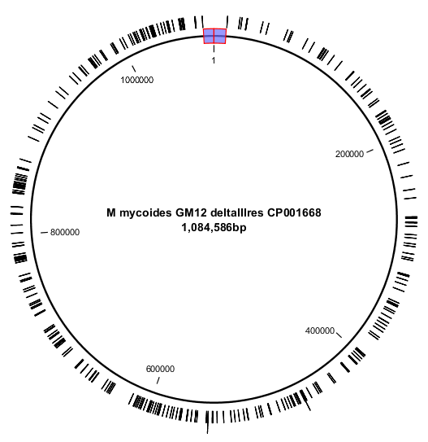
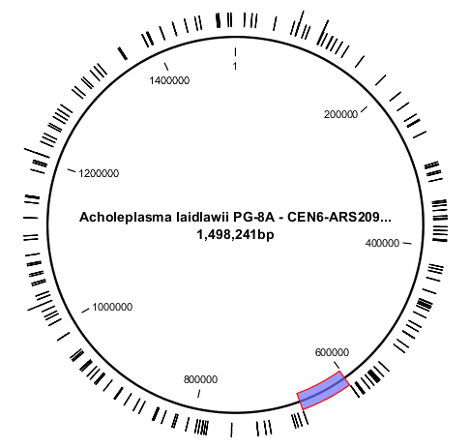
Supplementary Figure S1
11bp/17bp ACS sites: 27
biggest gap 198480 bp – GC-content 32%
11bp/17bp ACS sites: 21
biggest gap 246181 bp – GC-content 40%
11bp/17bp ACS sites: 303
biggest gap 21557 bp – GC-content 24%
11bp/17bp ACS sites: 179
biggest gap 65244 bp – GC-content 31.8%

Slide 2
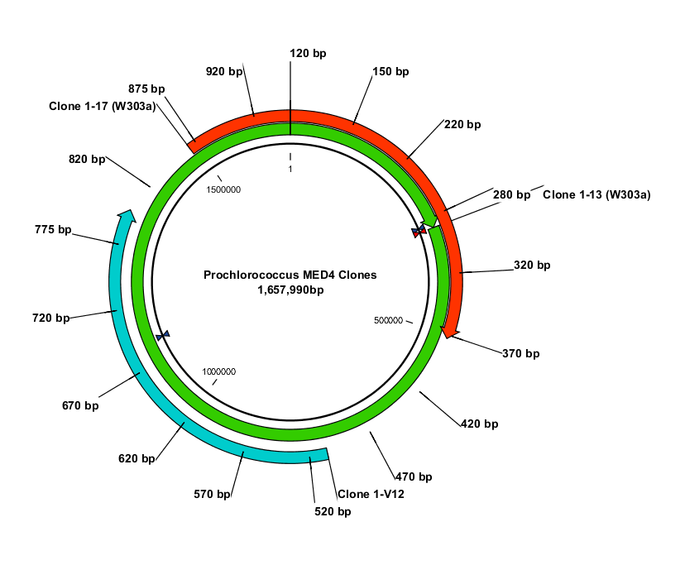
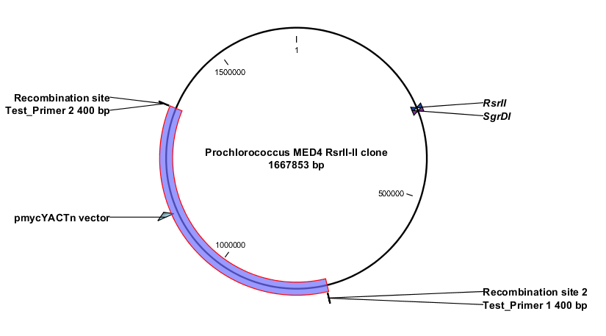
Supplementary Figure S2
(A.)
L 1-13 1-17 1-V12 wt H
2000 bp
1650 bp
1000 bp
850 bp
650 bp
500 bp
400 bp
RsrII
300 bp
SgrDI
200 bp
Prochlorococcus Clones
1-13: 1667 kb whole genome
1-V12: 583 kb partial genome
1-17: 675 kb partial genome
100 bp
RsrII
Gene PMM0328 (MutM)
Prochlorococcus MED4 Clones
1-V1 = 583 kb
1-V11 = 583 kb
1-V12 = 583 kb
Gene PMM1191 (Pnp)
(B.)
1-V12 Y H wt L
(C.)
L 1-V1 1-V11 1-V12 wt
1000 bp
900 bp
2000 bp
700 bp
500 bp
1650 bp
400 bp
1000 bp
300 bp
500 bp
200 bp
300 bp
100 bp
100 bp

