Slide 1
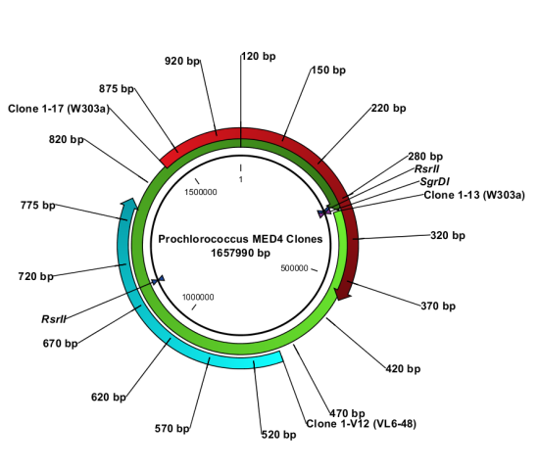
Supplementary Figure S3
Lane 1 2 3 4 5 6 7 8 9 10 11 12 13 14 15 16 17 18 19 20
L W303-1A 1-13 V 1-V12 1-V5 1-Y13 2-2 2-19 2-3 2-5 2-6 2-15 2-18 2-14 2-16 2-17 V-YPD 2-Y2 2-Y19
1000 bp
900 bp
800 bp
700 bp
RsrII-2
600 bp
500 bp
400 bp
300 bp
SgrDI
200 bp
100 bp
P. MED4 Clones 1-13 (SgrDI), 1-17 (SgrDI), 1-V12 (RsrII-2)
P. MED4 Clone 2-17
~ 200 kB
P. MED4 Clones 2-3, 2-5
~ 460 kB
P. MED4 Clone 1-V5
~ 350 kB
SgrDI
SgrDI
SgrDI
RsrII
SgrDI
P. MED4 Clone 2-14
~ 660-670 kB
P. MED4 Clone 2-6
~ 620 kB
P. MED4 Clones 2-2, 2-19
whole genomes
RsrII
SgrDI
SgrDI
SgrDI
P. MED4 Clone 2-16
~ 180 kB
P. MED4 Clone 2-18
~ 380 kB
P. MED4 Clone 2-15
~ 1 Mb
SgrDI
SgrDI
SgrDI

Slide 2
Supplementary Figure S3
Lane | Clone # | Sample | Clone Size
Lane 1 | L | 100 bp ladder Invitrogen
Lane 2 | W303-1A | W303-1A wt gDNA
Lane 3 | 1-13 | P. MED4 Clone 1-13 (W303-1A) grown in –HIS medium | Whole genome clone 1667852 bp
Lane 4 | V | W303-1A wt plus cloning vector only grown in –HIS medium
Lane 5 | 1-V12 | Clone 1-V12 (VL6-48) | 583042 bp
Lane 6 | 1-V5 | Clone 1-V5 (VL6-48) | ~ 350 kB
Lane 7 | 1-Y13 | P. MED4 Clone 1-13 (W303-1A) grown in YPD | Whole genome clone 1667852 bp
Lane 8 | 2-2 | P. MED4 Clone 2-2 (W303-1A) grown in –HIS medium | Whole genome clone 1667852 bp
Lane 9 | 2-19 | P. MED4 Clone 2-19 (W303-1A) grown in –HIS medium | Whole genome clone 1667852 bp
Lane 10 | 2-3 | P. MED4 Clone 2-3 (W303-1A) grown in –HIS medium | ~ 460 kB
Lane 11 | 2-5 | P. MED4 Clone 2-5 (W303-1A) grown in –HIS medium | ~ 460 kB
Lane 12 | 2-6 | P. MED4 Clone 2-6 (W303-1A) grown in –HIS medium | ~ 620 kB
Lane 13 | 2-15 | P. MED4 Clone 2-15 (W303-1A) grown in –HIS medium | ~ 1 MB
Lane 14 | 2-18 | P. MED4 Clone 2-18 (W303-1A) grown in –HIS medium | ~ 380 kB
Lane 15 | 2-14 | P. MED4 Clone 2-14 (W303-1A) grown in –HIS medium | ~ 660 kB
Lane 16 | 2-16 | P. MED4 Clone 2-16 (W303-1A) grown in –HIS medium | ~ 180 kB
Lane 17 | 2-17 | P. MED4 Clone 2-17 (W303-1A) grown in –HIS medium | ~ 200 kB
Lane 18 | V-YPD | W303-1A wt plus cloning vector only grown in YPD
Lane 19 | 2-Y2 | P. MED4 Clone 2-2 (W303-1A) grown in YPD | Whole genome clone 1667852 bp
Lane 20 | 2-Y19 | P. MED4 Clone 2-19 (W303-1A) grown in YPD | Whole genome clone 1667852 bp

