Slide 1
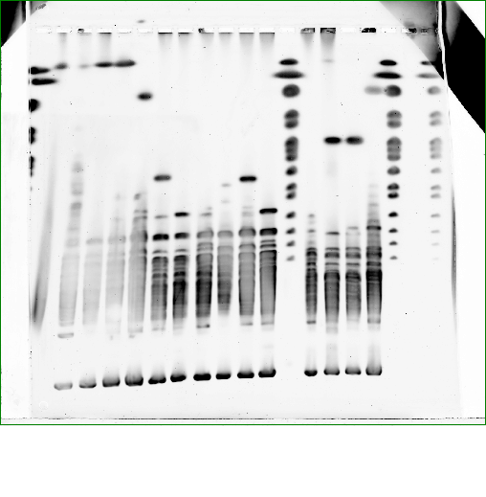
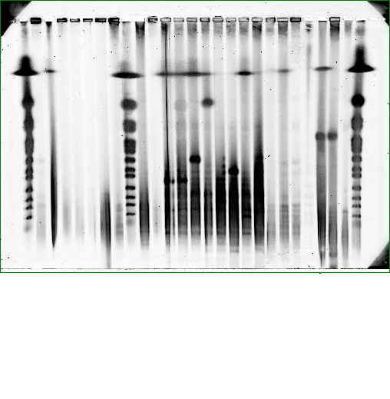
Supplementary Figure S4 (A.)
Lane | Clone # | Sample | Restriction enzyme used
Lane 1 | wt | Prochlorococcus MED4 wt gDNA | AsiSI
Lane 2 | 1-13 | P. MED4 Clone 1-13 (W303-1A) | NotI
Lane 3 | 2-2 | P. MED4 Clone 2-2 (W303-1A) | NotI
Lane 4 | 2-19 | P. MED4 Clone 2-19 (W303-1A) | NotI
Lane 5 | 2-15 | P. MED4 Clone 2-15 (W303-1A) | NotI
Lane 6 | 1-17 | P. MED4 Clone 1-17 (W303-1A) | NotI
Lane 7 | 2-3 | P. MED4 Clone 2-3 (W303-1A) | NotI
Lane 8 | 2-17 | P. MED4 Clone 2-17 (W303-1A) | NotI
Lane 9 | 2-6 | P. MED4 Clone 2-6 (W303-1A) | NotI
Lane 10 | 2-14 | P. MED4 Clone 2-14 (W303-1A) | NotI
Lane 11 | 2-5 | P. MED4 Clone 2-5 (W303-1A) | NotI
Lane 12 | M | Yeast chromosome marker | none
Lane 13 | W303-1A | W303-1A wt gDNA | RsrII
Lane 14 | 2-2 | P. MED4 Clone 2-2 (W303-1A) | RsrII
Lane 15 | 2-19 | P. MED4 Clone 2-19 (W303-1A) | RsrII
Lane 16 | 2-15 | P. MED4 Clone 2-15 (W303-1A) | RsrII
Lane 17 | M | Yeast chromosome marker | none
1 2 3 4 5 6 7 8 9 10 11 12 13 14 15 16 17
1,900 Kb
1,640 Kb
1,120 / 1,100 Kb
945 Kb
915 Kb
815 Kb
680 Kb
610 Kb
555 Kb
450 Kb
375 Kb
295 Kb
225 Kb
1 2 3 4 5 6 7
(B.)
1,900 / 1,640 Kb
Lane | Clone # | Sample | Restriction enzyme used
Lane 1 | 2-Y19 | P. MED4 Clone 2-19 (W303-1A) | NotI
Lane 2 | V | W303-1A wt cloning vector only | NotI
Lane 3 | M | Yeast chromosome marker | none
Lane 4 | wt | Prochlorococcus MED4 wt gDNA | RsrII
Lane 5 | 2-Y19 | P. MED4 Clone 2-19 (W303-1A) | RsrII
Lane 6 | V | W303-1A wt cloning vector only | RsrII
Lane 7 | M | Yeast chromosome marker | none
1,120 / 1,100 Kb
945 Kb
915 Kb
815 Kb
680 Kb
555 Kb
450 Kb
225 Kb

Slide 2
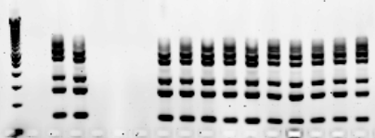
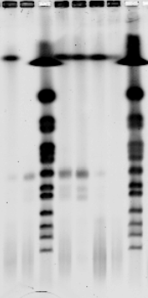
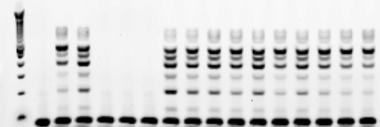
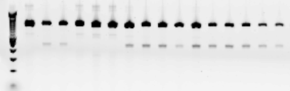
Supplementary Figure S5 (A.)
Fragment size
L 3-1 3-2 3-3 3-4 3-5 3-6 3-7 3-8 3-9 3-10 3-11 3-12 3-13 3-14 3-15 3-16
1 2 3 4 5 6 7 8
bp
875
775
670
570
470
370
1000 bp
800 bp
1,900 / 1,640 Kb
600 bp
500 bp
1,120 / 1,100 Kb
400 bp
300 bp
280
150
945 Kb
200 bp
915 Kb
815 Kb
100 bp
680 Kb
L 3-1 3-2 3-3 3-4 3-5 3-6 3-7 3-8 3-9 3-10 3-11 3-12 3-13 3-14 3-15 3-16
bp
555 Kb
920
820
720
620
520
420
450 Kb
1000 bp
800 bp
225 Kb
600 bp
500 bp
400 bp
300 bp
320
220
120
200 bp
Lane | Clone # | Sample | Restriction enzyme used
Lane 1 | 3-3 | P. MED4 Clone 3-3 (W303-1A) | NotI
Lane 2 | 3-4 | P. MED4 Clone 3-3 (W303-1A) | NotI
Lane 3 | M | Yeast chromosome marker | none
Lane 4 | 3-7 | P. MED4 Clone 3-7 (W303-1A) | NotI
Lane 5 | 3-8 | P. MED4 Clone 3-8 (W303-1A) | NotI
Lane 6 | 3-9 | P. MED4 Clone 3-9 (W303-1A) | NotI
Lane 7 | 3-10 | P. MED4 Clone 3-10 (W303-1A) | NotI
Lane 8 | M | Yeast chromosome marker | none
100 bp
L 3-1 3-2 3-3 3-4 3-5 3-6 3-7 3-8 3-9 3-10 3-11 3-12 3-13 3-14 3-15 3-16
bp
1000
500
1000 bp
800 bp
600 bp
500 bp
400 bp
300 bp
200 bp
100 bp
Notes:
0317 and 031811 scans

Slide 3
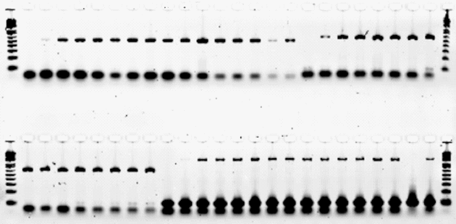
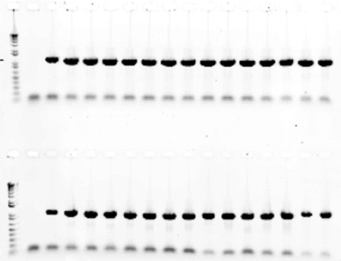

Supplementary Figure S5 (B.)
PMM1294 – (471 bp) PMM0039 - (609 bp)
L V 1-13 2-2 2-19 3-2 3-3 3-7 3-8 3-9 3-10 3-11 3-12 3-13 3-14 3-15 3-16 V 1-13 2-2 2-19 3-2 3-3 3-7 3-8 L
1000 bp
500 bp
300 bp
100 bp
PMM0039 - (609 bp) PMM0214 - (1656 bp)
L 3-9 3-10 3-11 3-12 3-13 3-14 3-15 3-16 V 1-13 2-2 2-19 3-2 3-3 3-7 3-8 3-9 3-10 3-11 3-12 3-13 3-14 3-15 3-16 L
1000 bp
500 bp
300 bp
100 bp
PMM1600 - (1368 bp)
PMM0214 - (1656 bp)
L V 1-13 2-2 2-19 3-2 3-3 3-7 3-8 3-9 3-10 3-11 3-12 3-13 3-14 3-15 3-16 L V 1-13 3-15
1000 bp
500 bp
PMM0844 - (1173 bp)
2000 bp
1650 bp
L V 1-13 2-2 2-19 3-2 3-3 3-7 3-8 3-9 3-10 3-11 3-12 3-13 3-14 3-15 3-16
1000 bp
1000 bp
500 bp

Slide 4





Supplementary Figure S6
Clone # | Cell Samples
V | W303-1A wt cloning vector only
1-13 | P. MED4 Clone 1-13 (W303-1A)
2-2 | P. MED4 Clone 2-2 (W303-1A)
2-19 | P. MED4 Clone 2-19 (W303-1A)
-HIS -HIS-LYS -HIS-URA -HIS-LEU -HIS-TRP
V
1-13
2-2
2-19

Slide 5
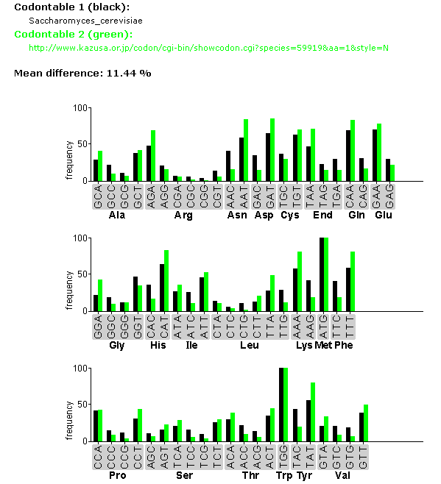
Supplementary Figure S7
S. cerevisiae: MED4

Slide 6
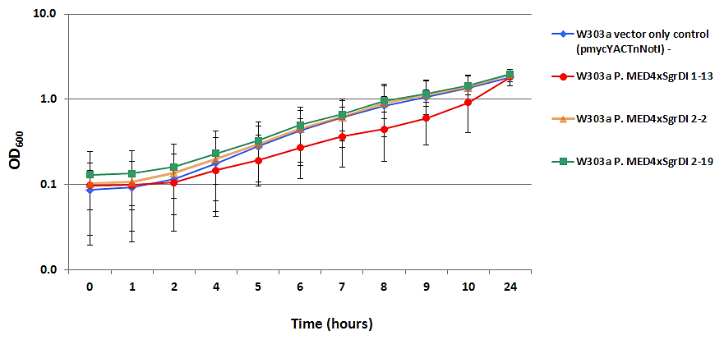
Supplementary Chart 1

