Slide 1
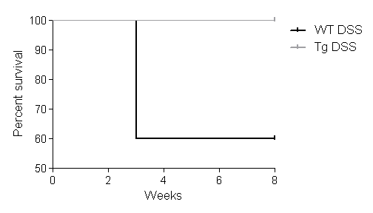








A
B
*
**
**
*
*
Body weight change in percentage
Body weight change in percentage
*
1
2
3
4
5
6
7
8
Weeks
1
2
3
4
5
6
7
8
Weeks
Start DSS
Sacrifice
End 1st DSS
End 2nd DSS
1 week recov
1 week recov
Start 2nd DSS
2 week recov
C
D
100
8/8
WT DSS
*
90
Tg DSS
*
80
Total clinical score
Percent survival
70
60
12/20
Week:
2
5
50
0
2
4
6
8
End 1st DSS
End 2nd DSS
Weeks
E
F
DSS
DSS:
WT
Tg
IP: PHB
Neg ctl
Mouse # 1 2 1 2
WT
Tg
p53
53 kDa
IB: pSTAT3
92 kDa
PUMA
23 kDa
IB: STAT3
92 kDa
Bcl-2
26 kDa
IB: p53
53 kDa
Bcl-xL
30 kDa
IB: PHB
32 kDa
β-actin
42 kDa
Supplemental Figure 1. PHB Tg show less inflammation-induced weight loss and sustained survival when treated with DSS without AOM injection. (A) Percent change in body weight of WT and Tg control mice maintained with water or injected with AOM and given water for the remainder of the experiment. (B) Percent change in body weight of WT and Tg mice treated with two cycles of DSS without AOM injection. *P < 0.05 and **P < 0.01 vs. WT DSS. (C) Clinical score following DSS treatment. End 1st cycle DSS: n = 20 WT; n = 8 Tg. End 2nd cycle DSS: n = 12 WT; n = 8 Tg. (D) Percent survival of WT and Tg mice treated with two cycles of DSS without AOM injection. P = 0.037. (E) PHB was immunoprecipitated from colon mucosal protein lysates from DSS-treated mice, followed by immunoblot for pSTAT3, STAT3 or p53 expression. Omission of primary antibody during the immunoprecipitation was performed as a negative control. (F) Representative Western blots of total protein isolated from colonic mucosal strippings from DSS-treated mice were probed for p53, PUMA, Bcl-2, and Bcl-xL.

