Slide 1
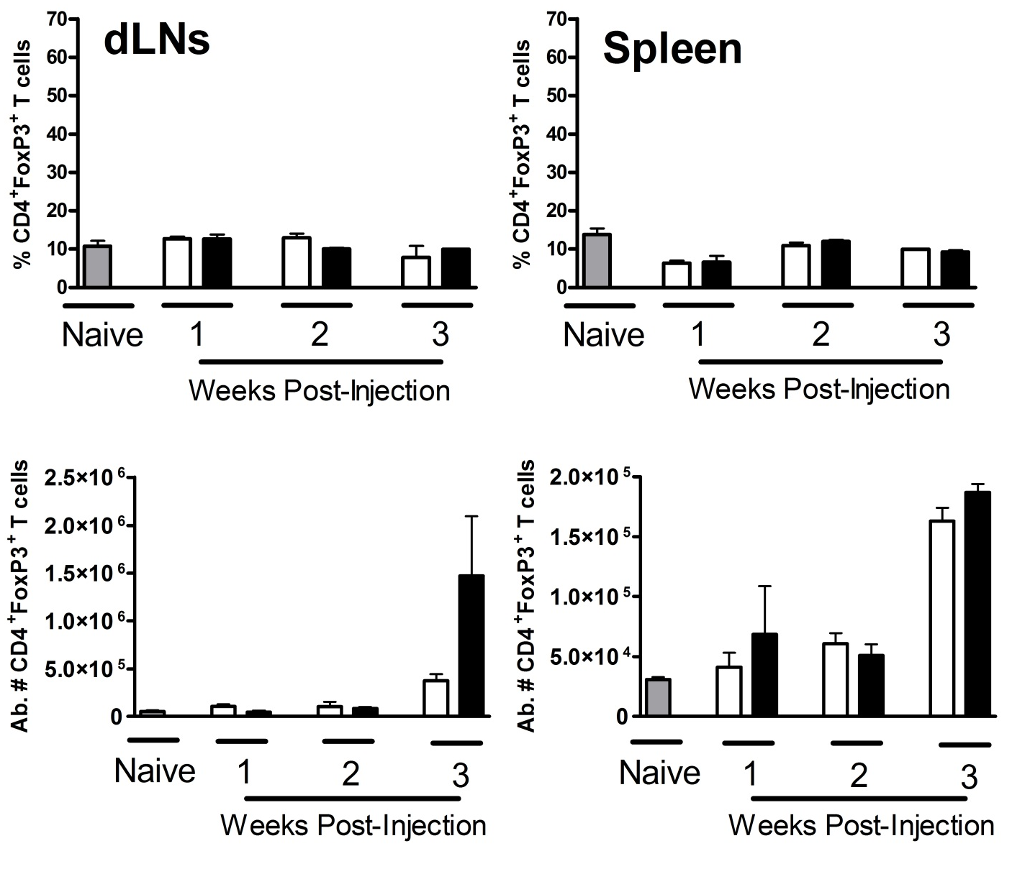
A
B
WT mice ic. V_{c} GL261
WT mice ic. IDO_{kd} GL261
Supplemental Figure 3: Brain tumor derived IDO and peripheral Tregs

