Slide 1
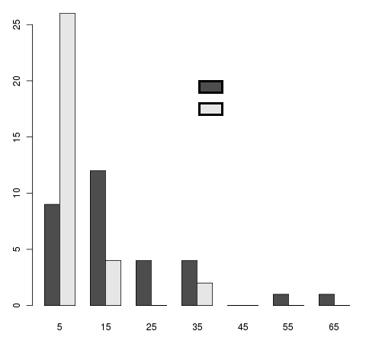
HSAs (human specific alterations per 1kb of selected peaks)
Hnp specific for human neurons
control
number of HSA
Neuron-restricted hnp: 20 HSAs per 1kb in peaks versus 8.36 in control
HSAs per 1kb
Case mean: 20.08 ± 5.52 HSAs per 1kb
Control mean: 8.36 ± 2.44 HSAs per 1kb

