Slide 1

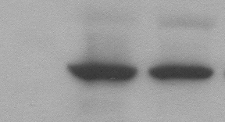
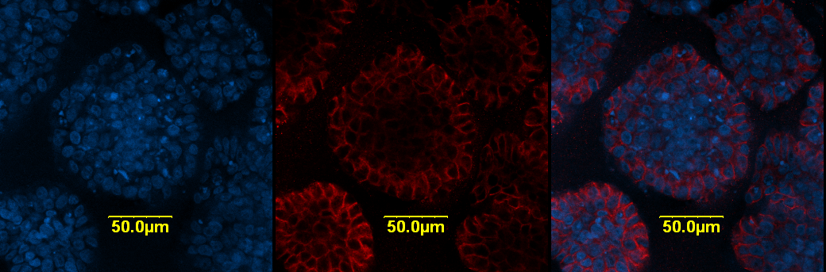
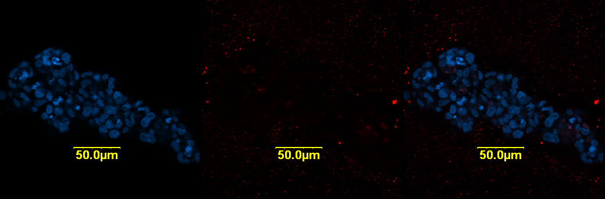
Supplementary Figure S1
HME:
DAPI/ E-cadherin
Control
CCN6 KD
Control
E-cadherin
CCN6 KD
β-Actin

