Slide 1
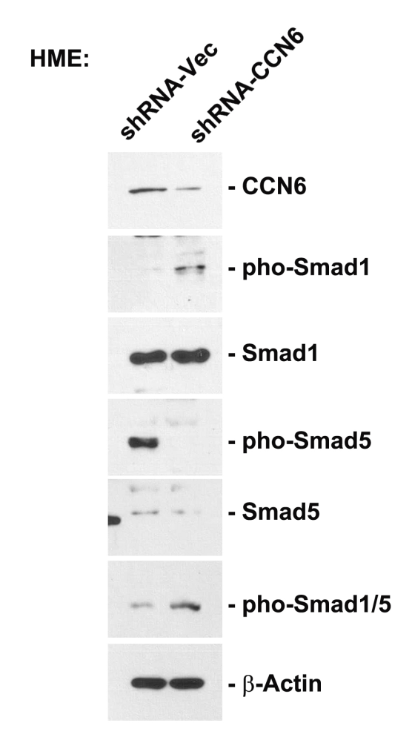

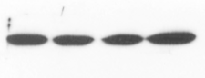
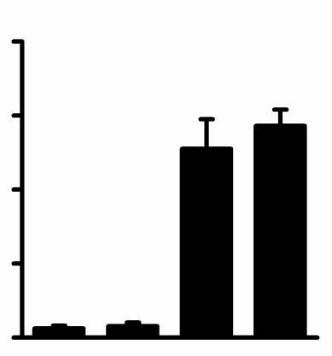
Supplementary Figure S2
A
B
CCN6 shRNA
-
-
+
+
Smad1 siRNA
-
+
-
+
Smad1
β-Actin
400
300
200
No. of invading cells
100
0
-
-
+
+
CCN6 shRNA
-
-
Smad1 siRNA
+
+

