Slide 1
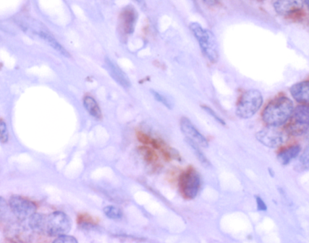
Supplementary Figure S4
Human invasive carcinoma

