Slide 1
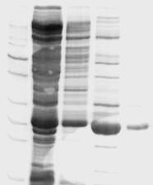
kDa
1 2 3 4 5
85-
70-
60-
50-
40-
30-
25-
20-
15-
Additional file 1: Figure S1. SDS-PAGE analysis of overproduced and purified B. cereus Fnr.
Samples of the purification fractions were analyzed by electrophoresis on an reducing SDS-12% polyacrylamide gel followed by Coomassie Brillant Blue staining. The position and mass (kDa) of molecular weight markers (lanes 1) are given on the left. Lane 1, standard proteins. Lane 2, soluble whole cell extract from E. coli. Lane 3, DE52 flow-through. Lane 4, hydroxyapatite pool. Lane 5, purified protein after Superdex 200 size exclusion chromatography.

