Slide 1
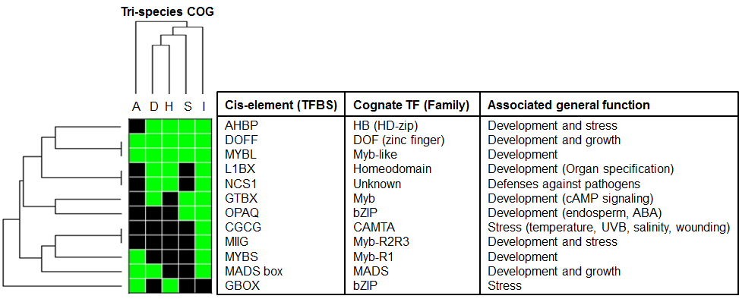
Motif present (1)
Motif absent (0)
Figure 5
Additional file 5

