Slide 1
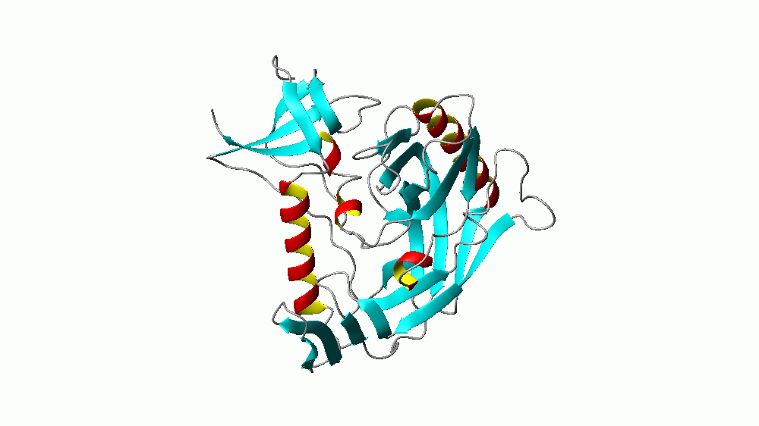
Supporting Figure 2
A gp120:CD4
ω₁ =4.97cm⁻¹
Mode 1

Slide 2
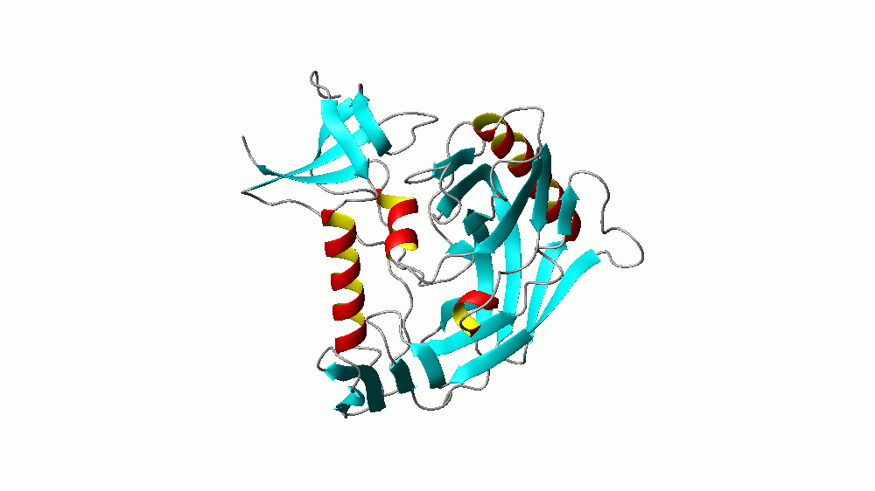
Supporting Figure 2
B gp120:CD4
ω₂ =5.70cm⁻¹
Mode 2

Slide 3
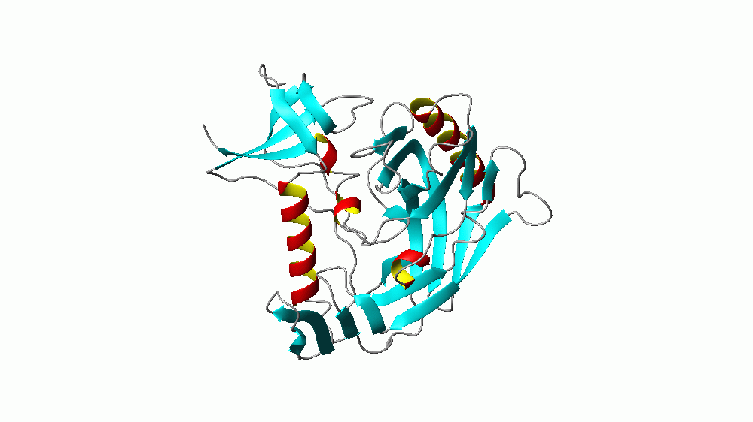
Supporting Figure 2
C gp120:CD4
ω₃ =5.85cm⁻¹
Mode 3

Slide 4

Supporting Figure 2
D gp120:CD4
ω₄ =6.46cm⁻¹
Mode 3
Figure S2

