Slide 1
A
D
0.0002
0.003
B
E
0.0004
0.0004
0.0006
C
F
0.0021
Figure 1.

Slide 2
Table 1. Gene microarray table illustrating fold change in gene expression of HNSCC cells treated with nisin compared to untreated controls.
Symbol | Description | Gene Ontology | Fold Change
CHAC1 | ChaC, cation transport regulator homolog 1 (E. coli) | Protein binding | 4.42976
PDE4C | phosphodiesterase 4C, cAMP-specific (phosphodiesterase E1 dunce homolog, Drosophila) | Signal Transduction | 4.29073
LGALS1 | lectin, galactoside-binding, soluble, 1 (galectin 1) | Sugar binding Regulation of apoptosis | 3.64717
S100P | S100 calcium binding protein P | Calcium ion binding Calcium-dependent protein binding | 3.21482
STC2 | stanniocalcin 2 | Cell surface receptor linked signal trasduction Response to nutrient | 3.17316
PILRA | paired immunoglobin-like type 2 receptor alpha | Protein binding Signal transduction Integral to membrane | 2.58501
ARC | activity-regulated cytoskeleton-associated protein | Membrane Cell junction | 2.35159
PYGM | phosphorylase, glycogen; muscle (McArdle syndrome, glycogen storage disease type V) | Carbohydrate metabolic process Glycogen catabolic process Glycogen phosphorylase activity | 2.34776
RAB3A | RAB3A, member RAS oncogene family | Membrane | 2.26615
TEX14 | testis expressed 14 | ATP binding | 2.24405
SDPR | serum deprivation response (phosphatidylserine binding protein) | Phosphatidylserine binding Membrane fraction | 2.20425
PLA2G12B | phospholipase A2, group XIIB | Phospholipase A2 activity Calcium ion binding Lipid catabolic process | 2.18512
ITGAM | integrin, alpha M (complement component 3 receptor 3 subunit) | Magnesium ion binding Calcium ion binding External side of plasma membrane Integral to membrane | 2.13638
SESN2 | sestrin 2 | Cell cycle arrest | 2.13004
PRR3 | proline rich 3 | Zinc ion binding Metal ion binding | 2.09132
CYP2B6 | cytochrome P450, family 2, subfamily B, polypeptide 6 | Endoplasmic reticulum Electron transport Membrane Metal ion binding | 2.06563
LAMA4 | laminin, alpha 4 | Receptor binding | 2.03249
NR4A2 | nuclear receptor subfamily 4, group A, member 2 | Seteroid hormone receptor activity Zinc ion binding Metal ion binding | 2.02835
ZNF34 | zinc finger protein 34 | Zinc ion binding Metal ion binding | 2.02091
TNFSF11 | tumor necrosis factor (ligand) superfamily, member 11 | Integral to plasma membrane Membrane Cell differentiation | 2.00225
Symbol | Description | Gene Ontology | Fold Change
ZBTB24 | zinc finger and BTB domain containing 24 | Metal ion binding | -3.76108
ZBTB24 | zinc finger and BTB domain containing 24 | Metal ion binding | -3.5799
ARHGAP11B | Rho GTPase activating protein 11B | Signal transduction | -2.5269
ALS2 | amyotrophic lateral sclerosis 2 (juvenile) | Response to oxidative stress | -2.52641
TRSPAP1 | tRNA selenocysteine associated protein 1 | Protein binding | 2.43763
MARS2 | methionyl-tRNA synthetase 2, mitochondrial | Mitochondrion Mitochondrial matrix | -2.36375
FST | follistatin | Negative regulation of cell differentiation | -2.34739
SETX | senataxin | ATP binding Cell death | -2.30816
PARG | poly (ADP-ribose) glycohydrolase | Response to DNA damage stimulus | -2.27345
KCTD1 | potassium channel tetramerisation domain containing 1 | Voltage-gated potassium channel activity Protein binding Potassium ion transport Voltage-gated potassium channel complex Memembrane | -2.26108
PPAN | peter pan homolog (Drosophila) | Protein binding | -2.2312
ZNF718 | zinc finger protein 718 | Zinc ion binding Metal ion binding | -2.1316
MED13 | mediator complex subunit 13 | Receptor activity Transcription | -2.11608
CCNT2 | cyclin T2 | Cell cycle Cell division | -2.01302

Slide 3
A
B
C
0.0004
0.0008
Calcium influx
(Relative Fluoresence
0.00178
0.0045
CTRL
Nisin (80 μg/ml)
CTRL
BP (5 μM)
BP (μM)
Nisin (80 μg/ml)
Nisin (80 μg/ml)
Figure 2.

Slide 4
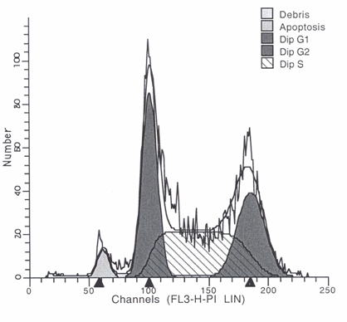
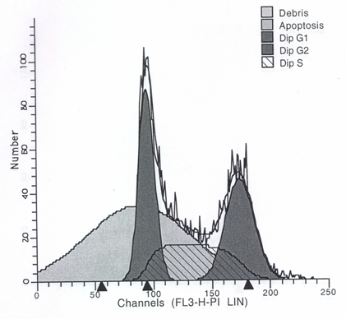
CTRL
Nisin
G2
(26.78%)
Apoptosis
(57.34%)
G2
(44.34%)
Apoptosis
(4.25%)
Figure 3

Slide 5
C
A
CTRL
Nisin
Chac 1
β-actin
B
CTRL siRNA
Chac1 siRNA
CTRL
Chac 1
β-actin
D
0.019
Nisin
Figure 4.

Slide 6

A
B
CTRL
Chac1 cDNA
Chac 1
β-actin
0.0245
Proliferation (Fold change)
C
D
Nisin
Figure 5.

Slide 7
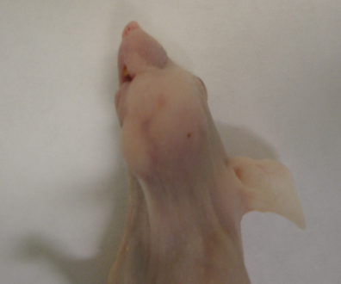
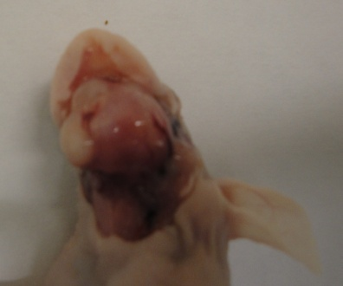
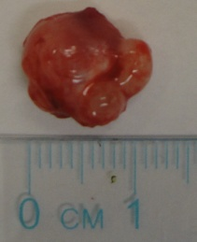
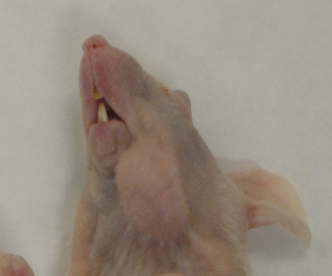
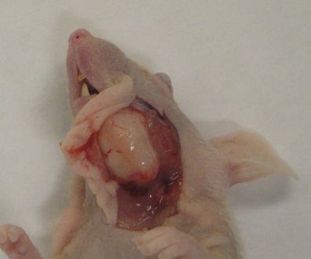
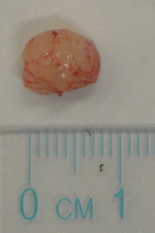
A
B
n=9
CTRL
n=10
0.015
Nisin
(200 mg/kg)
CTRL
Figure 6.

Slide 8


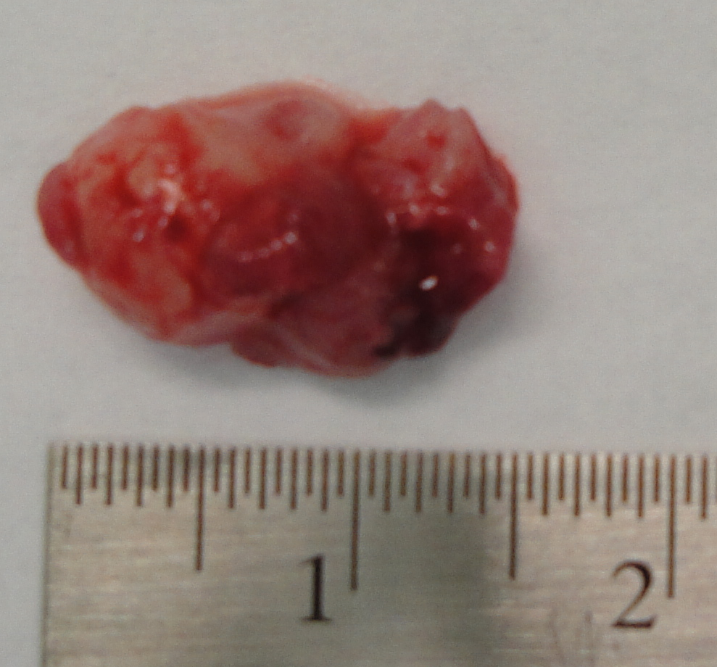
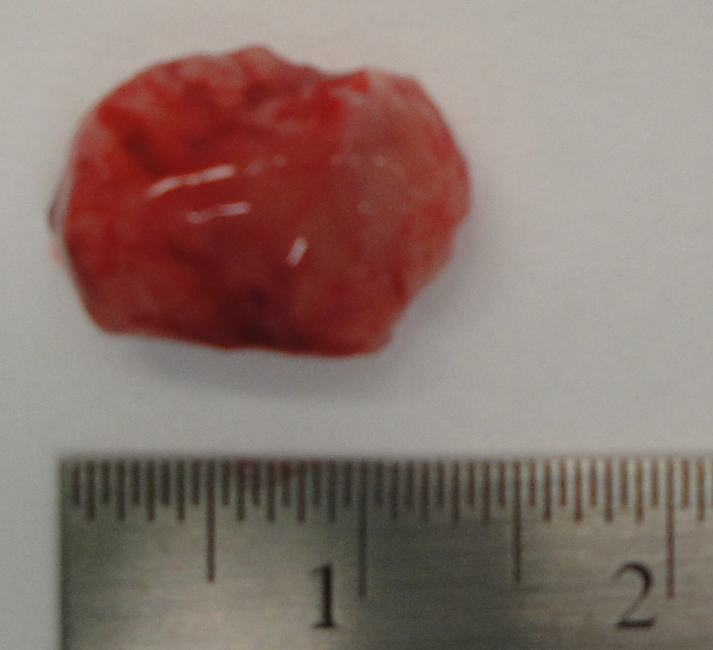
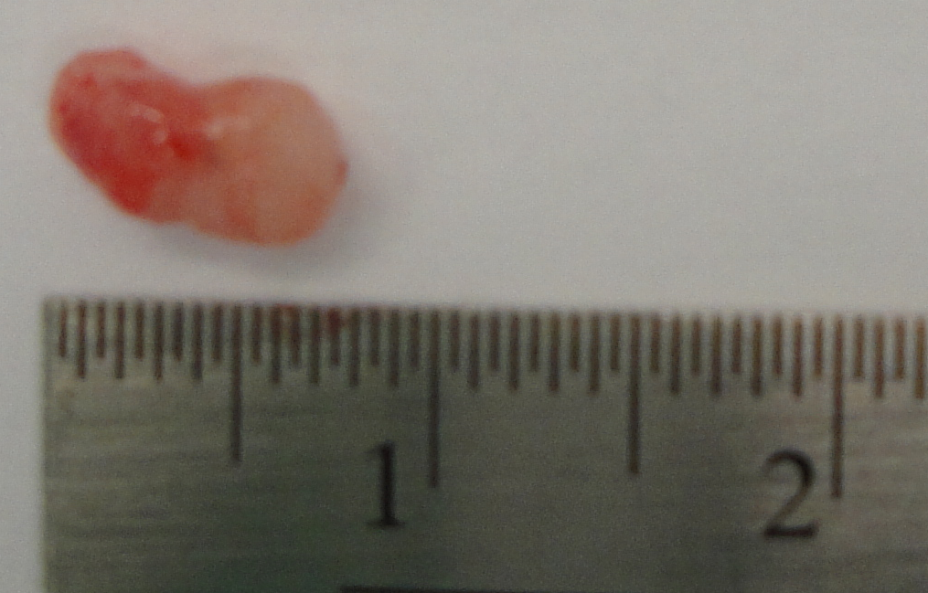
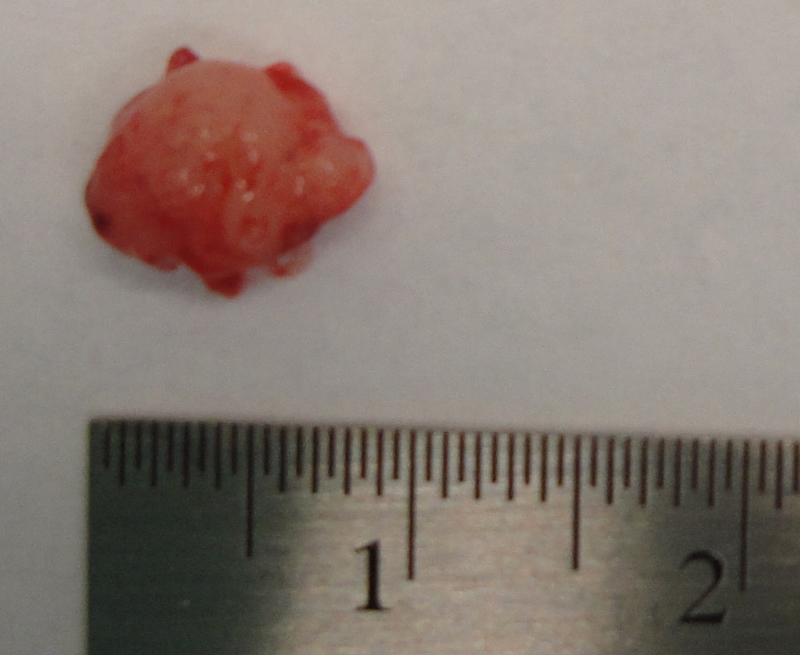
A
B
CTRL shRNA
Chac1 shRNA
n=7
0.048
Chac 1
n=8
*
β-actin
n=7
CTRL shRNA
Chac1 shRNA
n=7
CTRL
Nisin
Nisin
(200 mg/kg)
0.048
Figure 7.

Slide 9
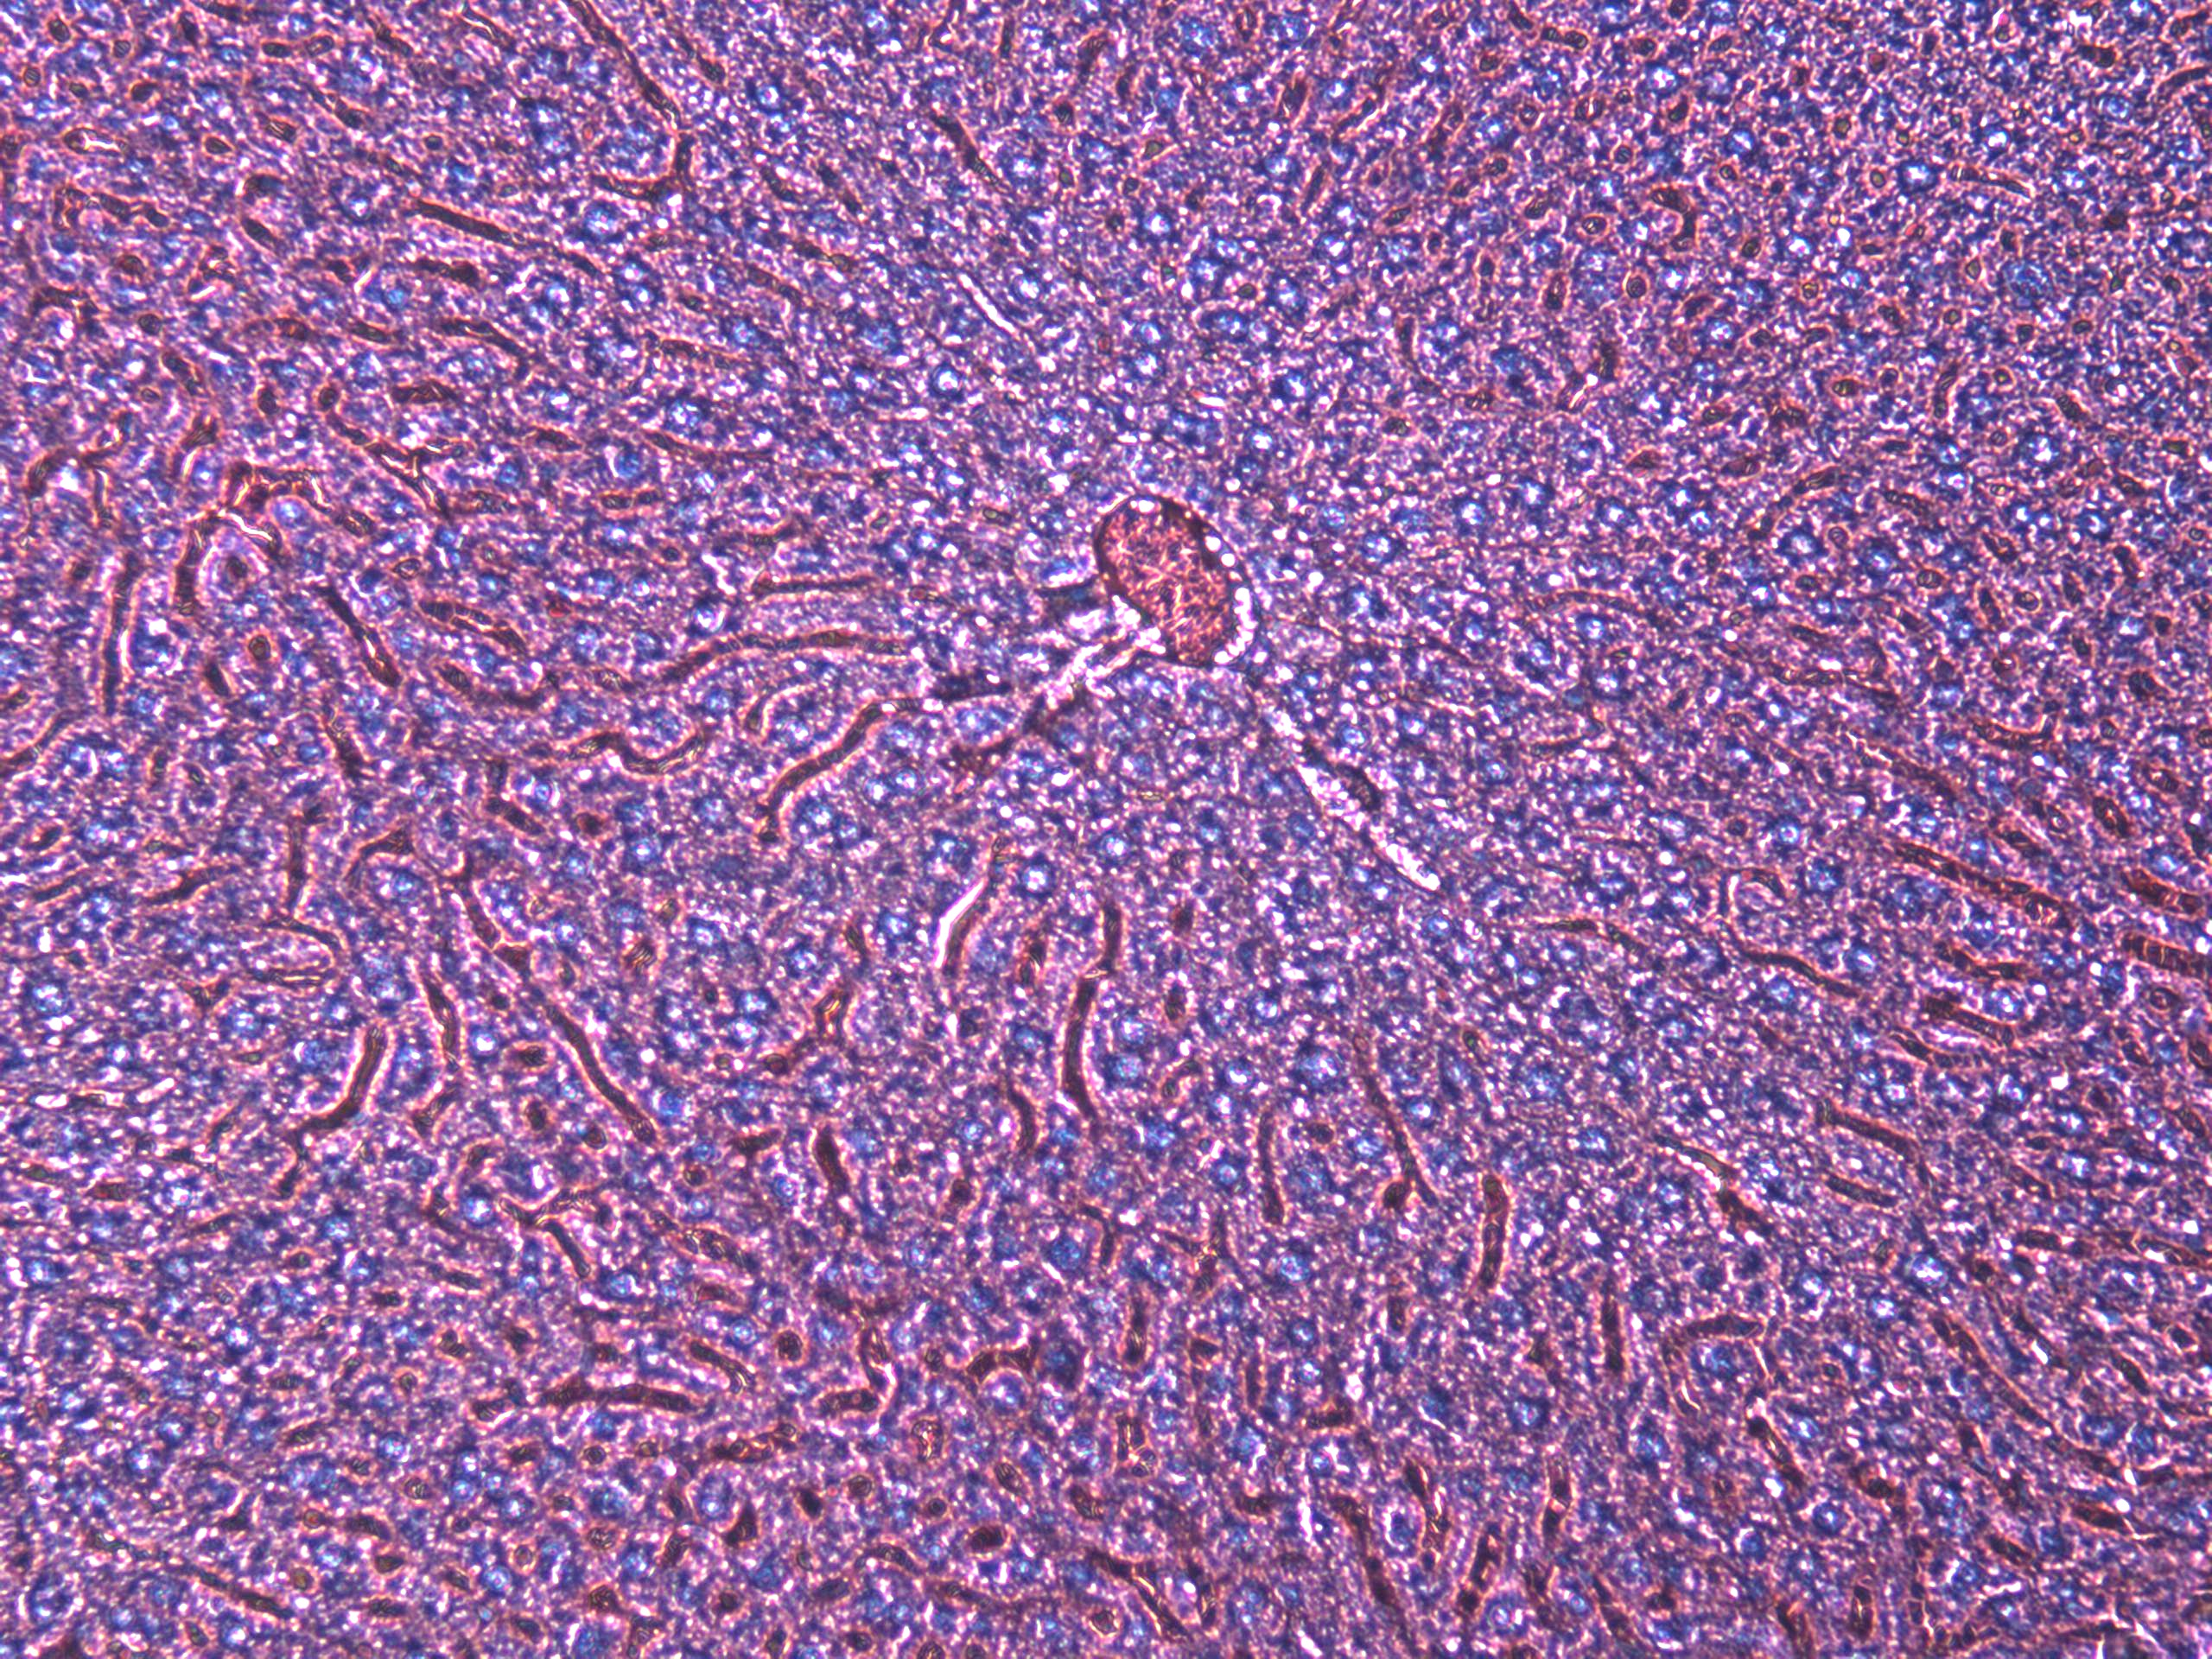
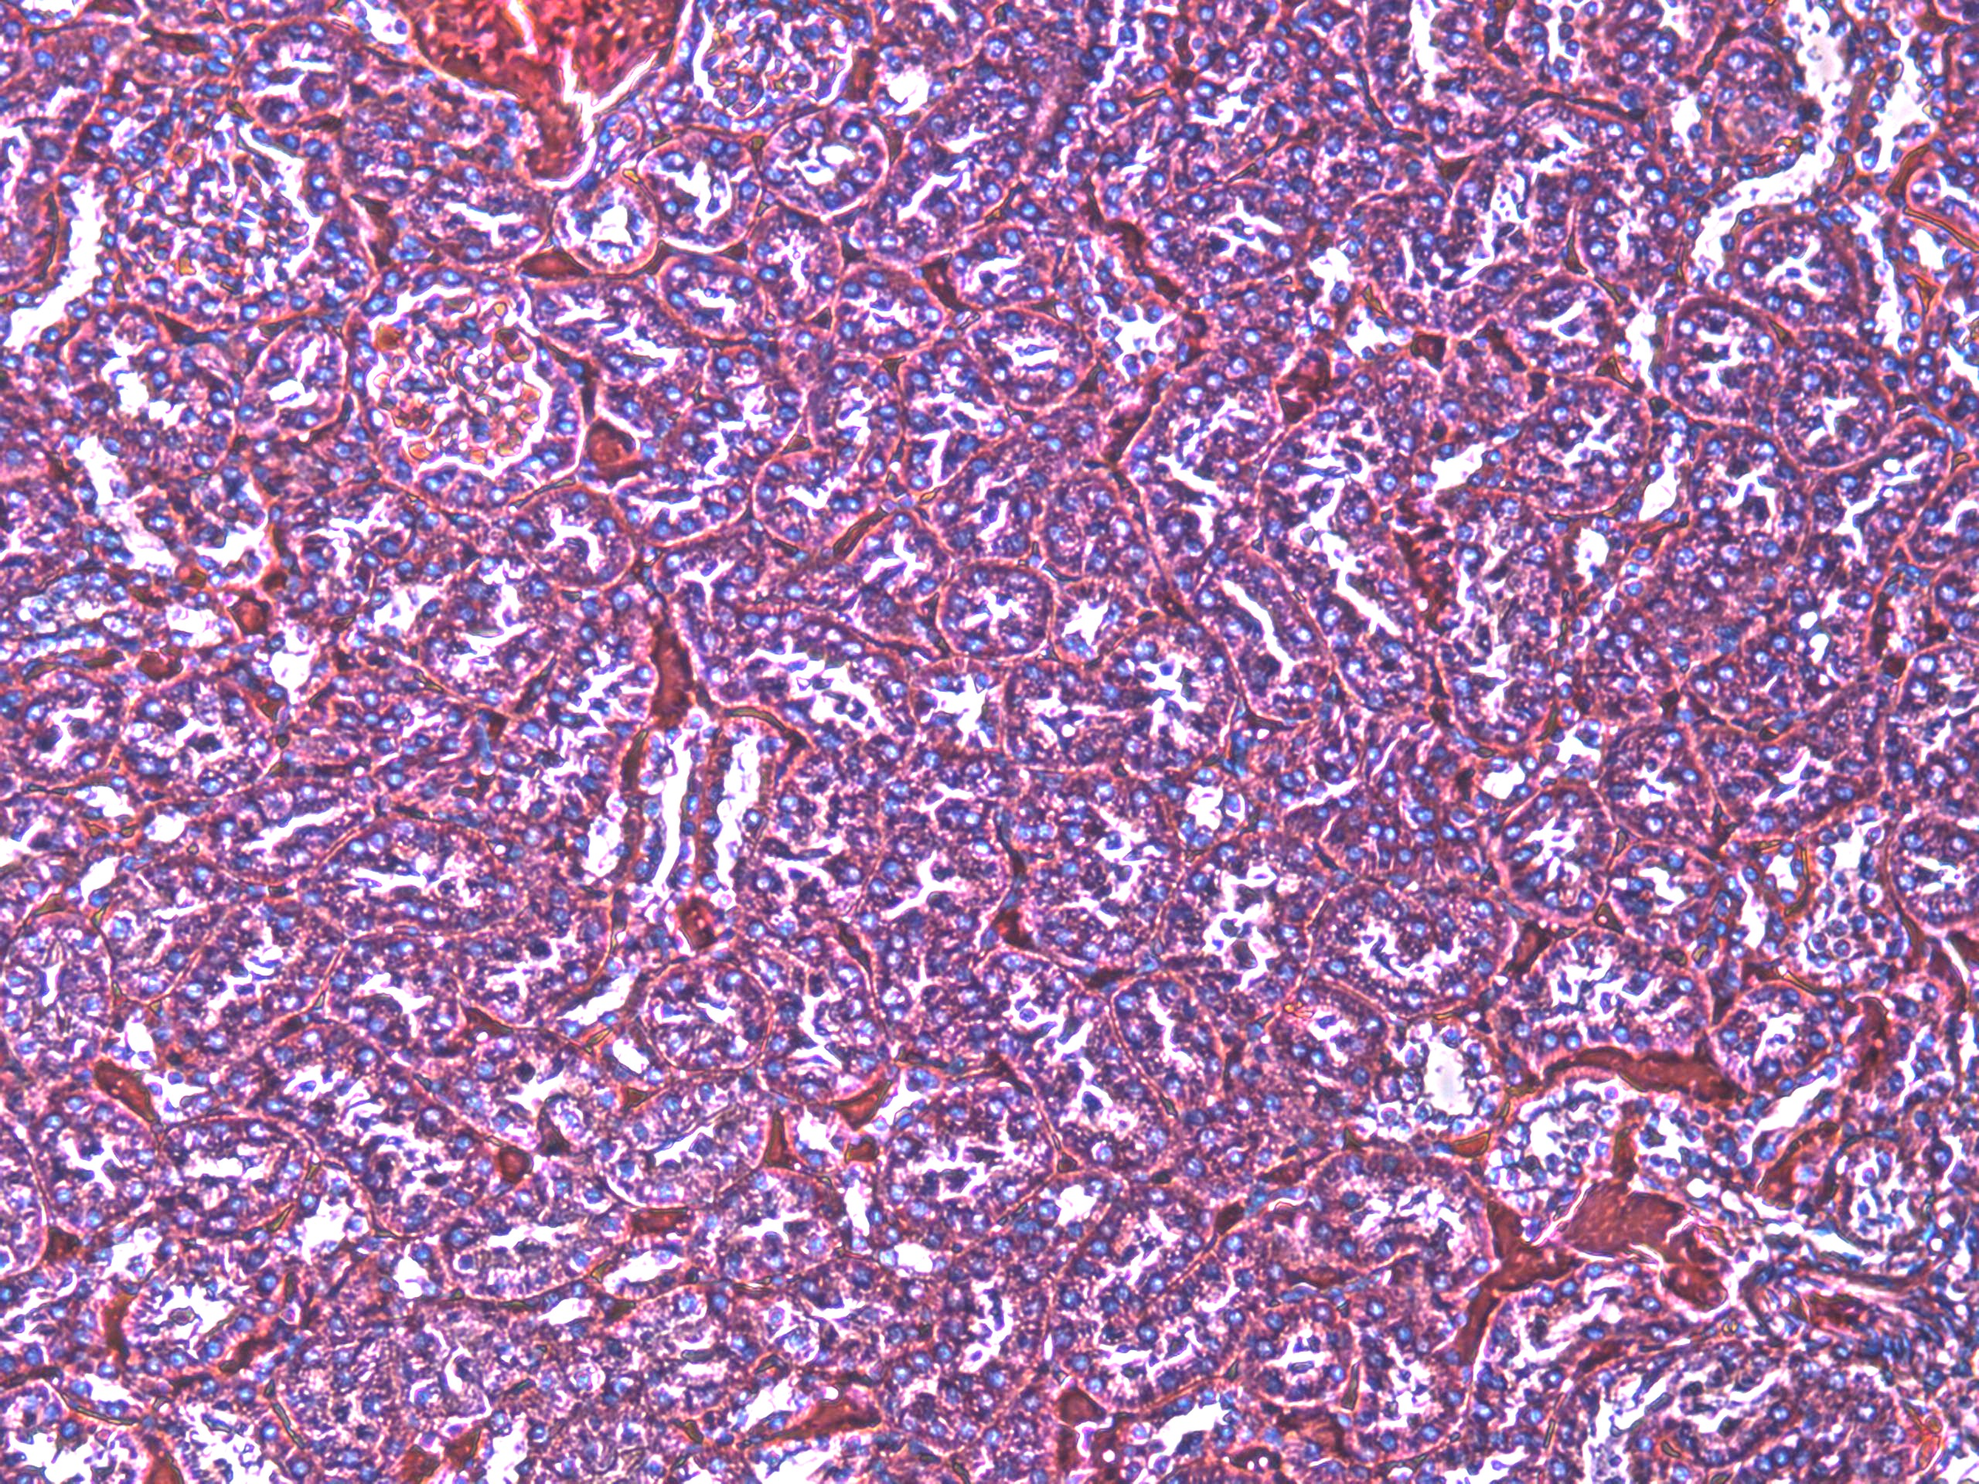
A
Liver
Kidney
Nisin
(150 mg/kg )
B
n=12
n=12
0.048
CTRL
Nisin (200 mg/kg/)
Supplemental Fig. 1

Slide 10






A
B
Nisin (80 µg/ml)
Nisin (80 µg/ml)
CTRL
CTRL
Cdc2
PARP
p-Cdc2
Cleaved
PARP
β-actin
Cleaved
caspase-3
β-actin
Supplemental Fig. 2

