Slide 1
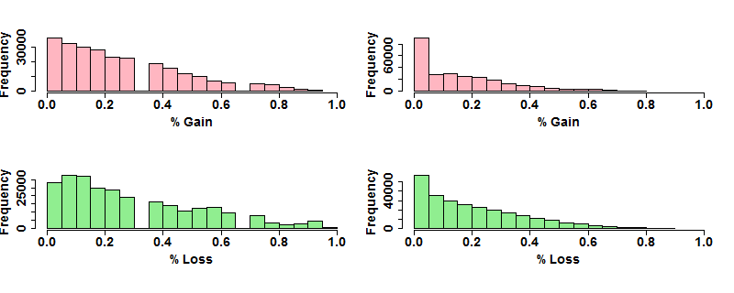
non-metastatic primary OSCC (n = 17)
metastatic OSCC (n = 20)
Figure S2. Summary of SNP probes copy number status in tumor cells from non-metastatic primaries and metastatic lymph nodes. Shown are histograms showing gains (red, top panel) and losses (green, bottom panel) in the 17 non-metastatic primary OSCC (left panel) and the 20 nodal metastases (right panel).

