Slide 1
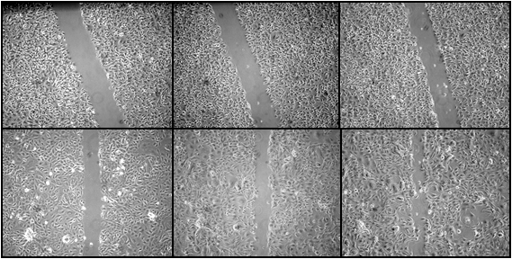
A
B
UM-SCC-14A
Wound-healing rate
0 hr
8 hr
20 hr
0 hr
8 hr
20 hr
UM-SCC-14C
Time (hour)
Figure S4. Characterization of cell migration capability of OSCC cell lines by wound-healing assay. Cells were plated into 6-well plates at a density of 1 X 10⁶/well. A sterile 200 μl pipette tip was used to scratch the cells to form a wound. The cells were then washed twice with 1XPBS and maintained in medium with 0.1% FBS. Pictures were taken at the 0, 8 and 20 hrs. Given the fast rate of wound closure in the JHU-019-SCC line, pictures were taken at 0, 3, 6 and 12 hrs. (A) Representative images show cell migration (wound-healing) at 0, 8, and 20 hr. time points for UM-SCC14A and 14C lines. (B) Cell migration rate was measured using ImageJ software (Wayne Rasband, NIH, Bethesda, MD). Results are present as the average percentage of wound-healing rate from 3 wounds. Error bars represent the standard deviation.

