Slide 1
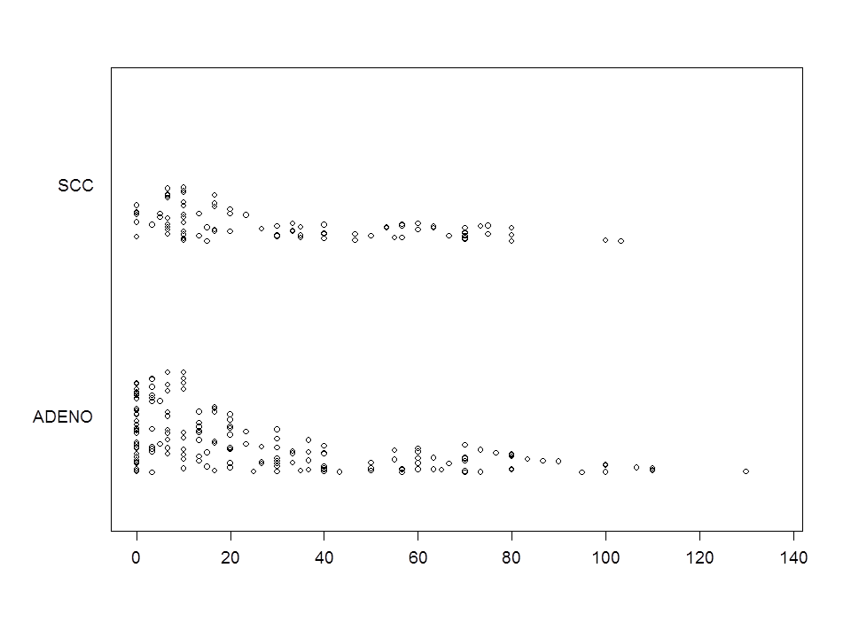
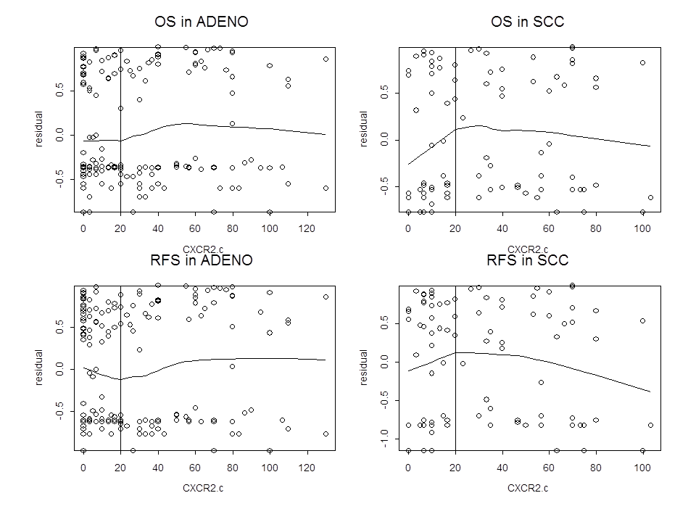
Supplementary Figure 1
A
B

Slide 2
Supplementary Figure 2

Slide 3
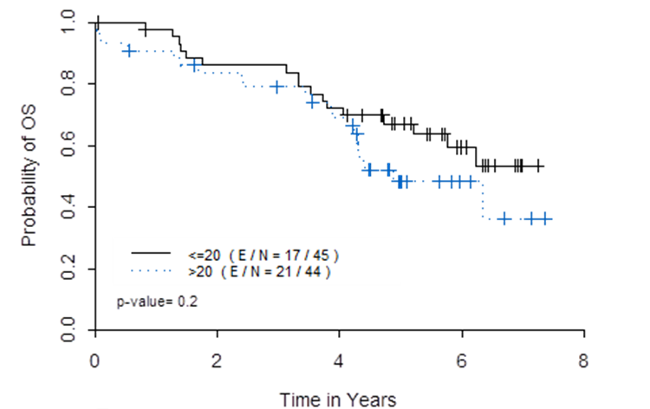
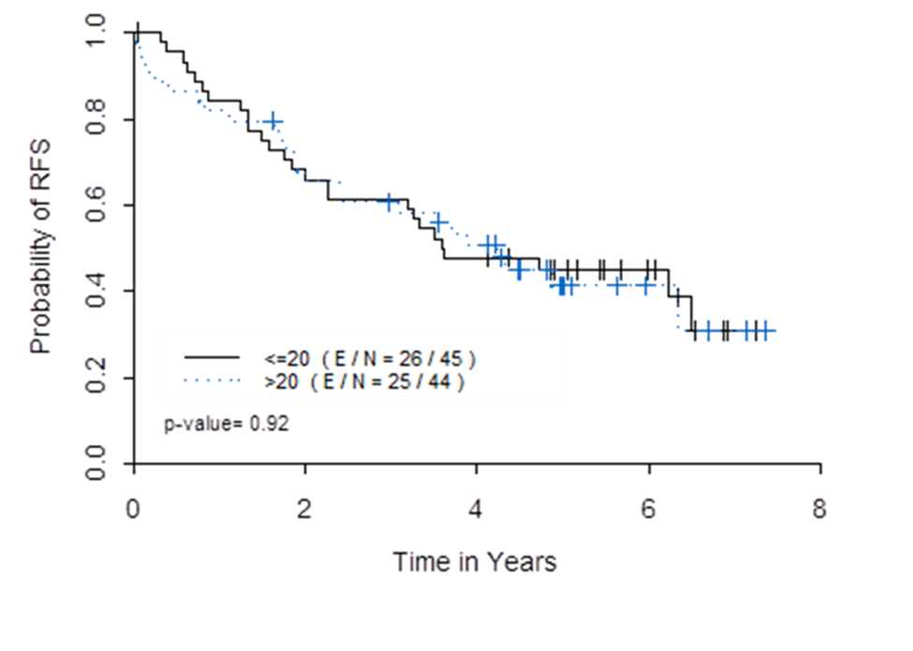
Supplementary Figure 3
A
B

Slide 4
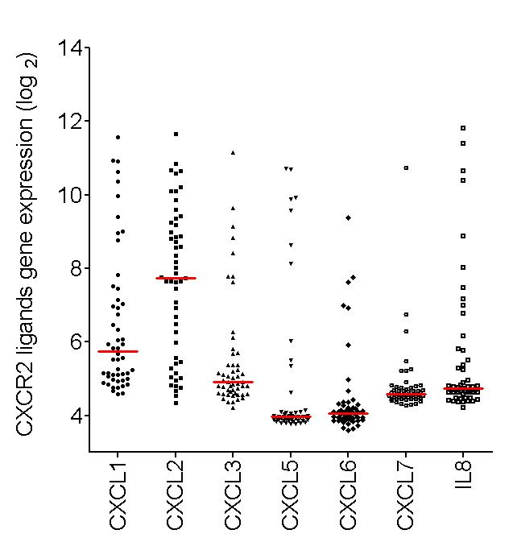
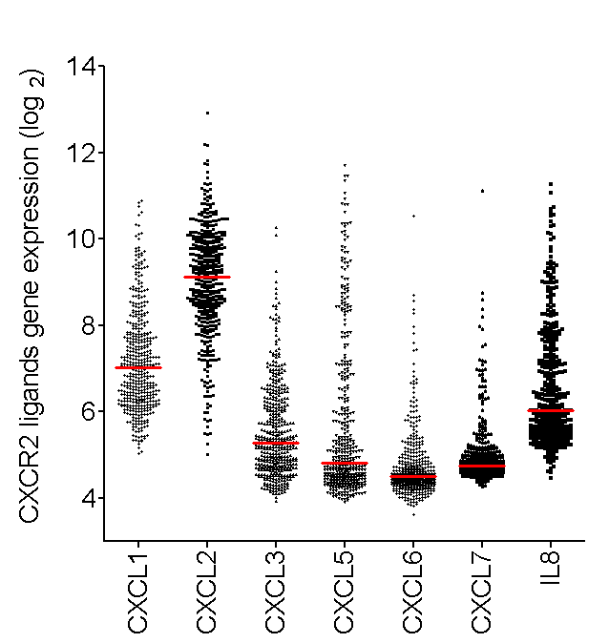
Supplementary Figure 4
A
B

Slide 5
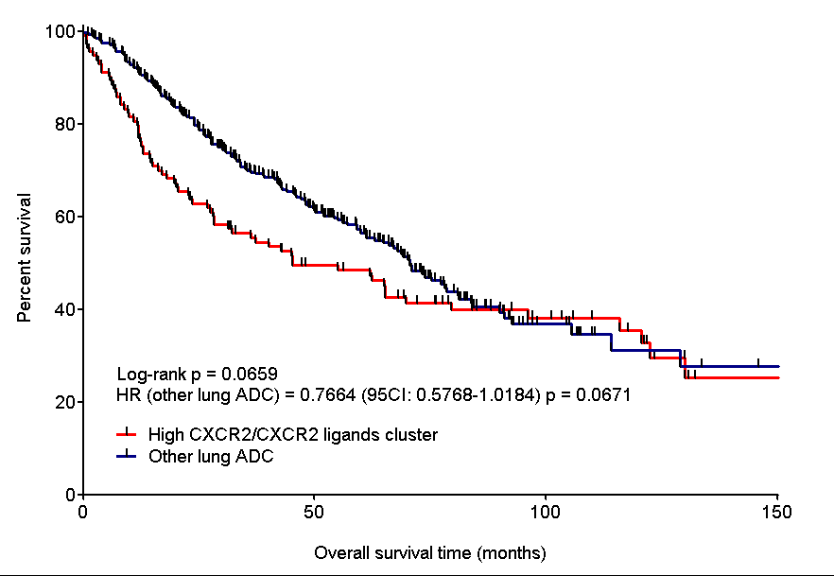
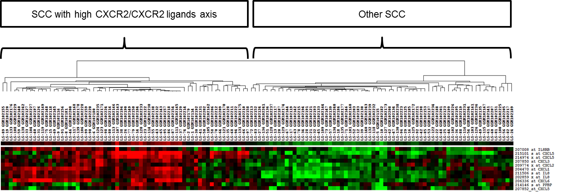
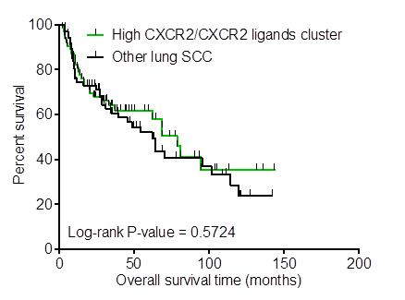
Supplementary Figure 5
A
B
C

Slide 6
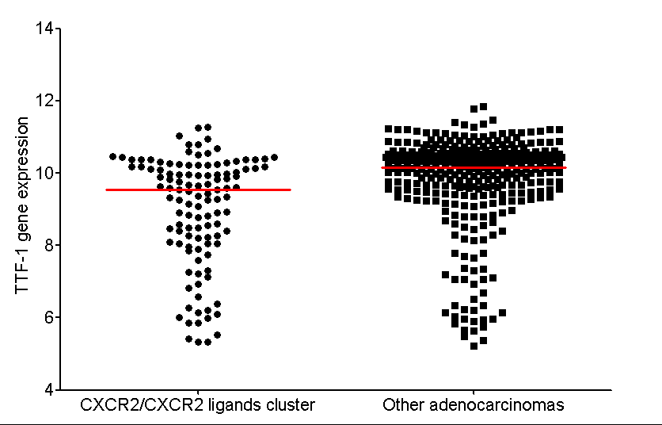
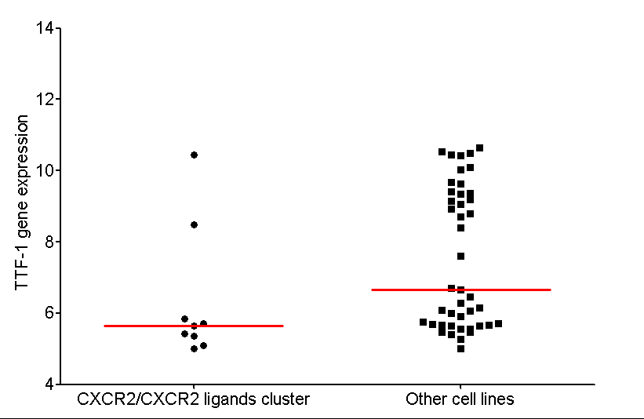
Supplementary Figure 6
A
B

Slide 7
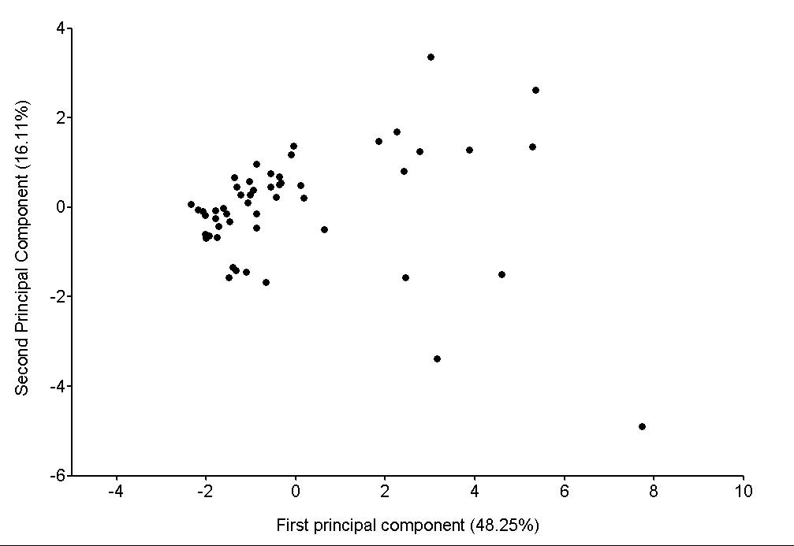
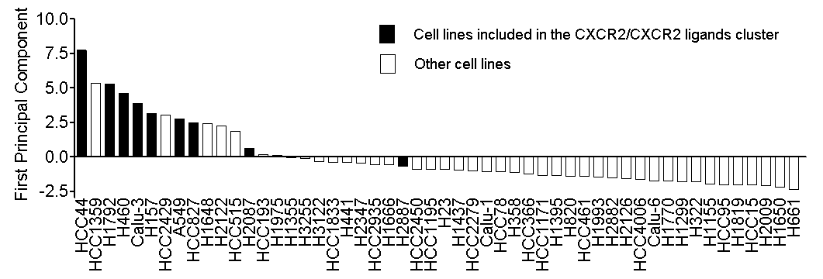
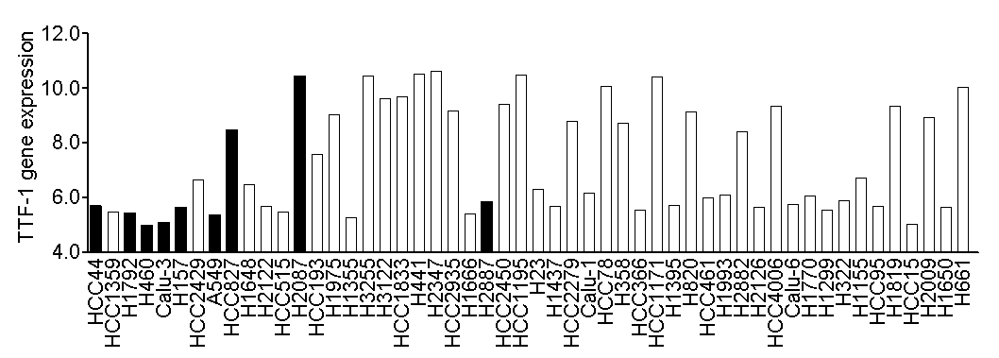
Supplementary Figure 7
A
*
B
C
*

Slide 8
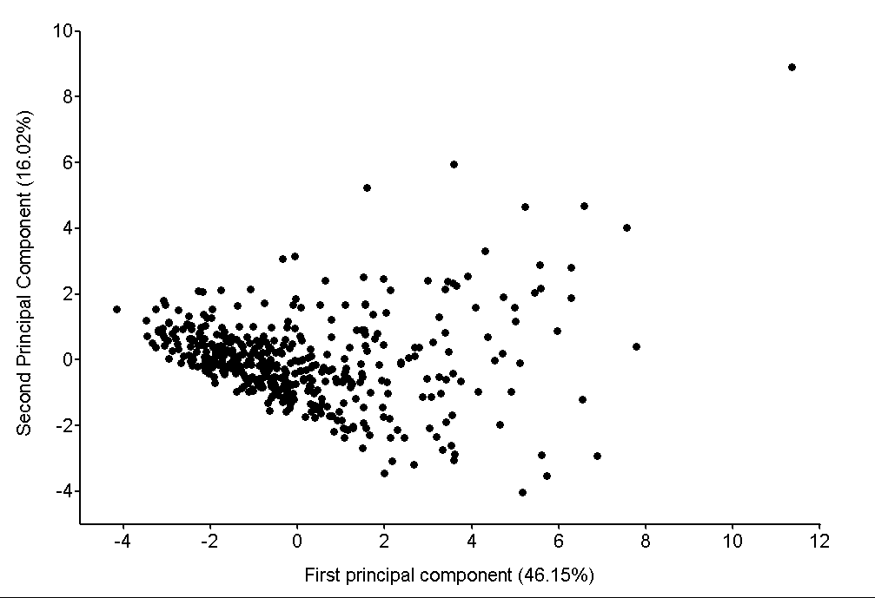
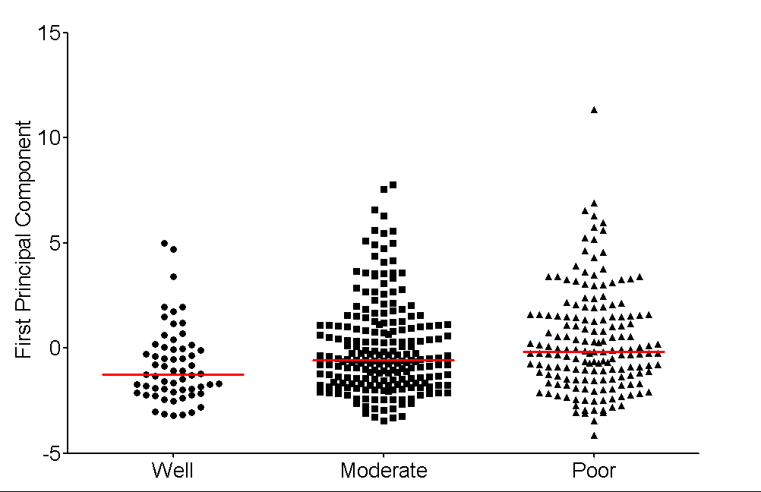
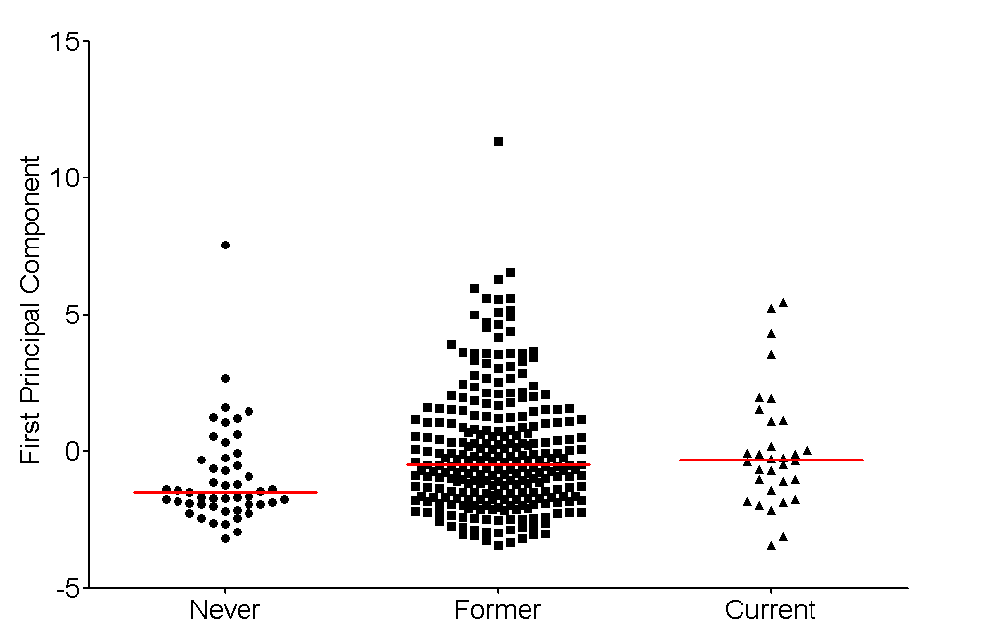
Supplementary Figure 8
A
B
*
*
C
*
*

Slide 9
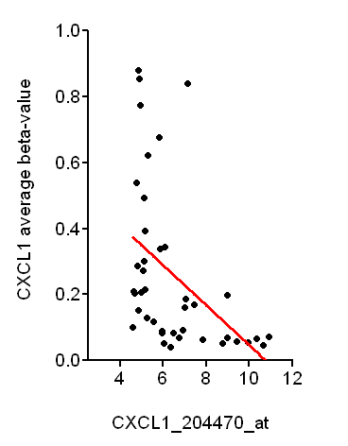
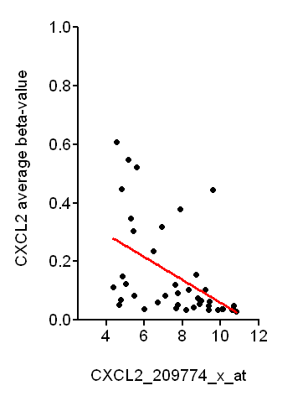
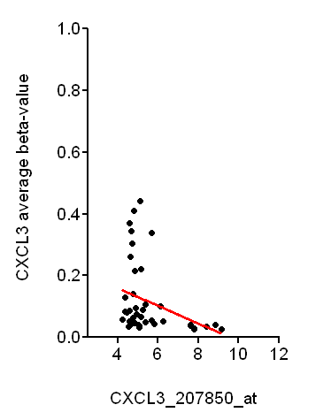
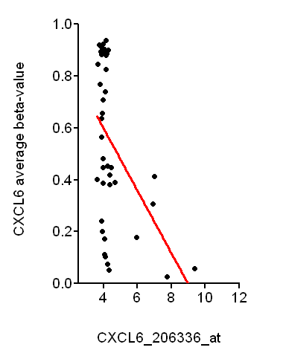
Supplementary Figure 9
A
B
r = -0.46
P=0.0021
r = -0.49
P=0.0010
C
D
r = -0.32
P=0.0390
r = -0.46
P=0.0022

Slide 10
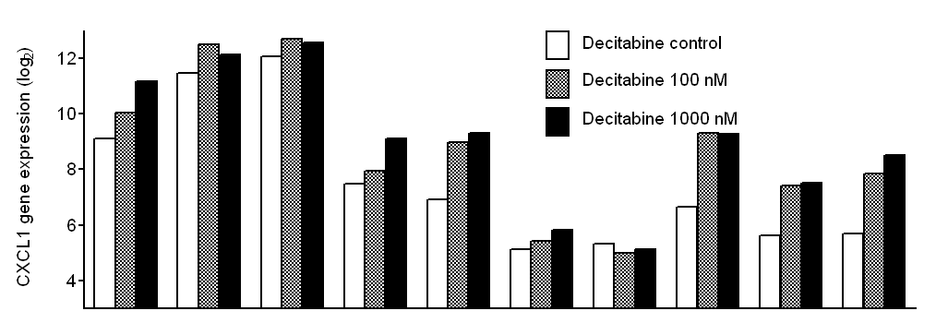
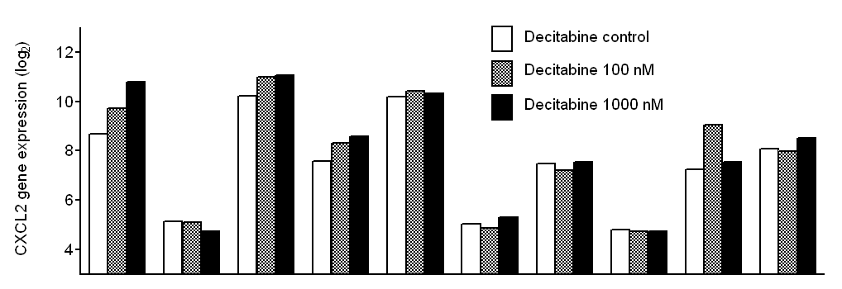
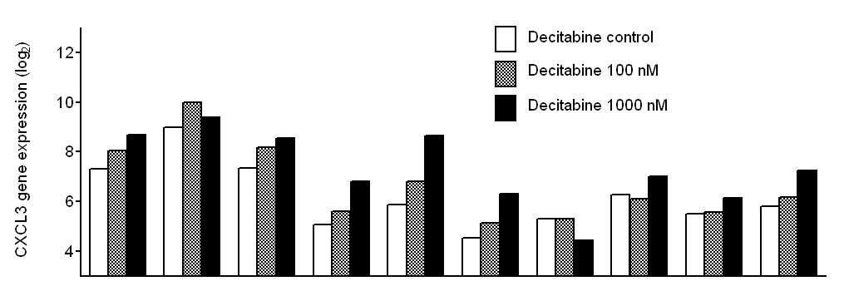
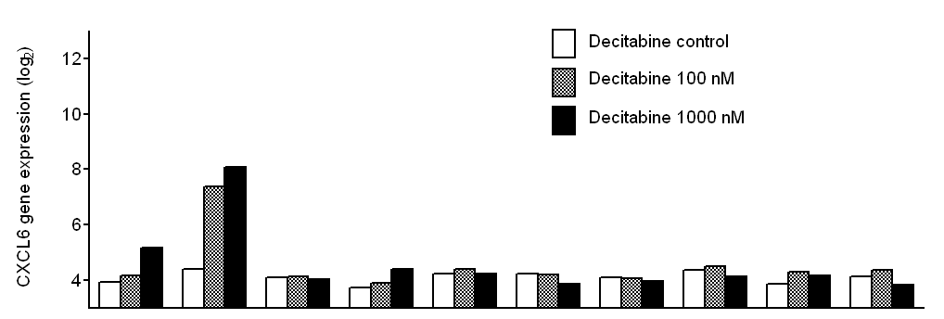
Supplementary Figure 10
A
B
C
D
Cell line | A549 | H157 | H460 | H1299 | H2347 | H1819 | H1993 | HBEC2 | HBEC3 | HBEC4
 | CXCR2/CXCR2 ligands cluster |  |  | Other cell lines |  |  |  | Immortalized bronchial epithelial cell lines

