Slide 1
Unusual sequence effects on nucleotide excision repair of arylamine lesions: DNA bending/distortion as a primary recognition factor
Vipin Jain¹, Benjamin Hilton^{2#}, Bin Lin^{3#}, Satyakam Patnaik¹, Fengting Liang¹, Eva Darian³, Yue Zou², Alexander D. MacKerell Jr.³, and Bongsup P. Cho¹
¹Department of Biomedical and Pharmaceutical Sciences, University of Rhode Island, Kingston, RI, 02881, USA
² Department of Biomedical Sciences, East Tennessee State University, Johnson city, TN, 37614, USA
³Department of Pharmaceutical Sciences, School of Pharmacy, University of Maryland, Baltimore, MD, 21201, USA
#contributed equally
*To whom correspondence should be addressed:
Telephone#: (+1) 401-874-5024; FAX# (+1) 401-874-5766; E-mail: bcho@uri.edu

Slide 2
Materials and Methods:
Computational methods
Initial double stranded (ds) DNA coordinates for canonical B DNA were generated using Nucleic Acid Builder module of the Discovery Studio 2.1 program (Accelyrs Inc.). Each ds-DNA was then read into the CHARMM program (59) where the calculations were performed using CHARMM27 all-atom additive nucleic acids force field (60,61). All subsequent molecular mechanics (MM) and molecular dynamics (MD) simulations were performed with the CHARMM or NAMD (62) programs.
To treat duplexes with modified bases the nucleic acid force field was extended to include p-fluoroaminobiphenyl (FABP), 2-aminofluorene (FAF), and 2-acetylaminofluorene (FAAF) parameters for the guanine adducts. Parameters were initially obtained from the CHARMM General Force Field (CGenFF) (63) followed by additional optimization of the internal parameters between the adducts and the guanine based following standard CGenFF protocols. This was followed by generating 11mer ds-DNA sequences (5’- CCATCXCTACC -3’)(5'-GGTAGCGATGG-3')(G*CT duplex) and (5’- CCATCXCAACC -3’)(5'-GGTTGCGATGG-3')(G*CA duplex), where X is either G, G-FABP, G-FAF or G-FAAF. Hydrogen atoms were constructed based on the internal coordinates in CHARMM27 nucleic acid force field. All non-hydrogen atoms were harmonically restrained with a force constant of 50 kcal⁻¹*mol*Å⁻², all force-field energy terms were turned on excluding electrostatics, and the duplexes were energy optimized with 500 steps of steepest descent (SD) (64) followed by 500 steps of conjugate gradient (CG) (65) minimization to relax the initial hydrogen atom positions. Next, a pre-equilibrated truncated octahedron of explicit TIP3P water molecules (66) was superimposed on the DNA structures. The size of the truncated octahedron was chosen to ensure at least a 14 Å layer of water from the backbone of the DNA and 8 Å layer of water from both ends of the strands and the edge of the octahedron. Water molecules within 4.1 Å of the DNA were deleted, and sodium counterions were placed by random selection of added water molecules to neutralize the net charge. Prior to the MD simulations, each solute+water+ions system was minimized and equilibrated. Periodic boundary conditions (67) were used and Coulomb interactions were treated with the particle mesh Ewald method (68) with the real space cutoff of 12 Å, a kappa value of 0.32, order 6 B-spline interpolation, and a grid spacing of approximately 1.0 Å. Lennard-Jones interactions were truncated at 12 Å with force switching over 10 to 12 Ån (69) and a long-range correction was applied to account for the effect of Lennard-Jones interactions beyond the truncation distance. The SHAKE algorithm (70) was applied to all hydrogen atoms with a tolerance limit of 10⁻⁸ and the nonbonded pairlist was heuristically updated whenever an atom's relative displacement exceeded 2 Å. The DNA was initially harmonically restrained with a force constant of 50 kcal⁻¹*mol* Å⁻², to allow the water and ions to minimize for 2000 SD steps. Subsequently the restraints in the DNA were decreased to 0.5 kcal⁻¹*mol* Å⁻², and the entire system was minimized for 1000 CG steps.
MD simulations for all the systems were performed in the isobaric-isothermal (NPT) ensemble. The equations of motion were integrated with 'leap-frog' algorithm and a 2 fs integration time step was used to propagate the system. The temperature was maintained at 298K by a Nose-Hoover (71,72) heat bath, with the thermal piston parameter of 10,000 kcal*mol⁻¹*ps². The constant

Slide 3
pressure of 1 atm was controlled using the Langevin piston (73) with a piston mass of 1,000 amu. An initial 20 ps of water-ion equilibration was performed by imposing 1 kcal⁻¹*mol*Å⁻² harmonic constraints on the DNA in the constant volume, isothermal (NVT) ensemble, followed by 80 ps unrestrained dynamics of the entire system in the NPT ensemble followed by 20 ns NPT production simulations.
PMF calculations were initiated using the OSRW sampling algorithm (74) as implemented in CHARMM and continued with restraints in the MMFP module of CHARMM. The reaction coordinate was defined as a pseudodihedral angle between the centers of masses of four groups of atoms (Figure S7, supporting information). For both G as well as the adducts these groups were p1) the 3’ and 5’ base paired guanine, p2) the 3’ phosphate group, p3) the 5’ phosphate group and p4) the 5-membered ring of the flipping guanine base (75) Individual 500 ps OSRW simulations were performed to flip the guanine base through both the major and minor grooves of the DNA. From these simulations 72 structures were selected with pseudodihedral angles ranging from 0° to 360° with an increment of 5°; these structures were used to initiate the PMF calculation. The umbrella potential for the PMF calculation was of the form w_{i}(x) = k_{i}(x- x_{i})² where k_{i} is the harmonic force constant, x is the value of the reaction coordinate, (i.e. the pseudodihedral angle) and the x_{i} is the restrained value of the COM dihedral. A force constant of 1,000 kcal/mol•rad² and x_{i} set to the appropriate value was used for each window in the PMF. In each window the first 0.5 ns of simulation was considered equilibration and the last 3ns were used to calculate the free energy profiles using weighted-histogram procedure (76,77) as well as to perform additional analyses.
The glycosidic torsion angle of canonical B DNA is anti and the simulations above will be referred as “anti” simulations or PMFs. In NMR experiments it was found that a syn-glycosidic torsion angle is also accessible to the DNA adducts, typically associated with the S-state of the lesions. An experimentally determined structure (PDB: 1C0Y) was used as a template to construct DNA adducts of syn-glycosidic torsion angle for the modified guanine. 11-mer ds DNA in the B conformation (preceding paragraph) was superimposed based on root-mean-square distances with 1C0Y with respect to the non-hydrogen atoms in the nucleotides common to 1C0Y and the studied duplexes. Next, coordinates of the common atoms are copied from the 1C0Y template to the new duplex with the atoms missing in the 1C0Y template maintained from the original canonical B DNA structure. An energy minimization of the DNA alone was then performed for 500 SD steps to relax some unphysical bond lengths obtained during the model building. These structures were then used to perform “syn” simulation or PMFs following the same protocol described about for the anti simulations.
Base stacking energies represent the total interaction energies between the selected groups of atoms and were performed with infinite cutoff. Solvent accessible surface areas (78) (SASA) were calculated with a 1.4 Å probe sphere radius. Helicoidal analysis was performed using the program Curves+ (79). Based on the PMF (Fig. 5) and SASA (Fig. S2) plots the S state was assigned the region of 330-360˚ of the syn PMFs, W state is the 60-90˚ of the syn PMFs, and the B state is defined as 340-360 for FABP and FAF, 320-340 for FAAF of the anti PMFs.

Slide 4
References:
59. Brooks, B. R., Brooks III, C. L., MacKerell Jr., A. D., Nilsson, L., Petrella, R. J., Roux, B., Won, Y., Archontis, G., Bartels, C., Boresch, S., Caflisch, A. et al (2009). CHARMM: The biomolecular simulation program. J. Comp. Chem. 30, 1545-1614.
60. MacKerell, A. D., Jr. & Banavali, N. K. (2000). All-atom empirical force field for nucleic acids: 2) Application to solution MD simulations of DNA. J. Comp. Chem. 21, 105-120.
61. Foloppe, N. & MacKerell, A. D., Jr. (2000). All-atom empirical force field for nucleic acids: 1) Parameter optimization based on small molecule and condensed phase macromolecular target data. J. Comp. Chem. 21, 86-104.
62. Phillips, J. C., Braun, R., Wang, W., Gumbart, J., Tajkhorshid, E., Villa, E., Chipot, C., Skeel, R. D., Kale, L. & Schulten, K. (2005). Scalable molecular dynamics with NAMD. J. Comp. Chem. 26, 1781-1802.
63. Vanommeslaeghe, K., Hatcher, E., Acharya, C., Kundu, S., Zhong, S., Shim, J., Darian, E., Guvench, O., Lopes, P., Vorobyov, I. & MacKerell, A. D., Jr. (2010). CHARMM general force field: A force field for drug-like molecules compatible with the CHARMM all-atom additive biological force fields. J. Comp. Chem. 31, 671-690.
64. Levitt, M. & Lifson, S. (1969). Refinement of Protein Conformations Using a Macromolecular Energy Minimization Procedure. J. Mol. Biol. 46, 269-279.
65. Fletcher, R. & Reeves, C. M. (1964). Function Minimization by Conjugate Gradients. Computer Journal 7, 149-154.
66. Jorgensen, W. L., Chandrasekhar, J., Madura, J. D., Impey, R. W. & Klein, M. L. (1983). Comparison of Simple Potential Functions for Simulating Liquid Water. J. Chem. Phys. 79, 926-935.
67. Allen, M. P. & Tildesley, D. J. (1989). Computer Simulation of Liquids, Oxford University Press, New York.
68. Darden, T. A., York, D. & Pedersen, L. G. (1993). Particle mesh Ewald: An Nlog(N) method for Ewald sums in large systems. J. Chem. Phys. 98, 10089-10092.
69. Steinbach, P. J. & Brooks, B. R. (1994). New Spherical-Cutoff Methods of Long-Range Forces in Macromolecular Simulations. J. Comp. Chem. 15, 667-683.
70. Ryckaert, J. P., Ciccotti, G. & Berendsen, H. J. C. (1977). Numerical Integration of the Cartesian Equations of Motion of a System with Constraints: Molecular Dynamics of n-alkanes. J. Comp. Phys. 23, 327-341.
71. Nose, S. & Klein, M. L. (1983). Constant Pressure Molecular Dynamics for Molecular Systems. Molecular Physics 50, 1055-1076.
72. Hoover, W. G. (1985). Canonical Dynamics - Equilibrium Phase-Space Distributions. Physical Review A 31, 1695-1697.
73. Feller, S. E., Zhang, Y., Pastor, R. W. & Brooks, R. W. (1995). Constant Pressure Molecular Dynamics Simulation: The Langevin Piston Method. J. Chem. Phys. 103, 4613-4621.

Slide 5
74. Zheng, L., Chen, M. & Yang, W. (2008). Random walk in orthogonal space to achieve efficient free-energy simulation of complex systems. Proc Natl Acad Sci U S A 105, 20227-20232.
75. Song, K., Campbell, A. J., Bergonzo, C., de los Santos, C., Grollman, A. P. & Simmerling, C. (2009). An Improved Reaction Coordinate for Nucleic Acid Base Flipping Studies. Journal of Chemical Theory and Computation 5, 3105-3113.
76. Kumar, S., Bouzida, D., Swendsen, R. H., Kollman, P. A. & Rosenberg, J. M. (1992). The Weighted Histogram Analysis Method for Free-Energy Calculations on Biomolecules. I. The Method. J. Comp. Chem. 13, 1011.
77. Grossfield, A. (2011). WHAM: an implementation of the Weighted Histogram Analysis Method (http://dasher.wustl.edu/alan/wham, ed.).
78. Ponder, J. W. & Richards, F. M. (1987). Tertiary Templates for Proteins. Use of Packing Criteria in the Enumeration of Allowed Sequences for Different Structural Classes. J. Mol. Biol. 193, 775-791.
79. Lavery, R., Moakher, M., Maddocks, J. H., Petkeviciute, D. & Zakrzewska, K. (2009). Conformational analysis of nucleic acids revisited: Curves+. Nucleic Acids Res. 37, 5917-5929.

Slide 6
(a)
FABP
(b)
FAF
(c)
FAAF
-G*CT-
G*CA-
-G*CT-
G*CA-
-G*CT-
G*CA-
17 ˚C
5 ˚C
17 ˚C
30 C
30 C
60 ˚C
50 ˚C
45 ˚C
42 ˚C
40 ˚C
37 ˚C
35 ˚C
30 ˚C
25 ˚C
20 ˚C
15 ˚C
B
S
B
B
S
10 ˚C
B
S
W
S
W
B
S
B
5 ˚C
2 ˚C
-115
-117
-119 ppm
-115
-117
-119 ppm
-115
-117
-119 ppm
-115
-117
-119 ppm
-115
-117
-119 ppm
-115
-117
-119 ppm
Figure S1: Temperature dependent dynamic 1D ¹⁹F NMR spectra of (a) FABP-, (b) FAF-, and (c) FAAF-modified 11-mer duplexes on the G*CT and G*CA sequence contexts. The signals were assigned as B-, S- and W-conformers based on H/D solvent effect, adduct-induced circular dichroism (ICD_{290-350nm}) and chemical shift patterns. Insets are the NOESY spectra, the off-diagonal signals indicate that the conformers are in exchangeable equilibrium with each other

Slide 7
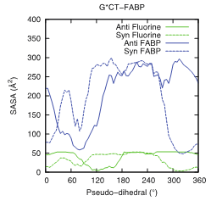
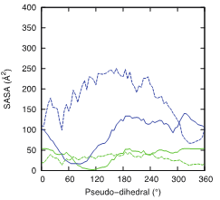
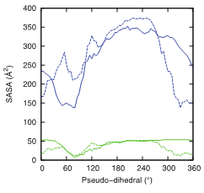
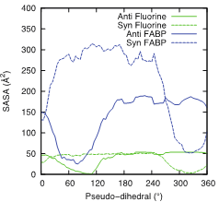
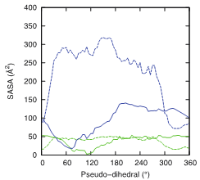
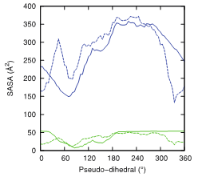
(a) FABP
(b) FAF
(c) FAAF
G*CT
G*CA
Figure S2: Solvent Accessible Surface Area (SASA, Å²) calculated for the G*CT and G*CA duplexes modified by either a) FABP, b) FAF, or c) FAAF adduct. Results for the full adduct (blue line) and fluorine atom (green line) shown. In the anti-G* PMFs, the average solvent accessible surface areas (SASA) of both the lesion and fluorine atom are high in the vicinity of the B state (330 ~ 360˚) whereas in the syn PMFs, the SASA values are low in the regions of the minima corresponding to the S-state (330 ~ 360˚). Moreover, the syn PMFs of FAAF exhibit SASA minima in 60 ~ 120˚, which encompasses the W state.

Slide 8
(a) FABP
(b) FAF
(c) FAAF
G*CT
G*CA
Figure S3: Imino proton region (10-15 ppm) of proton NMR of G*CT and G*CA duplexes modified by a) FABP, b) FAF and c) FAAF at 5 ˚C. The spectra displays a mixture of broad imino signals arising not only from those involved in Watson-Crick hydrogen bonds (12 ~ 14 ppm), but also from the lesion site and its vicinity (11-12 ppm).

Slide 9
(a)
G*CA [FAAF]
S(64%)
B
(~22%)
W(14%)
-115
-116
ppm
-117
-118
(b)
G*CT [FAAF]
S(53%)
W(30%)
B
(~17%)
-115
-116
-117
-118
ppm
Figure S4: Line simulation of fully paired FAAF-modified (a) G*CA and (b) G*CT duplexes at 20 ˚C. The simulations were performed to calculate the population ratio of B-, S- and W-conformers in FAAF modified G*CA and G*CT duplexes using WINDNMR-Pro (version 7.1.6; J. Chem. Educ. Software Series; Reich, H. J., University of Wisconsin, Madison, WI).

Slide 10
(a)
(b)
Figure S5: Overlay CD spectra of FABP-, FAF-, and FAAF-modified 11-mer duplexes in (a) the G*CA and (b) G*CT sequence contexts. Both unmodified and modified duplexes displayed a positive and negative ellipticity at around 270 and 250 nm, respectively, which is an S-curve characteristic of a B-type DNA double helix. In addition, the modified duplexes displayed significant blue shifts relative to the unmodified duplex and the results are tabulated in Table 1.

Slide 11
(a) FABP
(b) FAF
(c) FAAF
Figure S6: DSC thermograms of (a) FABP- (b) FAF- and (c) FAAF-modified relative to control duplexes. GCA control duplex (Green); GCT Control Duplex (Black); GCA-modified duplex (Red); GCT-modified duplex (Blue). The area of the curve is proportional to the transition heat, which was normalized for the number of moles of the sample to provide the transition enthalpy, ΔH. T_{m} was the temperature at half the peak area. The presence of lesion (FABP, FAF or FAAF) resulted into the thermal and thermodynamic destabilization of the duplexes as evident from their reduced Tm and area under the curve values(ΔH).

Slide 12
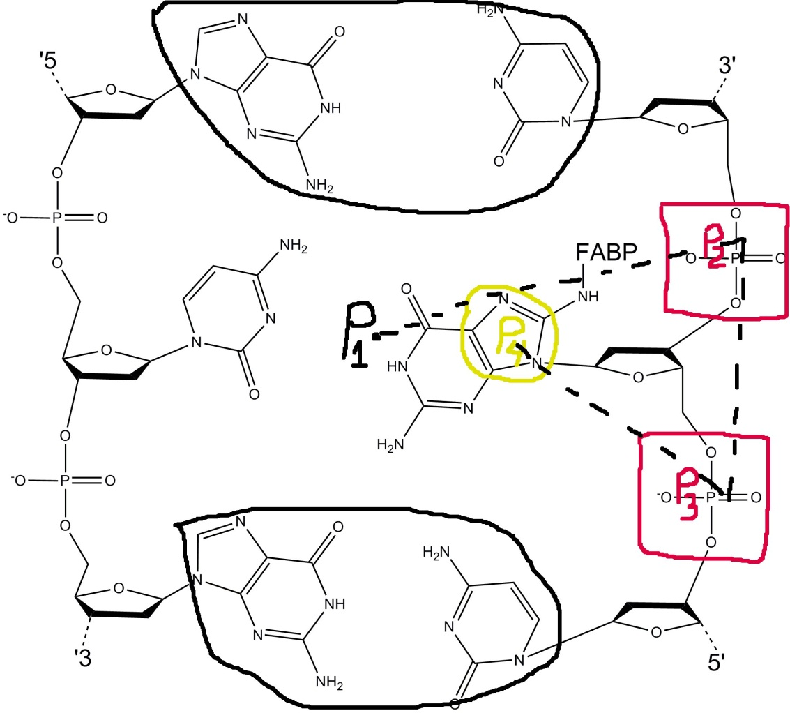
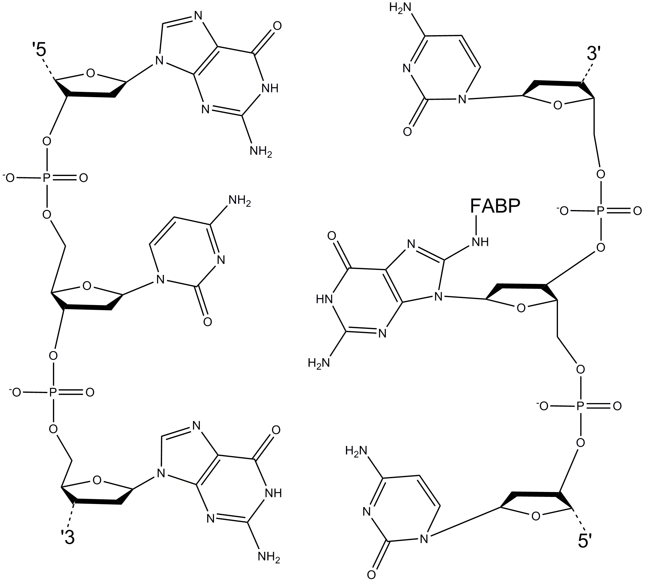
P2
P1
P4
P3
Figure S7: Definition of the reaction coordinate: The Pseudo-dihedral angle P1-P2-P3-P4 is an angle between the Center Of Mass (COM) of the following atom groups: P1 is defined as a COM of the base pairs above and below the flipping guanine base (3’-C5:G7, 5’-C7:G5), P2 and P3 are defined as the COM of the phosphate group in 3’- and 5’- direction from the flipping base and P4 is taken as a COM of the 5-membered ring of the flipping guanine base G6. Based on the above definition 330~360° in anti simulations corresponds to the Watson-Crick base paired B state, 330~360° in syn simulations corresponds to the S state, and 60~90° in syn simulations corresponds to W state. Major groove path ranges from 180° to 360° and the minor groove path ranges from 0° to 180°.

Slide 13
Note: Figures S8 to S11 present "NOE distance" plots extract from the PMFs. To identify if the PMFs were sampling experimentally relevant conformations NOE distance plots, based on published NMR experiments on different lesions and sequences were created. These plots involved determining the average distances between the atom pairs identified in the NMR experiments for the individual windows in the PMFs, such that regions where shorter distances in the PMFs occur correspond to conformations that are consistent with the experimental data.
Figure S8: Distances of atom pairs for comparison to those listed in Table 3 of Mao et al. Biochemistry,1998, 37, 95. Atom pairs are defined in Table S3. Distances are averages calculated over last 3 nanosecond trajectory of anti simulations. 330~360° region is corresponding to B-state.

Slide 14
Figure S9: Distances of atom pairs for comparison to those listed in Table IV of O'Handley et al. Biochemistry,1993, 32, 2481. Atom pairs are defined in Table S4. Distances are averages calculated over last 3 nanosecond trajectory of syn simulations. 330~360° region is corresponding to S-state.

Slide 15
Figure S10: Distances of atom pairs for comparison to those listed in Table 4 of Eckel and Krugh. Biochemistry,1994, 33, 13611. Atom pairs are defined in Table S5. Distances are averages calculated over last 3 nanosecond trajectory of syn simulations. 330~360° region is corresponding to S-state.

Slide 16
Figure S11: Distances of atom pairs for comparison to those listed in Table 5 Abuaf et al, Chem. Res. Toxicol. 1995, 8, 369. Atom pairs are defined in Table S6. Distances are averages calculated over last 3 nanosecond trajectory of syn simulations. 60~90° region is corresponding to W-state.

Slide 17
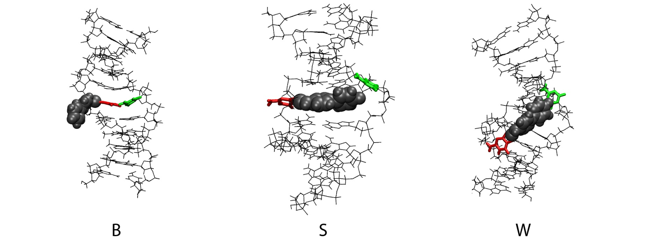
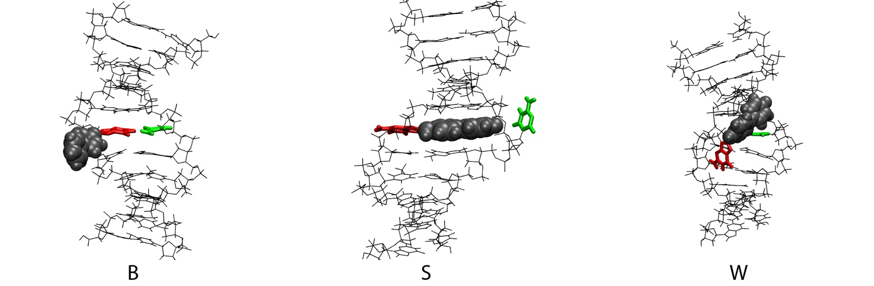
Figure S12: FABP B, S and W conformations for G*CT (upper) and G*CA (lower)

Slide 18
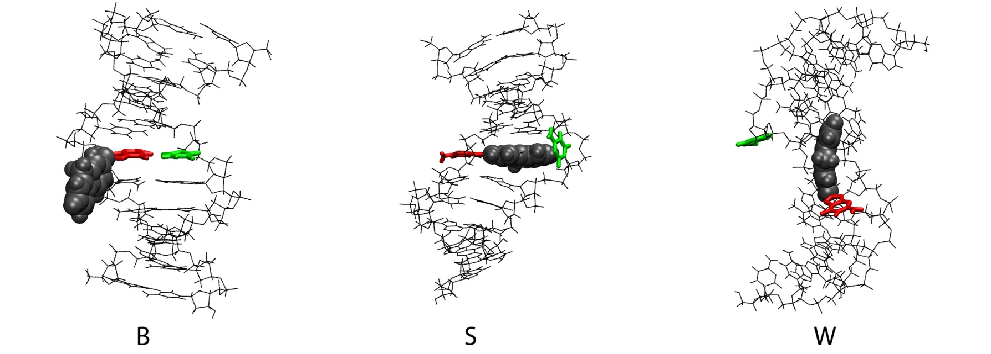
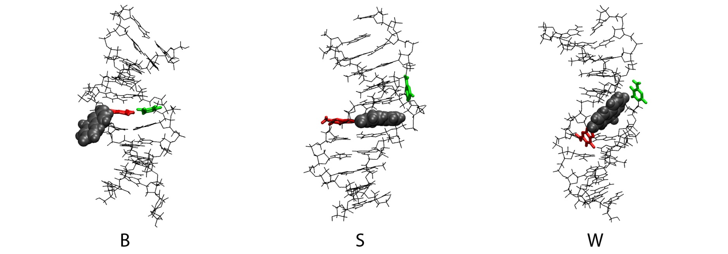
Figure S13: FAF B, S and W conformations for G*CT (upper) and G*CA (lower)

Slide 19
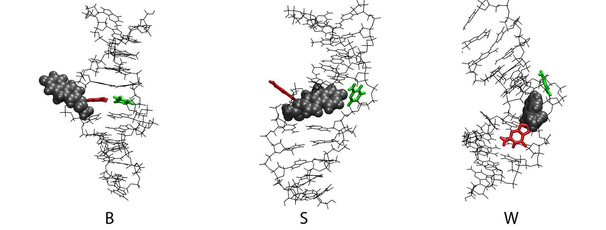
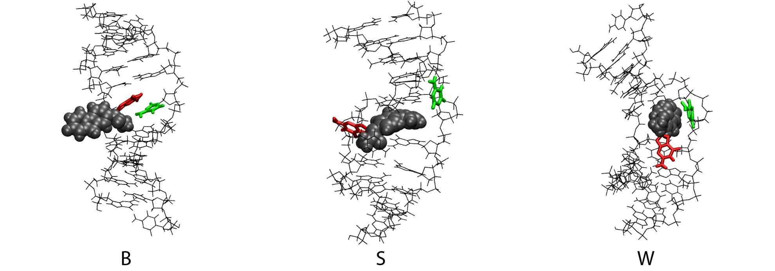
Figure S14: FAAF B, S and W conformations for G*CT (upper) and G*CA (lower)

Slide 20
Figure S15: Probability distributions of the helical bending angles for the DNA-adducts in both the GCT and GCA sequences and for the (a) B-, (b) S- and (c) W-states. In the B- and S-states the extent of bending is significantly larger with FAAF (cyan) versus FABP (red) and FAF (blue). Moreover, the extent of bending in G*CA sequence is more when the lesions are in the S-state.

Slide 21
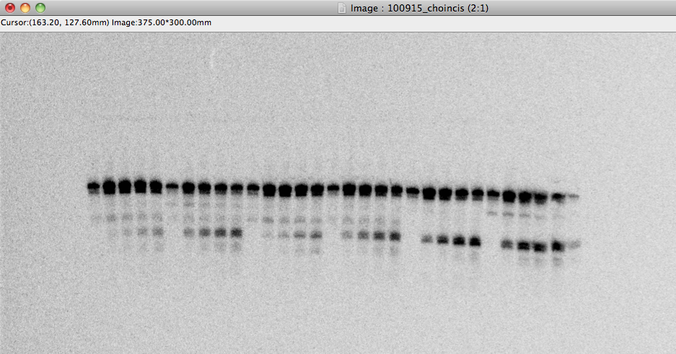
(a) FABP
(b) FAF
(c) FAAF
G*CT
55mer
22mer
mins 0 5 10 20 30
0 5 10 20 30
0 5 10 20 30
G*CA
55mer
22mer
mins 0 5 10 20 30
0 5 10 20 30
0 5 10 20 30
Figure S16: The 5ꞌ-terminally labeled G*CT and G*CA DNA substrates (2 nM) modified by either a) FABP, b) FAF or c) FAAF were incubated with UvrABC (UvrA, 10 nM, UvrB, 250 nM, and UvrC, 100 nM) in UvrABC reaction buffer at 37°C for the time period mentioned above. The incision products were then analyzed on a 12% polyacrylamide sequencing gel under denaturing condition. The 55-mer represents the intact DNA substrates, and the 22mer represent the 5ꞌ-incised DNA fragments. The results are tabulated and relative incision efficiencies are plotted in Figure 6.

Slide 22
Table S1: Thermal and thermodynamic parameters from UV-melting curves
CCATCG*CAACC GGTAGCGTTGG |  |  |  |  |  | CCATCG*CTACC GGTAGCGATGG
 | -ΔH kcal/mol | -ΔS eu | -ΔG₃₇ kcal/mol | T_{m}^{b} ºC |  | -ΔH kcal/mol | -ΔS eu | -ΔG₃₇ kcal/mol | T_{m}^{b} ºC
Controlª | 87.6 | 241.3 | 12.7 | 60.6 | Control | 90.9 | 251.9 | 12.7 | 59.8
FABPª | 73.8 | 207.6 | 9.4 | 49.8 | FABP | 68.5 | 192.7 | 8.7 | 47.2
FAFª | 68.5 | 189.8 | 9.6 | 51.5 | FAF | 70.1 | 196.0 | 9.3 | 49.7
FAAF | 54.2 | 146.2 | 8.8 | 50.9 | FAAF | 52.6 | 144.0 | 8.0 | 45.7
 | ΔΔH^{c} kcal/mol | ΔΔS^{d} eu | ΔΔG₃₇e kcal/mol | ΔT_{m}^{f} ºC |  | ΔΔH^{c} kcal/mol | ΔΔS^{d} eu | ΔΔG₃₇e kcal/mol | ΔT_{m}^{f} ºC
FABP | 13.8 | 33.7 | 3.3 | -10.8 | FABP | 22.4 | 59.2 | 4.0 | -12.6
FAF | 19.1 | 51.5 | 3.1 | -9.1 | FAF | 20.8 | 55.9 | 3.4 | -10.1
FAAF | 33.4 | 95.1 | 3.9 | -9.7 | FAAF | 38.3 | 107.9 | 4.7 | -14.1
a) The results of curve fit and T_{m}-lnC_{t} dependence were within 15% of each other, and these numbers are averages of the two methods. The average standard deviations for -ΔG, -ΔH, and T_{m} are ±0.2, ±6.2, and ±0.4, respectively.
b) T_{m} values at 0.1mM extrapolated from these two methods.
c) ΔΔH = ΔH (modified duplex) - ΔH (control duplex).
d) ΔΔS= ΔS (modified duplex) - ΔS (control duplex).
e) ΔΔG = ΔG (modified duplex) - ΔG (control duplex).
f) ΔTm = Tm (modified duplex) - Tm (control duplex).

Slide 23
Table S2: Kinetic and Thermodynamic parameters from dynamic ¹⁹F NMR
 | FABP |  | FAF
Sequenceª | -G*CA- | -G*CT- | -G*CA- | -G*CT-
Ratio B:S^{b} (20°C) | ~100:0 | 40:60 | 34:66 | 10:90
ΔG_{B} ↔_{S} (20°C) kcal/mol^{c} | >2.0^{l} | -0.24 | -0.39 | -1.28
ΔΗ_{B}↔_{S} kcal/mol^{d} | ~ | 3.63^{k} | 4.04 | 6.18
ΔS_{B}↔_{S} Cal mol⁻¹K^{-1e} | ~ | 11.5^{k} | 15.6 | 25.3
k_{c} (s⁻¹) ^{f} | ~ | 850^{k} | 921 | ~
k_{30°C} (s⁻¹) ^{g} | ~ | 570^{k} | 300 | ~
τ (ms)^{h} | ~ | 1.75^{k} | 3.33 | ~
ΔG≠_{B}↔_{S} (20°C) kcal/mol^{i} | ~ | 14.1^{k} | 14.3 | ~
ΔΗ≠_{B}↔_{S} kcal/mol^{j} | ~ | 11.5^{k} | 13.7 | ~
a. The trimer portion of duplexes used in the present study. See Figure 1 for full sequence contexts. G*= FABP or FAF. b B/S conformer ratios by integration of ¹⁹F signals at 20 °C. c. The energy difference between the B-and S-conformers: ΔG°= -RT ln K [K_{equ}= S/B]. d,e.Enthalpy and entropy differences between the B- and S-conformers were estimated from the van’t Hoff plots of the B/S-ratios vs temperature. f. Rate constants at a coalescence temperature, a lower limit on the exchange rate between the two conformers. K_{c} =2.22Δν (the chemical shift difference between the two signals in Hz at slow exchange, i.e., at 5 °C). g. Rate constant at 30°C. The data were obtained by complete line shape analysis of temperatura dependent ¹⁹F NMR results using the WINDNMR-Pro (see Experimental Procedures). h. Exchange time (1/k) indicates the amount of time the adduct spends in one conformation before jumping into another conformation. i,j The S/B interconversion energy barrier at 20 °C obtained from Eyring plots. k. Measured with D₂O as medium for better resolution of the B/S 19F NMR signals. l. 3% detection limit of ¹⁹F NMR signal was assumed.

Slide 24
Table S3: Atom pairs used in NOE experiment vs PMF calculations for B-state NOE distance plot (Figure S10).ª
atom pair # | NMR atom pair names | PMF atom pair names | NMR distance | atom pair # | NMR atom pair names | PMF atom pair names | NMR distance
2 | AF(NH)-dG4(H1ʹ) | FAF(H81)-C5(H1’) | 3.0-5.0 | 3 | AF(NH)-dG4(H2ʹ) | FAF(H81)-C5(H2') | 4.0-6.0
4 | AF(NH)-[AF]dG5(H1') | FAF(H81)-G6(H1') | 3.0-5.0 | 5 | AF(NH)-[AF]dG5(H2ʹ′) | FAF(H81)-G6(H2') | 2.5-5.0
6 | AF(NH)-dG4(H2ʹ') | FAF(H81)-C5(H2'') | 2.5-5.0 | 7 | AF(NH)-[AF]dG5(H3') | FAF(H81)-G6(H3') | 2.0-4.0
8 | dG4(H1′)-[AF]dG5(H4′) | G5(H1')-G6(H4') | 2.2-4.5 | 10 | dG4(H1')-AF(H3) | G5(H1')-FAF(H10) | 2.8-5.3
11 | dG4(H2ʹ)-AF(H3) | C5(H2’)-FAF(H10) | 2.1-4.5 | 12 | dG4(H2'')-AF(H1) | G5(H2'')-FAF(H12) | 2.0-4.0
13 | dG4(H2'')-AF(H3) | G5(H2'')-FAF(H10) | 2.1-3.9 | 14 | dG4(H3')-AF(H1) | G5(H3')-FAF(H12) | 2.8-5.3
15 | dG4(H3ʹ)-AF(H3) | C5(H3’)-FAF(H10) | 2.4-4.5 | 16 | [AF]dG5(H3ʹ)-AF(H3) | G6(H3’)-FAF(H10) | 3.0-5.6
17 | [AF]dG5(H3ʹ)-AF(H1) | G6(H3’)-FAF(H12) | 2.8-5.2 | 18 | dC6(H5)-AF(H1) | C7(H5)-FAF(H12) | 3.0-5.7
a) Experimental results from Table 3 of Mao et al, Biochemistry 1998, 37, 81-94.

Slide 25
Table S4: Atom pairs used in NOE experiment vs PMF calculations for S-state NOE distance plot (Figure S11).ª
atom pair # | NMR atom pair names | PMF atom pair names | NMR distance | atom pair # | NMR atom pair names | PMF atom pair names | NMR distance
1 | G5(H1)-A3(H3') | G6(H1)-T4(H3') | ≤4.5 | 2 | AAF(H1)-G5(H1') | FAAF(H12)-G6(H1') | ≤3.2
3 | A3(H2’) to C4(H1') | T4(H1')-C5(H3') | ≤3.5 | 4 | G13(H3’)-C14(H6) | G16(H3')-C17(H6) | ≤3.5
5 | C14-(H4')-G15(H8) | C17(H4')-G18(H8) | ≤4.0 | 6 | A3(H2'')-C4(H6) | T4(H2'')-C5(H6) | ≥3.5
7 | G13(H8)-C14(H5) | G16(H8)-C17(H5) | ≤5.0 | 8 | AAF(H1)-C4(H2') | G6(H12)-C5(H2') | ≤5.0
9 | G13(H8)-G13(H2') | G18(H8)-G18(H2') | ≤2.5 | 10 | A3(H8)-A3(H2') | T8(H8)-T8(H2') | ≤2.5
11 | T12(H2')-G13(H8) | T4(H2')-G16(H8) | ≥2.6 | 12 | T12(H2'')-G13(H8) | A15(H2'')-G16(H8) | ≥2.6
13 | G13(H2')-C14(H6) | G16(H2')-C17(H6) | ≥2.6 | 14 | G13(H2'')-C14(H6) | G16(H2'')-C17(H6) | ≥2.8
15 | C14(H1')-G15(H8) | C17(H1')-G18(H8) | ≥2.8 | 16 | A3(H2')-C4(H6) | T4(H2')-C5(H6) | ≥3.5
17 | C6(H2’’)-A7(H8) | C7(H2’’)-T8(H8) | ≥2.6
a) Experimental results from Table IV of O'Handley et al. Biochemistry, 1993, 32, 2481.

Slide 26
Table S5: Atom pairs used in NOE experiment vs PMF calculations for S-state NOE distance plot (Figure S12).ª
atom pair # | NMR atom pair names | PMF atom pair names | NMR distance | atom pair # | NMR atom pair names | PMF atom pair names | NMR distance
2 | F(H7)-C15(H5) | G6(F22)-C17(H5) | 3.6±0.7 | 3 | F(H5)-C15(H1') | G6(H18)-C17(H1') | 3.9±0.8
4 | F(H7)-C15(H1') | G6(F22)-C17(H1') | 3.0±0.6 | 5 | F(H8)-C15(H1') | G6(H19)-C17(H1') | 3.4±0.7
9 | F(H4)-T16(H1') | G6(H11)-A18(H1') | 3.1±0.6 | 10 | F(H1)-A5(H1') | G6(H12)-G16(H1') | 3.7±0.7
11 | F(H1)-A5(H2'') | G6(H12)-G16(H2'') | 3.1±0.6 | 12 | F(H1)-A5(H3') | G6(H12)-G16(H3') | 3.1±0.6
a) Experimental results from Table IV of Eckel et al, Biochemistry, 1994, 33, 13611.

Slide 27
Table S6: Atom pairs used in NOE experiment vs PMF calculations for W-state NOE distance plot (Figure S13).ª
atom pair # | NMR atom pair names | PMF atom pair names | NMR distance | atom pair # | NMR atom pair names | PMF atom pair names | NMR distance
6 | C7(H1’)-AF(H1) | C7(H1’)-FAF(H1) | 3.0-5.0 | 7 | G18(H1')-AF(H1) | G18(H1')-FAF(H12) | 4.0-6.0
8 | C7(H1’)-AF(H3) | C7(H1’)-FAF(H10) | 3.5-5.5 | 9 | G6(H1’)-AF(H3) | G6(H1’)-FAF(H10) | 3.5-5.5
10 | I17(H1’)-AF(H4) | C17(H1')-FAF(H11) | 4.0-6.0 | 11 | G18(H1’)-AF(H4) | G18(H1’)-FAF(H11) | 4.0-6.0
12 | I17(H1')-AF(H5) | C17(H1')-FAF(18) | 4.0-6.0 | 13 | G18(H1’)-AF(H5) | G18(H1’)-FAF(H18) | 4.0-6.0
a) Experimental results from Table IV of Abuaf et al, Chem. Res. Toxicol. 1995, 8, 369.

Slide 28
Table S7: Average Twist, Roll and Tilt Values for base pair 8 in the studied systems for the B- and S-states. Averages over the average results from the individual windows of the PMFs defining the B- and S-states as described in the text. Errors represent standard deviations.
 | FABP |  | FAF |  | FAAF
 | G*CT | G*CA | G*CT | G*CA | G*CT | G*CA
Twist
B-state | 37.8±4.7 | 35.9±4.1 | 37.0±5.1 | 36.0±4.1 | 38.8±5.2 | 34.6±5.0
S-state | 37.8±5.0 | 35.7±4.5 | 38.8±4.9 | 36.2±4.3 | 37.5±4.5 | 34.8±4.8
Roll
B-state | 3.4±7.6 | 4.2±5.5 | 5.6±7.8 | 4.7±5.8 | 1.4±7.8 | 6.5±6.7
S-state | 2.7±7.7 | 5.1±6.1 | 2.4±7.7 | 4.2±5.7 | 1.6±7.1 | 4.8±6.2
Tilt
B-state | -1.0±4.8 | -3.9±4.2 | -0.8±5.3 | -4.2±4.0 | -1.9±4.9 | -4.6±4.1
S-state | -0.6±5.0 | -4.6±4.0 | -1.3±4.9 | -4.3±4.0 | -0.3±4.7 | -4.5±4.2

