Slide 1
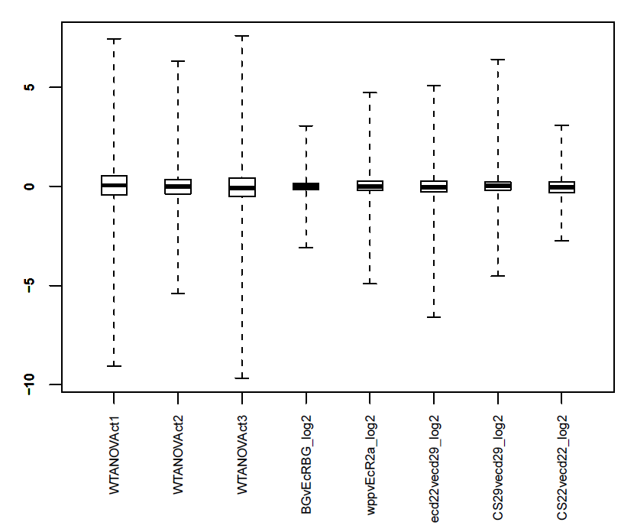
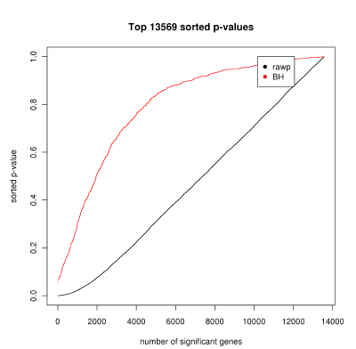
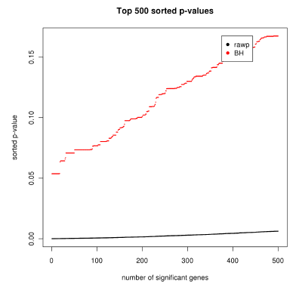
Notes:
Supplemental Figure 1. Intermediate output of the LIMMA stats analysis from bioconductor, as run through the CARMA interface. The top panel distplays the pre-normalized box-plots of gene expression, indicating the varying range of gene expression dynamics. The bottom two pannels are the sorted p-values for the mixed model ANOVA for all genes tested (left) and the top 500 genes (right).

Slide 2
Temperature specific gene response
Notes:
Supplemental Figure 2. Heat Response genes as defined from the CS-22C vs CS-29C comparison (hyb 2). 43 of the 13811 genes were defined to be regulated according to the selected cut off criteria

Slide 3
EcRnull BG vs WPP-ecd¹
Notes:
Supplemental Figure 3. Differentially regulated genes between the unliganded receptor vs hormone targets. 756 of the 13811 genes were defined to be regulated according to the selected cut off criteria

Slide 4
B.
EcRnull wpp vs wpp-ecd¹
Notes:
Supplemental Figure 3. EcRnull mutant at white pre-pupa (wpp) vs the ecd¹ mutant at wpp. 382 genes were defined to significantly different in this paired analysis. Red points indicate genes which are significantly different between these categories. This indicate genes that are either hormone or receptor dependent but yet require the hormone signal in some fashion.

Slide 5
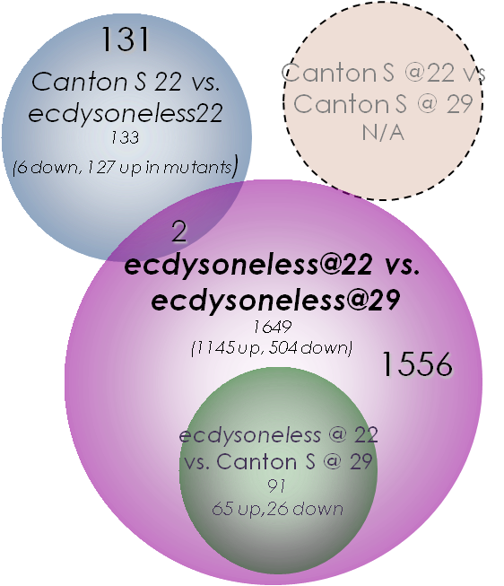
Notes:
Supplemental Figure 4. Target gene overlaps for ecdysoneless comparisons. Gene lists were defined at a p-value <0.05 and FDR 10% for this comparison.

Slide 6
BG-EcR- WPP-EcR-
BG-CS CG-CS WPP-CS
Notes:
Supplemental Figure 5. Line graph showing the temporal expression trend of a subset of genes in the EcR null mutants and wild-type animals. There is only a slight repression in expression between the BG and wpp+6 stage in the mutant animals. However, the wild-type expression indicates that these genes are normally highly activated across the onset of pupal development. Two genes show an expression pattern where they are activated 2+ fold between BG and wpp, but then are repressed 3+ fold within 6 hours of pupariation. These perhaps follow the trend of early genes as described in the Ashburner model.

Slide 7
ecd¹ WPP-EcR- BG-EcR-
D20
Kc
L1
S2
D20
Kc
L1
S2
D20
Kc
L1
S2
EcR + hormone
EcR - hormone
Notes:
Supplemental Figure 6. Dynamically bound target genes. Of the three mutant categories, each gene list has a significant number of genes which also overlap with EcR binding targets (within 1Kb of transcription start site). This graph shows the overlap from two types of EcR binding assays, blue represents the bound genes which are in the presence of ecdysone, red represents the bound genes in the absence of hormone. These assays were done in four different cell lines including two embryonic lines (Kc and S2) as well as two imaginal disc cell lines (D20 and L1). The log-10 hypergeometric pvalue for the overlaps of these respective gene lists is shown.

