Slide 1
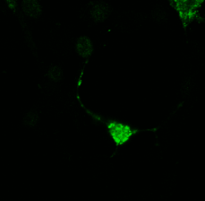
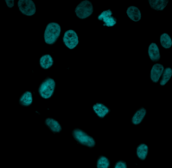
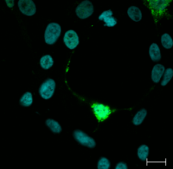
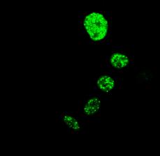
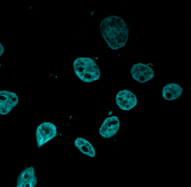
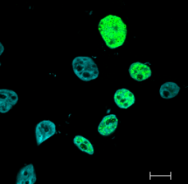
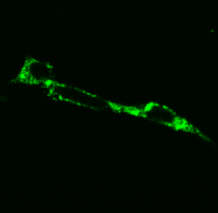
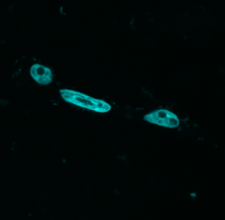
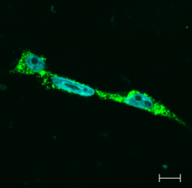
Supplementary Figure.2
HEK293T
c-Myc tag
nucleus
merge
rCTF-Q13
Myc
Hoechst 33258
merge
rCTF-Q13-NLS
Myc
Hoechst 33258
merge
rCTF-Q13-NES
Myc
Hoechst 33258
merge
Supplementary Figure 2. rCTF expression in HEK293T cells.
While rCTF-Q13 distributed both in the cytoplasm and nucleus of HEK293T cells, NLS and NES both efficiently shifted the rCTF localization in the nucleus and cytoplasm, respectively. (scale bars: 10μm)

