Slide 1
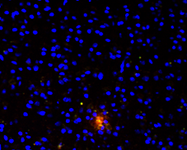
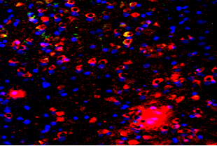
(A)
(B)
*
3xTgAD
*
*
*
3xTgAD
WT
WT
D1 D2 D3 D4 D5 D6
D1 D2 D3 D4 D5 D6
Hidden Platform Training (Day)
Hidden Platform Training (Day)
(C)
WT
3xTgAD
50 μm
Supplemental Fig. 1.

Slide 2
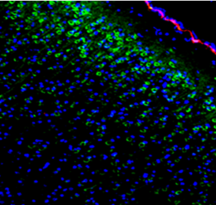
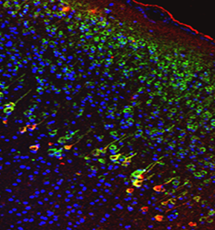
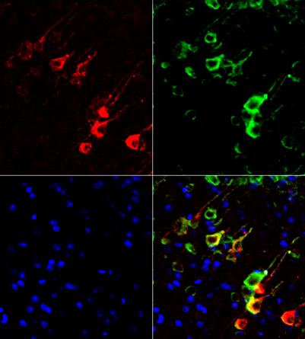
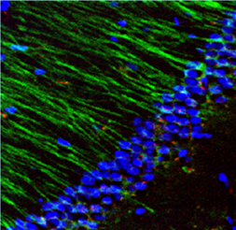
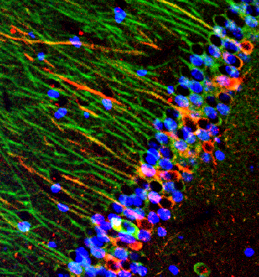


(A)
(B)
(C)
Aβ
LC3
WT
100 μm
3xTgAD
DAPI
20 μm
Merge
LC3 Aβ DAPI
(D)
(E)
F
WT 3xTgAD
Mouse
1 2 3 4 1 2 3 4
LC3-I
LC3-II
β-actin
*
LC3 /β-actin
*
P=0.06
WT
20 μm
3xTgAD
LC3 p-Tau DAPI
LC3-l LC3-ll LC3-ll/LC3-l
Supplemental Fig. 2.

Slide 3
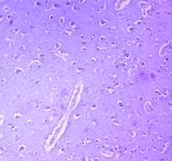
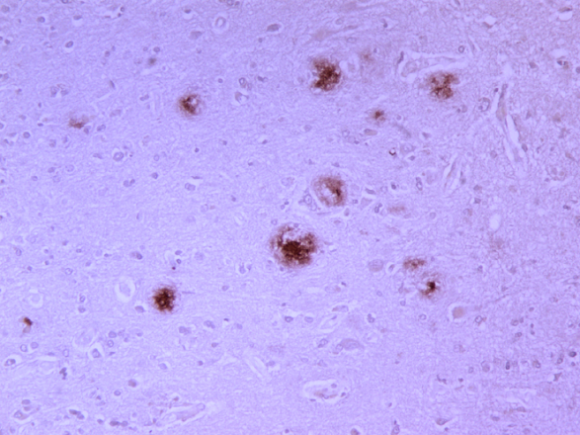
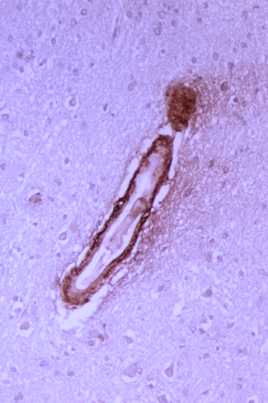
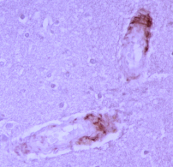
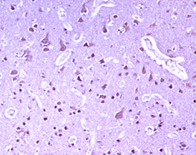
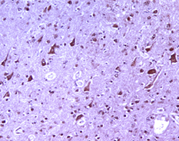
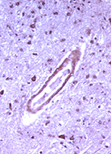
(A)
(B)
(C)
Cont_Aβ
AD_Aβ
(D)
(E)
AD_Aβ
(F)
Cont_LC3
100 µm
AD_LC3
AD_LC3
Supplemental Fig. 3

